Slide 1

GLOBAL ENTREPRENEUR PROGRAMME
6th British-Polish Tech Forum
12th November 2024
Notes:
My name is Tony Kypreos and I will say a few words about the Global Entrepreneur Programme and ideas to support you in future collaboration

Slide 2
Agenda
What is the Global Entrepreneur Programme and how does it work?
What does the GEP look for?
Alumni companies and case studies
Background and areas of focus
Q&A

Slide 3
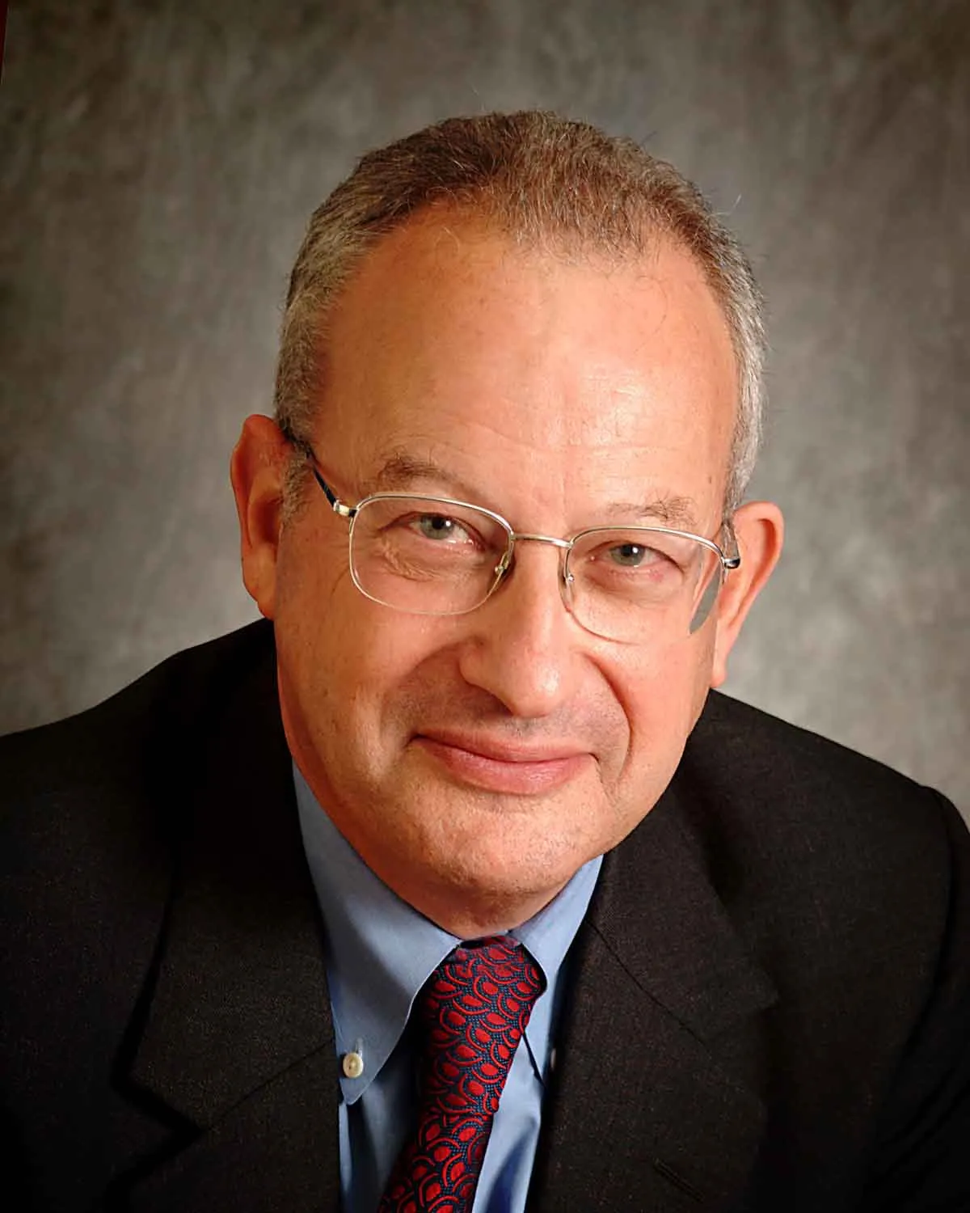
What is Global Entrepreneur Programme?
The Global Entrepreneur Programme is the Department for Business and Trade’s flagship initiative designed to support ambitious entrepreneurs and their innovative technology businesses in scaling and growing their strategic operations from the UK.
The programme offers strategic support and mentorship to assist founders in establishing their operations in the UK smoothly.
Once the business is established in the UK, founders become part of the GEP community and can access further support across the UK tech eco-system.
David Sainsbury, the UK's Minister of Science and Innovation from 1998 to 2006
Notes:
The GEP was created by David Sainsbury, the UK's Minister of Science and Innovation from 1998 to 2006
Responsible for the Office of Science and Technology, Innovation, Space, the Bioscience and Chemical Industries, and the Patent Office
In 2003 he thought of 3 things:
The UK should be able to attract the world’s best science and technology entrepreneurs to collaborate with the UK R&D ecosystem
These entrepreneurs need to connect with other entrepreneurs & investors – who have created, scaled and exited ventures and help support them on the journey (not civil servants)
He also realised that these Entrepreneurs in Residence (Dealmakers) would not do this full-time (as active with their own ventures) and would be retained for some days per month

Slide 4
How does Global Entrepreneur Programme work?
Global Entrepreneur Programme assists entrepreneurs who want to access the UK's world-class ecosystem to accelerate their growth.
GEP deploys a team of experienced entrepreneurs, known as dealmakers, who work part-time while remaining entrepreneurs themselves meaning that they can provide guidance around the UK’s tech ecosystem.
Dealmakers provide strategic support for establishing the business in the UK as well developing funding strategies, building partnerships and networks.
Once founders set up a business in the UK, they become part of our GEP Alumni Network and receive support from GEP team with navigating the UK ecosystem.
GEP can provide businesses with an Innovator Founder Visa endorsement.
Notes:
GEP works with international entrepreneurs helping them to explore their UK market and investment opportunities.
Once in the UK, the programme supports these businesses to scale-up and internationalise.
Since 2003 the GEP has:
Helped over 1200 businesses establish in the UK
Raised over £2.5 billion in VC and angel investment
£500 million raised in the last 18 months

Slide 5

What does GEP look for?
Our goal is to support founders and companies who want to leverage UK’s world class ecosystem to scale and expand into international markets.​
Focus on companies building technology solutions to solve global issues.​
Aim is to help companies scale and internationalise, leveraging the UK ecosystem
However, a client must fit GEP’s criteria to qualify for GEP support​
Notes:
We don’t persuade founders to come to the UK or leave their home country
If they are serious about expanding into the UK and beyond and satisfy certain criteria, we would love to talk to them
Next slide is the criteria

Slide 6





A GEP company must…
Have real innovative tech products/solutions and be well beyond proof of concept.
Be viable and scalable, have traction in their home market and ideally generating revenue.
    Have clear plans for building the company in the UK, including fast growth and creating high skilled jobs.
    Set up a UK Strategic presence or Global HQ.
    We help and encourage our alumni to trade globally.
    At least one founder must work in the UK or create a senior strategic role in the UK.
Notes:
The dealmaker will identify and speak with the founders for due diligence and their objectives
Then is there is a fit on both sides we would sponsor the venture for assessment by the HQ team – application process
No cost no equity
What does the UK look for? Mainly creation of high value skilled jobs and innovations that are complimentary to the R&D and commercial ecosystem

Slide 7
































GEP Alumni Companies
Notes:
Many notable successes
Jobandtalent – Madrid Spain - created over 3,000 jobs (800+ in UK) met the founders Felipe Navío, Juan Urdiales in 2011 <10 employees seeking £1M – workforce management system - in 2016 Jobandtalent turned to a transactional business model in which it became a Temporary Employment Agency – revenue €5M to €137M in 2018
2016 Series B Atomico €38M
2021 $500M in a Series E round that drew participation from Atomico, DN Capital, SoftBank Group, Kinnevik, and Kibo Ventures – valued $2.35BN
Many companies have been acquired e.g. Nutmeg acquired $1BN JPMorgan 2021 (Stanford MBA graduate met in 2012)
LifeBit 2021 Series B $60BN – got into techstars London

Slide 8





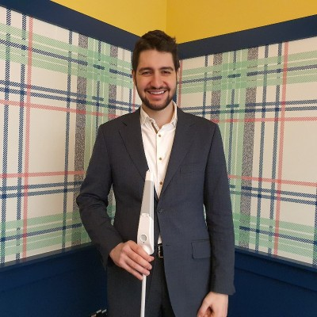



Revolutionising the white cane
Enhancing the mobility of visually impaired people through a revolutionary smart cane and smartphone app.
Raised £2m
£400k R&D grant
Imperial College London

Slide 9


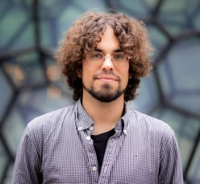

Revolutionising biomedical data
Lifebit is a precision medicine software company that builds enterprise data platforms for use by organisations with sensitive genomic and biomedical datasets.
Raised $70.50M funding (3 funding rounds)
Notes:
Maria Chatsou Dunford &

Slide 10
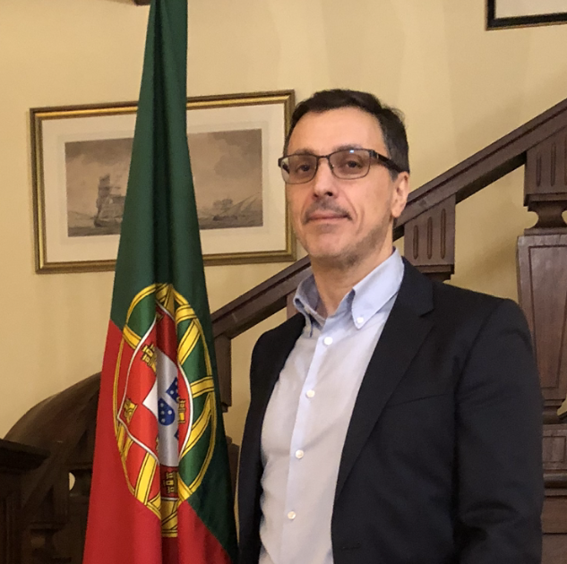
Background and collaboration ideas
Academia
Corporate innovation
Entrepreneur / co-founder
Investor (angel, CVC, VC)
http://linkedin.com/in/tkypreos
Notes:
A corporate leader in innovation – the customer
A venture capitalist investor - the investor
An entrepreneur – the founder (most important to be founder centric – understand their challenges and risks)
Academic partnerships – R&D collaboration and spin-out

Slide 11
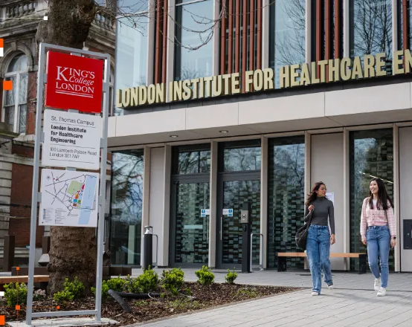

Focus: MedTech – Entrepreneur in Residence
King’s College London School of Biomedical Engineering & Imaging Sciences (BMEIS)
The London Institute for Healthcare Engineering (LIHE)
Collaboration with EU R&D centres
UK market access (NHS), regulatory, health economics, IP, industry collaboration, R&D grants & investment
Notes:
Entrepreneur in residence at King’s College London
Helped design the Medtech Accelerator and Venture Builder
Expanding collaboration into Europe – could be great potential here

Slide 12
Witamy w GEP
https://www.great.gov.uk/campaign-site/gep/
global.entrepreneurs@businessandtrade.gov.uk

