Slide 1
6th British–Polish Tech Forum
Understanding the UK Market for Health Technologies
Neil Roberts, Managing Director, SEHTA

Slide 2

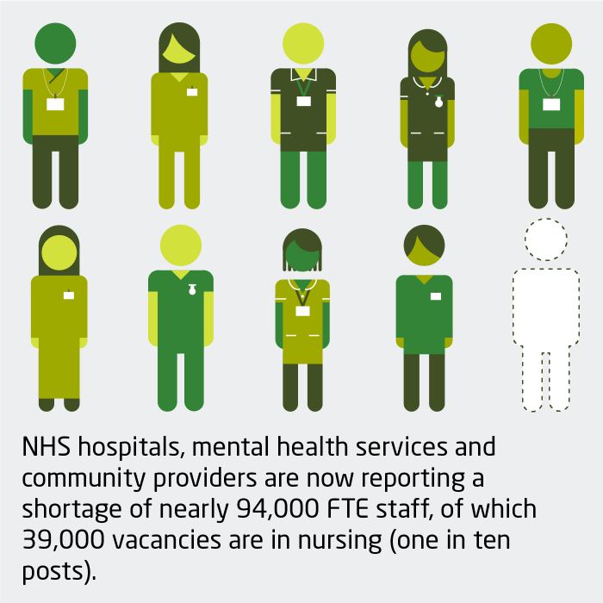


Shaping the Landscape - UK

Slide 3
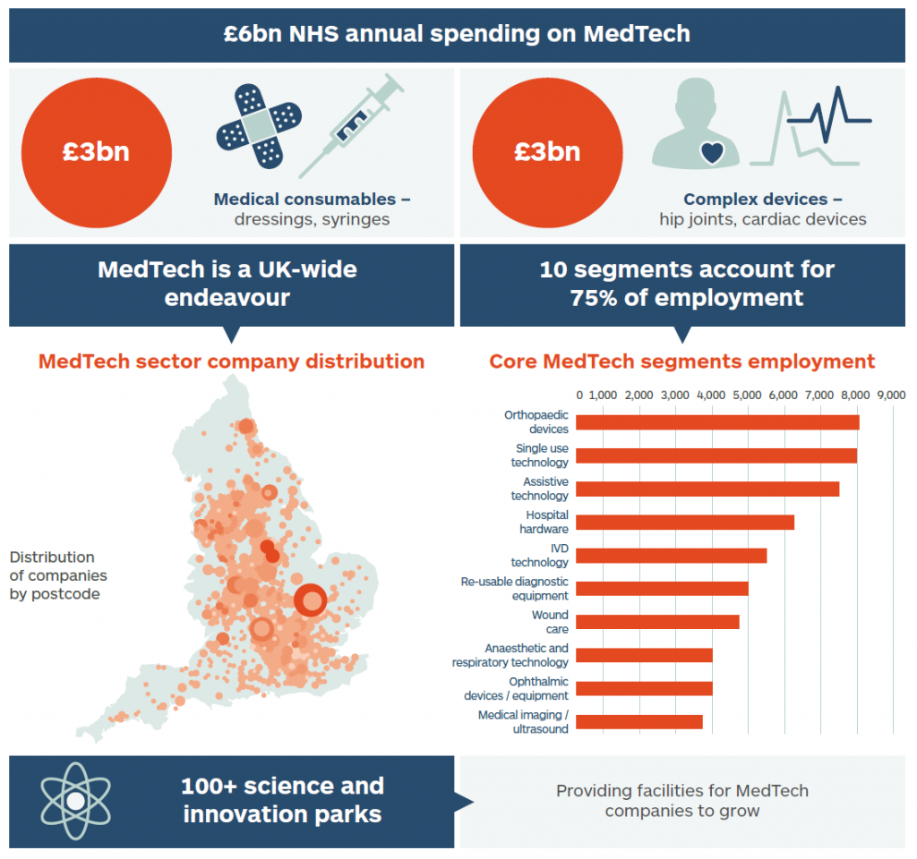
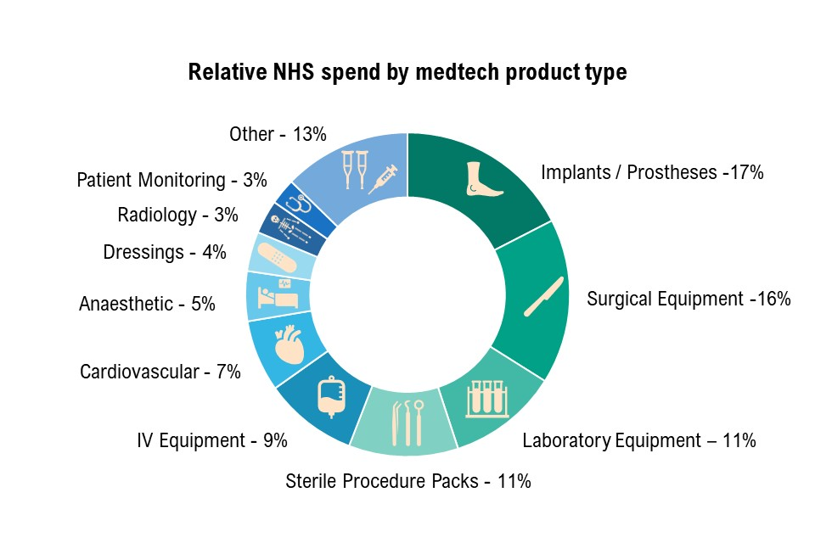
The Landscape for MedTech

Slide 4

Going to Market
The Challenges and Opportunities
Pressure on healthcare expenditure
Navigating and figuring in the ‘ecosystem’
Changing behaviour
Profitable Sales Models
Adoption rates are of new tech is Low
  Legacy
  Procurement processes
  ‘Unknown’

Slide 5
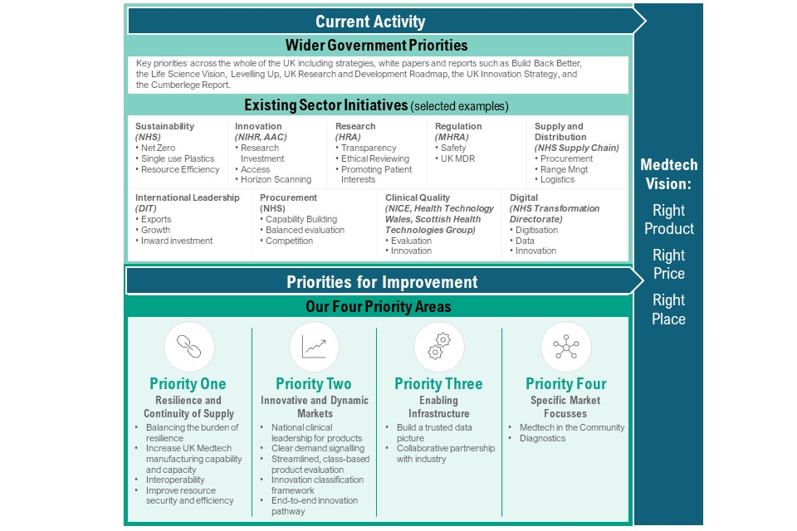
UK Health Technology - Strategy

Slide 6
UK Market Access – The Key Steps
Market Understanding
Value Proposition
Gap Analysis
Pricing and Business Models
UK Evaluation of Technology - compliance to standards and regulatory
NHS Procurement Routes
Partners and Collaborations
Relationship Mapping

Slide 7




NHS Procurement Routes
NHS Supply Chain – Framework agreements
CCS Spark DPS
CCS G-Cloud Framework
NHS LPP CDS Framework

Slide 8
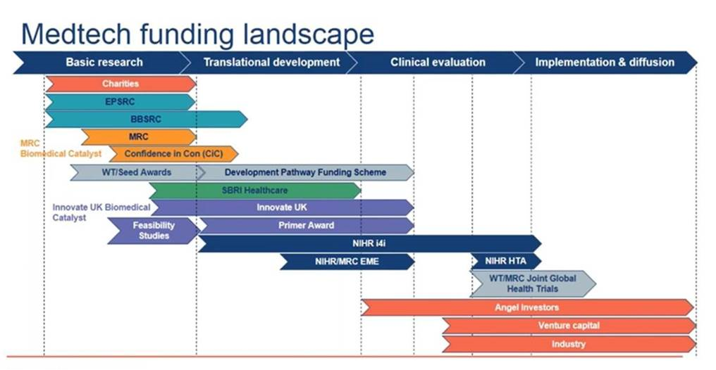
UK Medtech grant funding landscape

Slide 9

SEHTA – WHO WE ARE
Established in 2005 to foster relationships between Universities, Clinicians, and SME’s
Not for profit membership support network – over 1400 members
Provide 1 to Many and 1 to 1 support
Market Access - navigation
Innovate - RTO
Mentoring
Grant-writing + project participation Events - Information and Networking

