Slide 1

MedCity and London’s Life Sciences Ecosystem
Omer Safdar MSc
Life Sciences Investment Manager
MedCity part of London&Partners

Slide 2
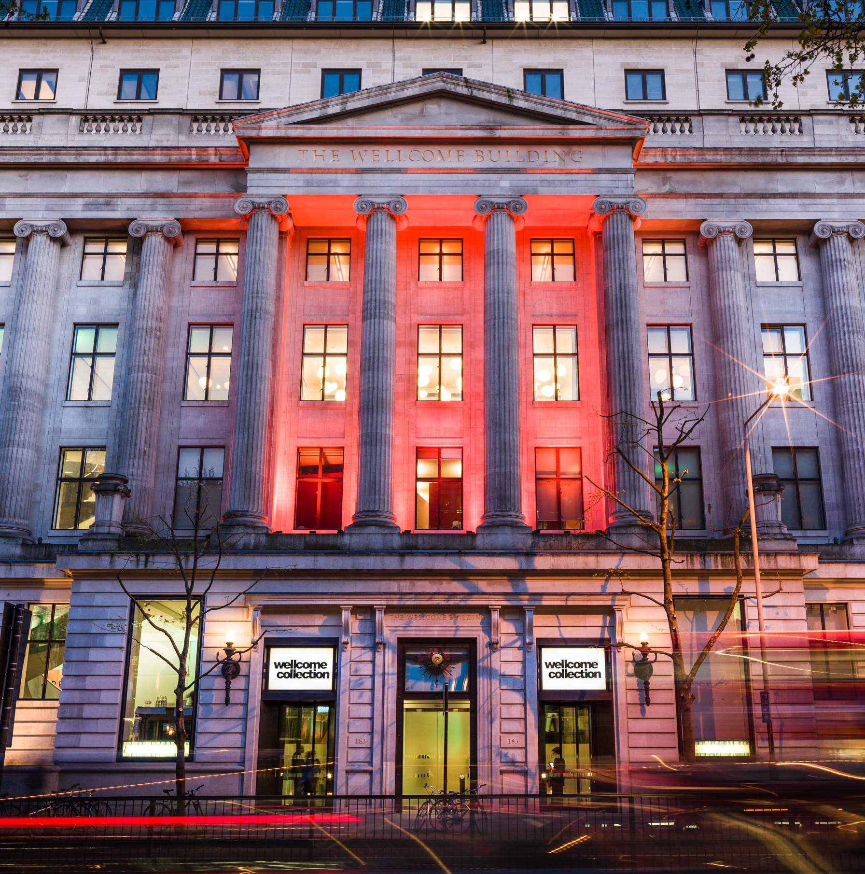
Overview
About MedCity
Why choose London
How we can help

Slide 3

MedCity
Founded in 2014 by the Mayor of London and three Academic Health Science Centres (now Health Innovation Networks).
The Cluster Organization for the World-Leading Health and Life Science Sector in London.
Merged with London & Partners in April 2023

Slide 4
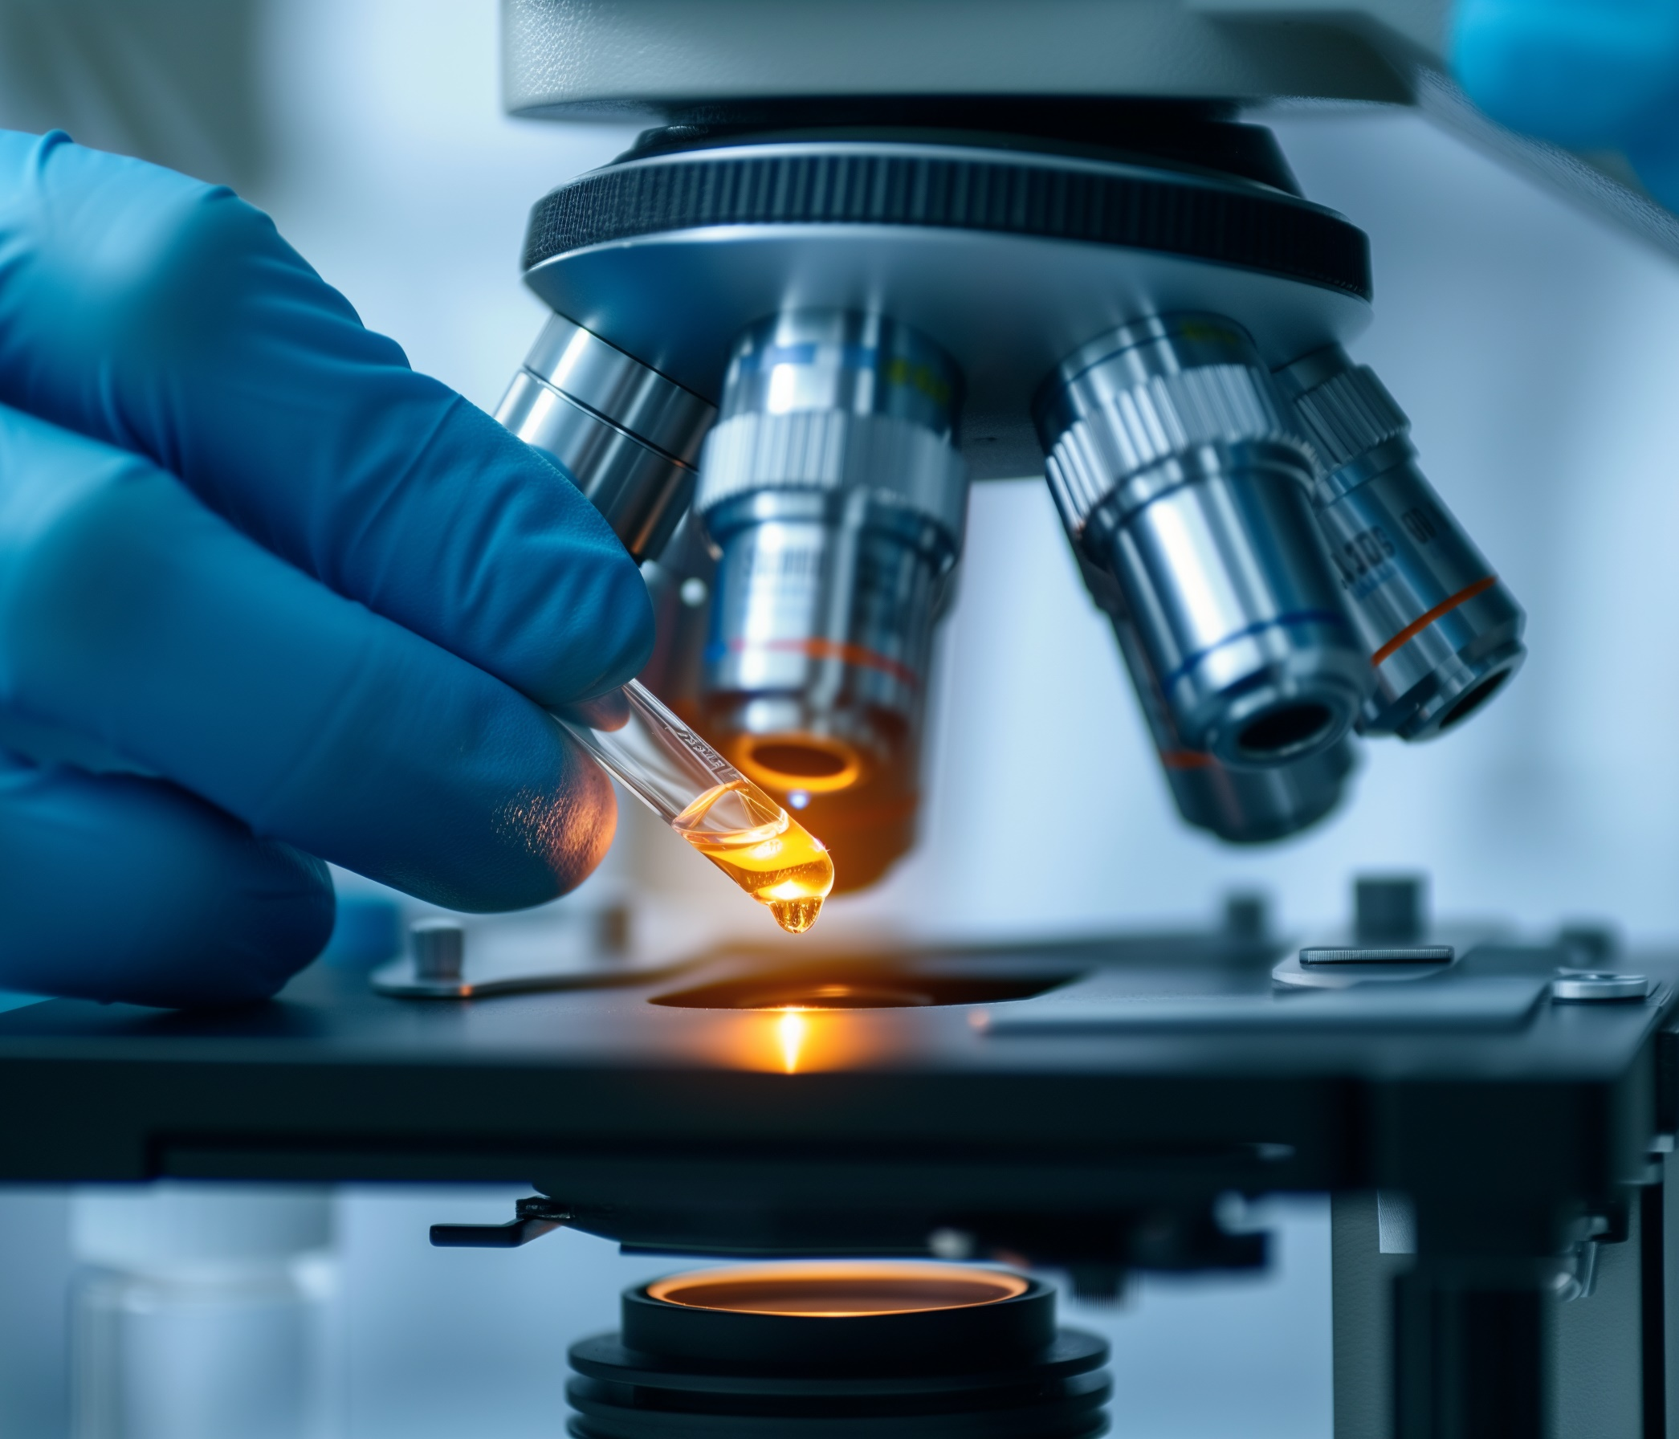

What do we do?
Working in close partnership with London’s world-leading universities, MedCity connects private industry with partners in the NHS, charity sector and research institutes.

Slide 5



OUR ECOSYSTEM – London life sciences
HEALTHCARE SYSTEM 9 million patients living in London. 140 Specialist Services 5 Integrated Care Systems (ICSs) 39 Acute trusts (secondary, tertiary and quaternary care) | RESEARCH & ACADEMIA 3 AHSCs (Kings’ Health Partners, Imperial College Academic Health Science Centre, UCLPartners) 3 HINs (Health Innovation Network, Imperial College Health Partners, UCLPartners) 3 Clinical Research Networks 3 ARCs (Applied Research Collaboration) 7 Biomedical Research Centres 1 London Diagnostic Evidence Cooperative (based at Imperial) 2 Health Technology Cooperatives (Cardio-vascular disease – G&STT and Enteric Health- Barts) Health Informatics Cooperative (Oxford-Cambridge-London) | BIOINFORMATICS 100k genomes (headquartered at QMUL) 3 Genomics Medicine Centres
 |  | CLINICAL TRIALS Between 2020-2023: 45% of UK clinical studies had a site in London More than 64% of which were in part industry-funded 30% of UK clinical trial participants were from London between 2020-2022
INDUSTRY
5,300 life sciences companies operate in the UK, nearly 50% in London region
GOVERNMENT & PUBLIC SECTOR
Regulators (MHRA, HRA, NICE) Funding agencies (NIHR, MRC, Innovate UK)
Government departments (DHSC, DBT) Research charities

Slide 6
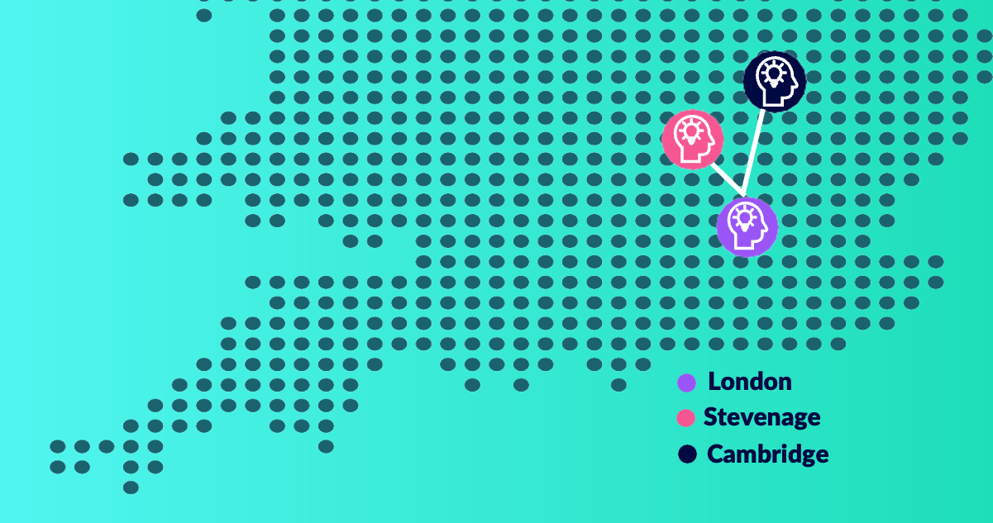


London’s Innovation Districts
Olympic Park
Whitechapel
Knowledge Quarter
Paddington Life Sciences
Canary Wharf Life Sciences
White City Innovation District
SC1
Innovation Gateway, Sutton

Slide 7
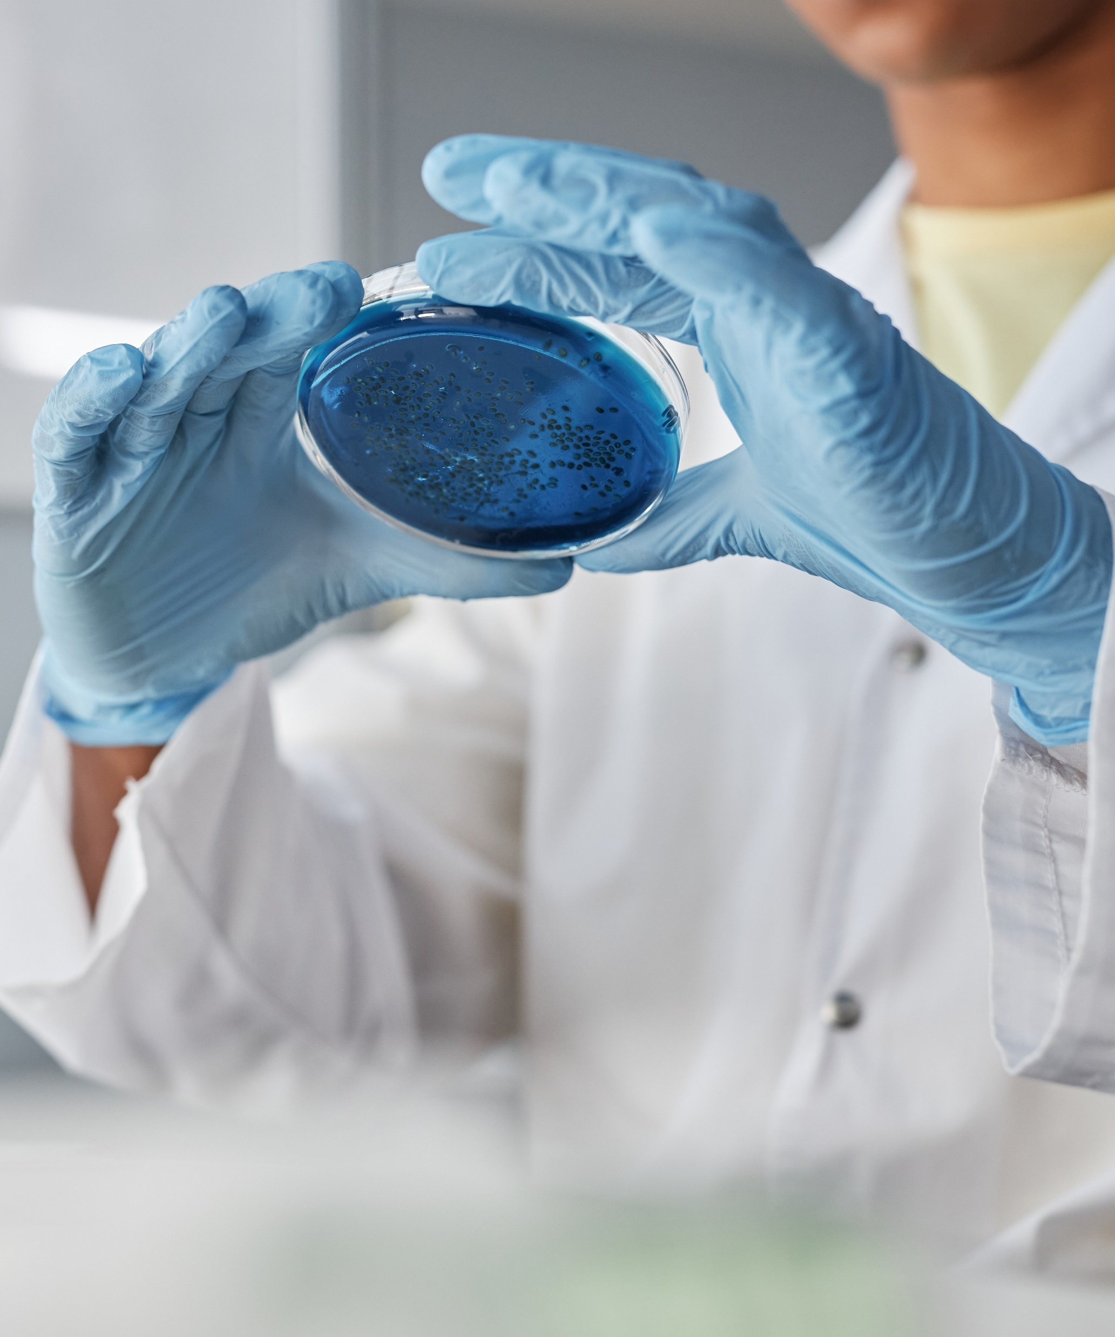
Seven thriving, independent, yet connected, urban life science clusters across the city
White City (Imperial College, Novartis)
Paddington/ Albertopolis (Imperial College, IQVIA, Takeda)
London Cancer Hub (Royal Marsden Hospital, Institute of Cancer Research)
Knowledge Quarter (Francis Crick Institute, UCL, MSD, Google)
SC1 (Kings College, Guy’s Hospital)
WhiteChapel / Canary Wharf (Queen Mary University, Barts Hospital)
Olympic Park (UCL, Cancer Research UK)
All within 25 minutes of central London via the Elizabeth Line or Jubilee line

Slide 8
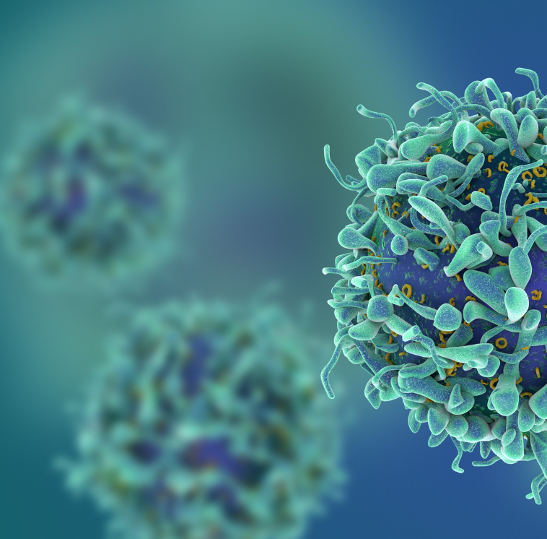
Why London for Life Sciences?

Slide 9






World Leading Research & Exceptional Healthcare System

Slide 10
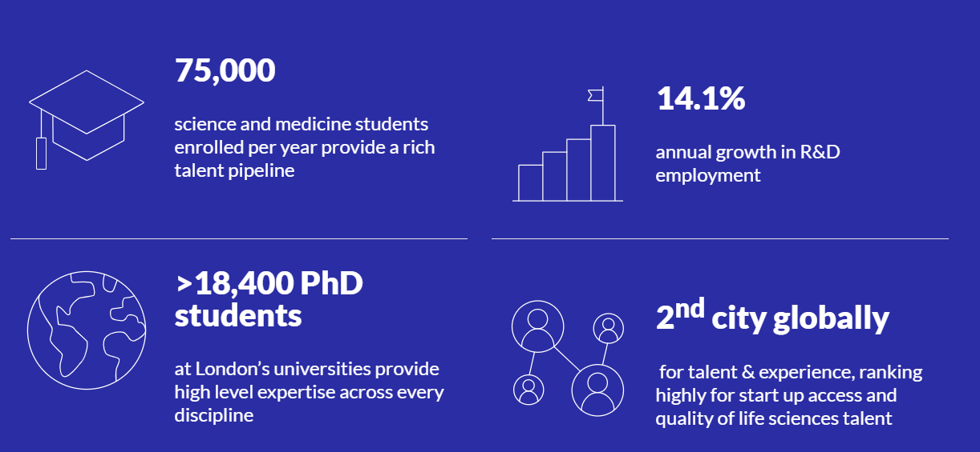
The largest Life Science talent pool in Europe

Slide 11
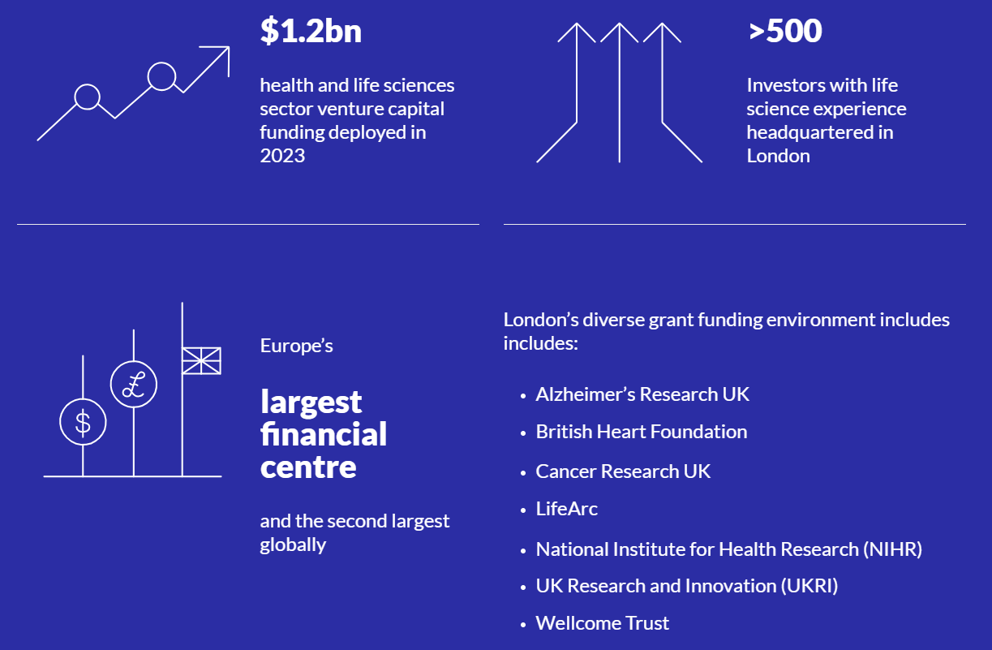

Investment in Life Sciences
80% of UK VCs are in London, more than any city in Europe

Slide 12
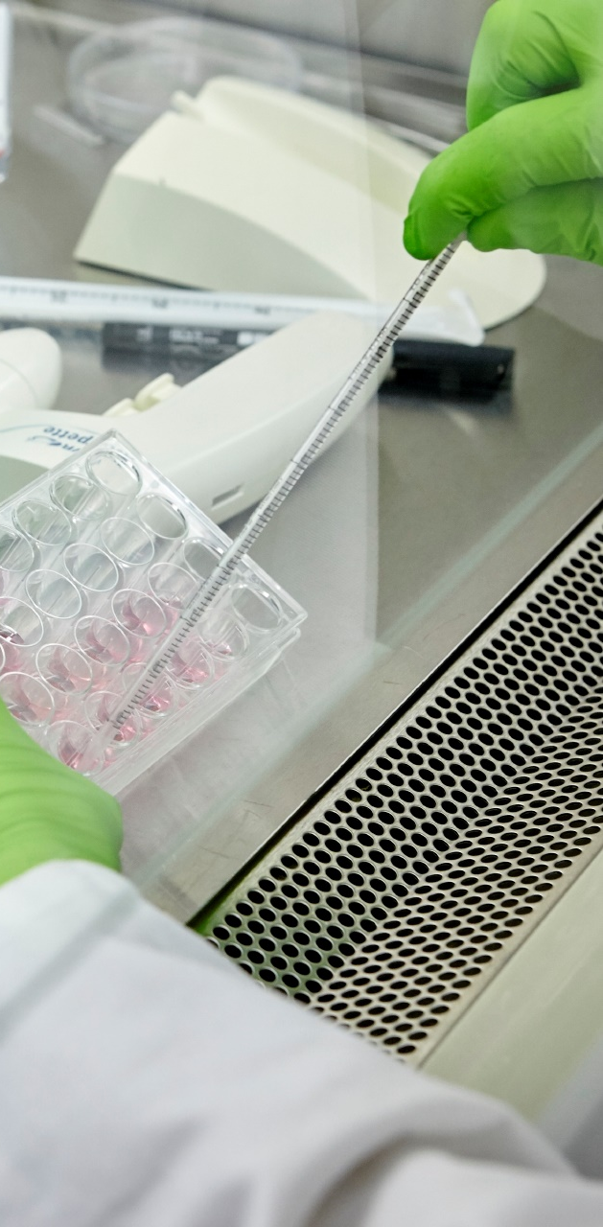
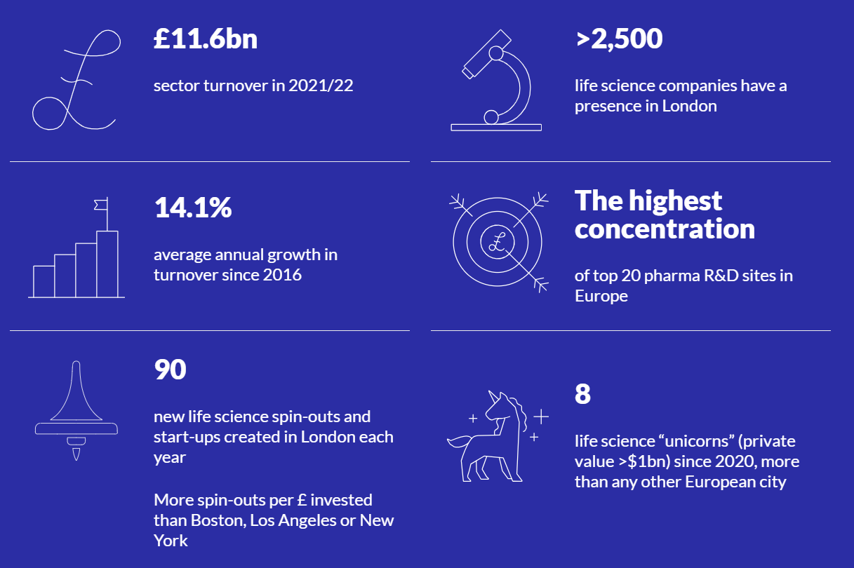
Thriving Commercial Ecosystem

Slide 13
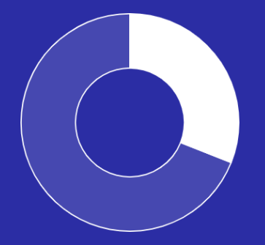
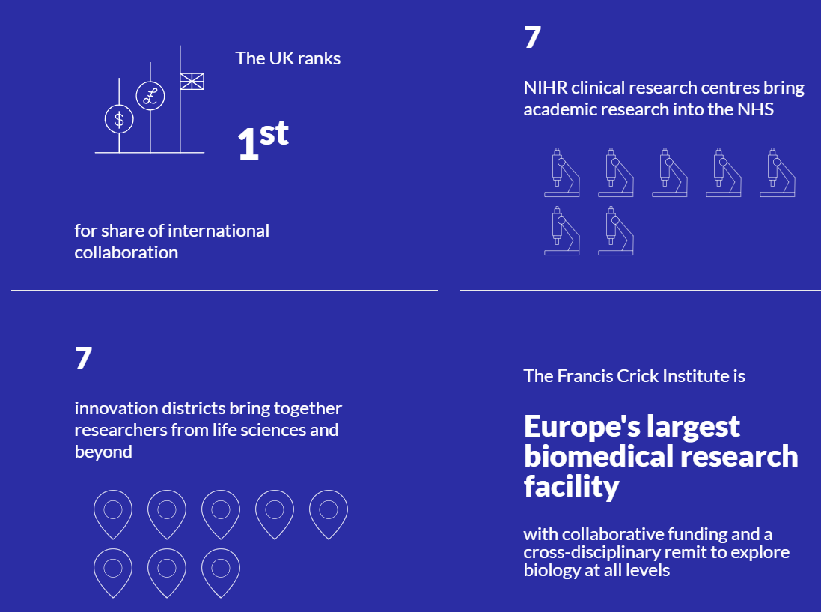
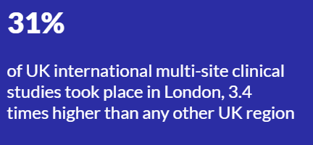
Collaboration Opportunities

Slide 14

How we can help

Slide 15
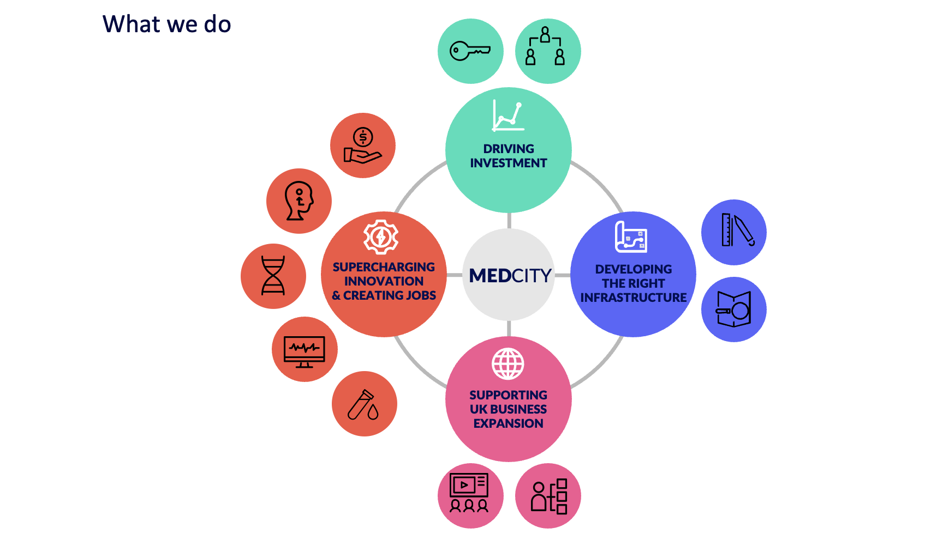

Slide 16



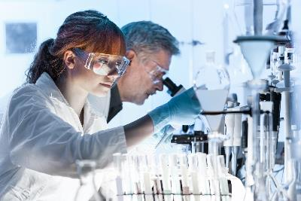
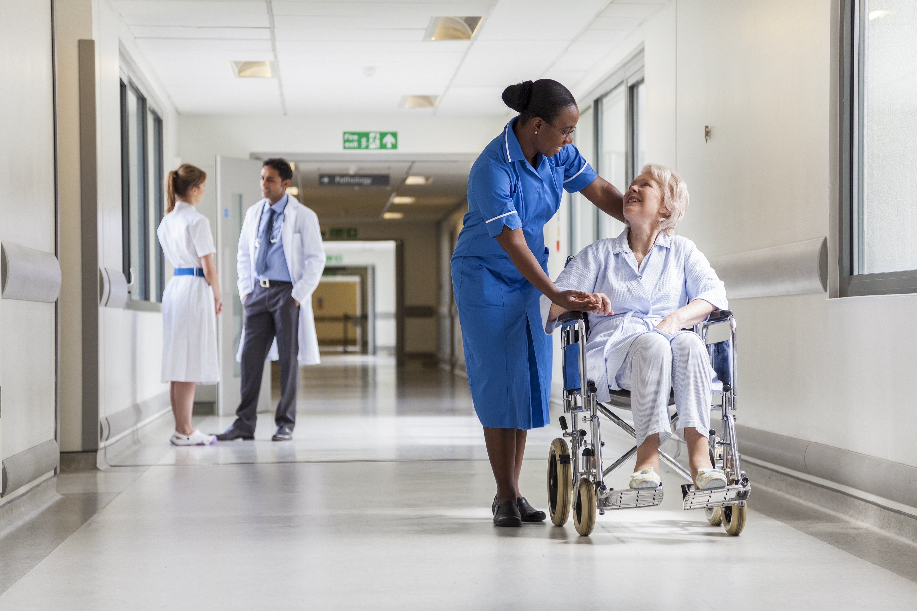

Guidance on how to set up in London
Setting up a UK entity and navigating the legal environment
Banking, accounting, tax, VAT and payroll
Recruiting your team
Finding and setting up your office or lab
Sector specific insights, contacts and events
Long term support and advice for your continued growth

Slide 17


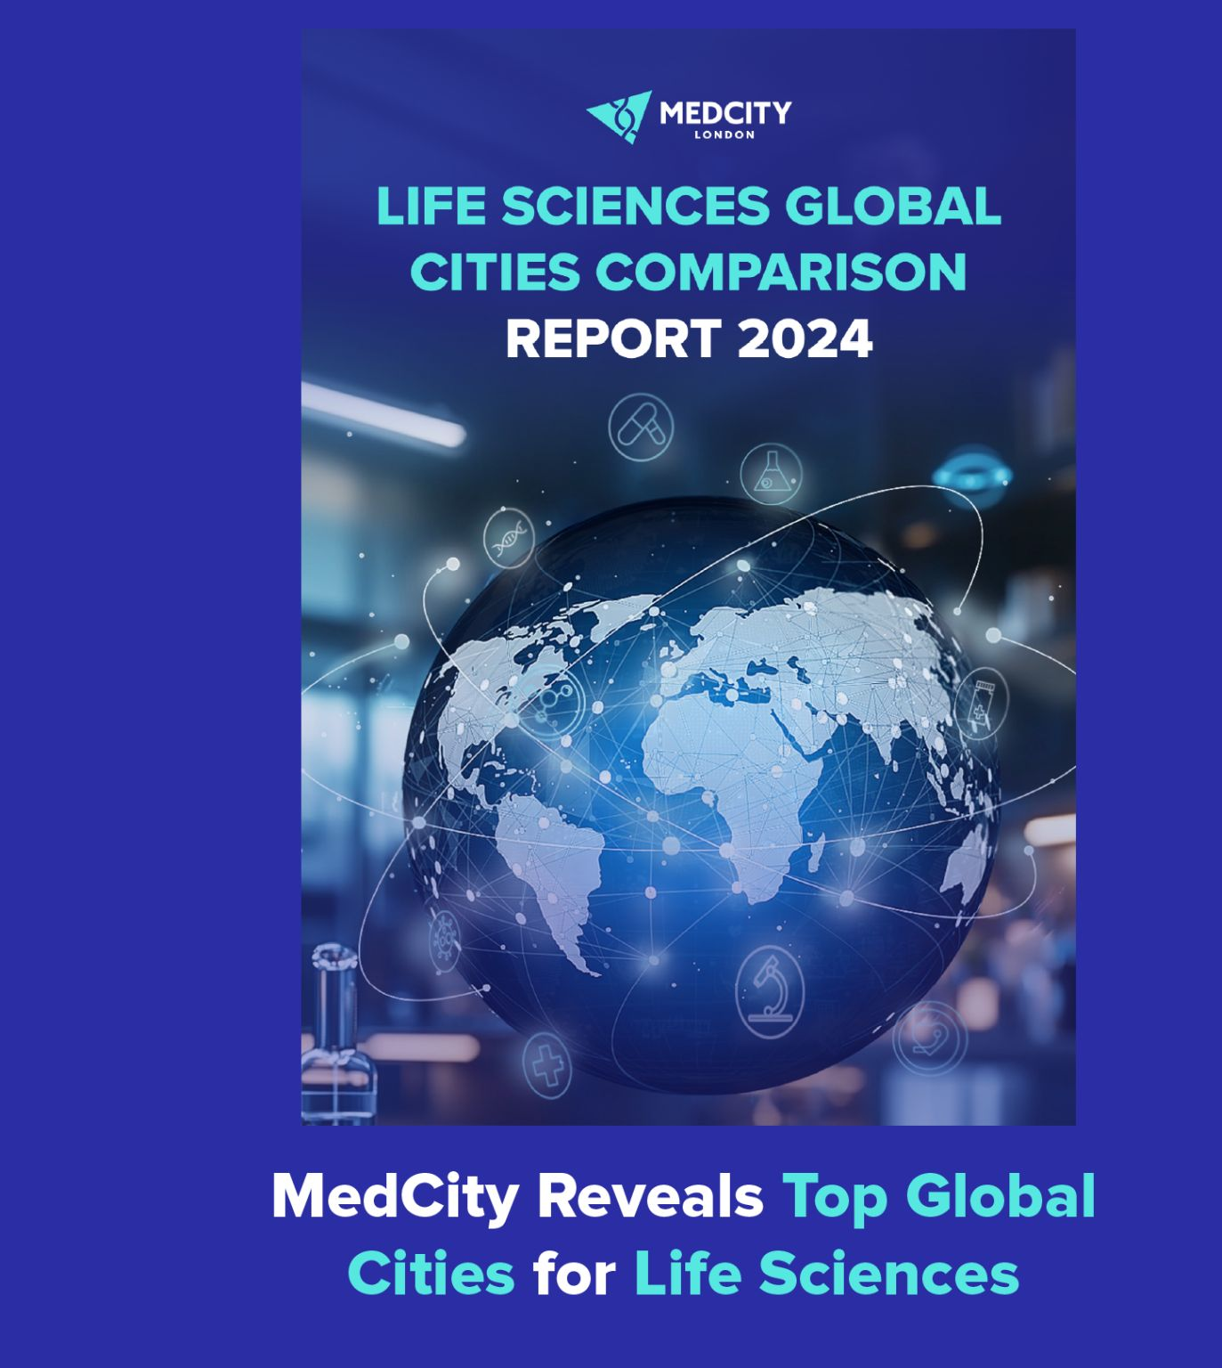
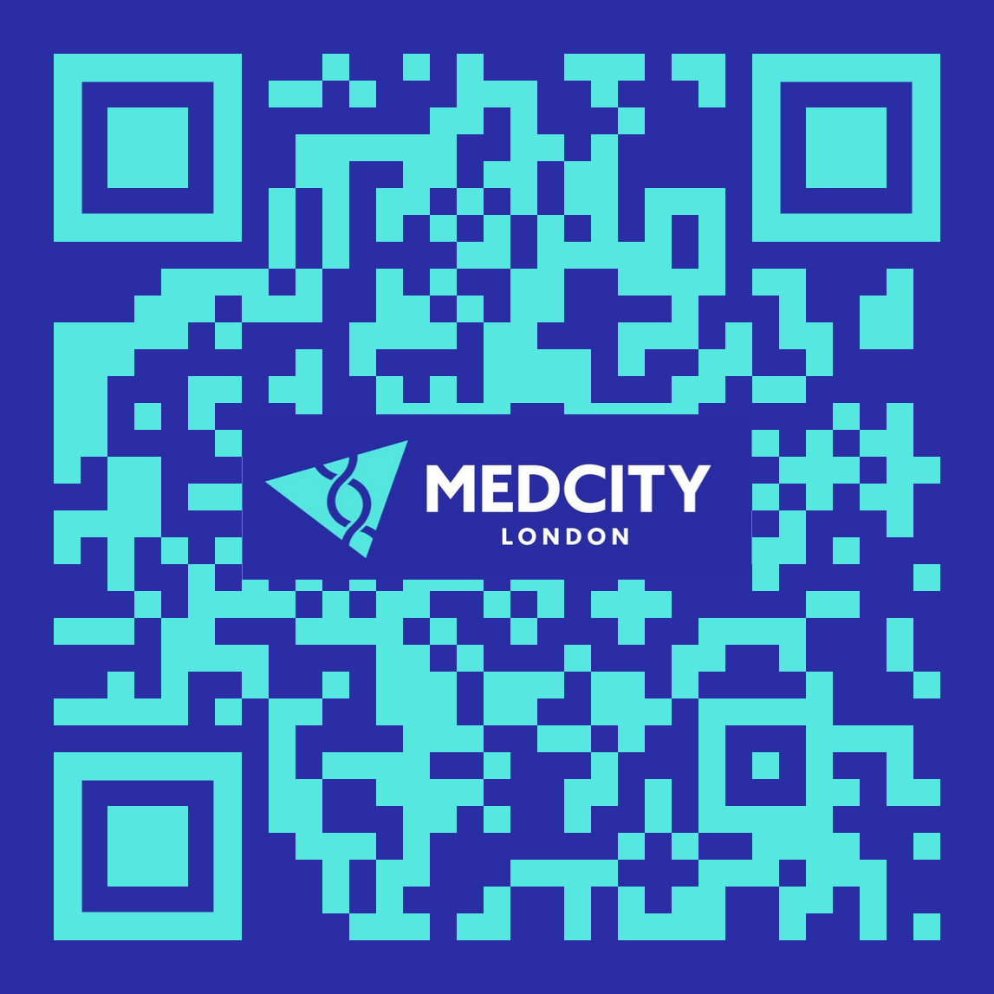
Explore the full London Life Sciences Offer

Slide 18
Contact us
osafdar@londonandpartners.com

