Slide 1
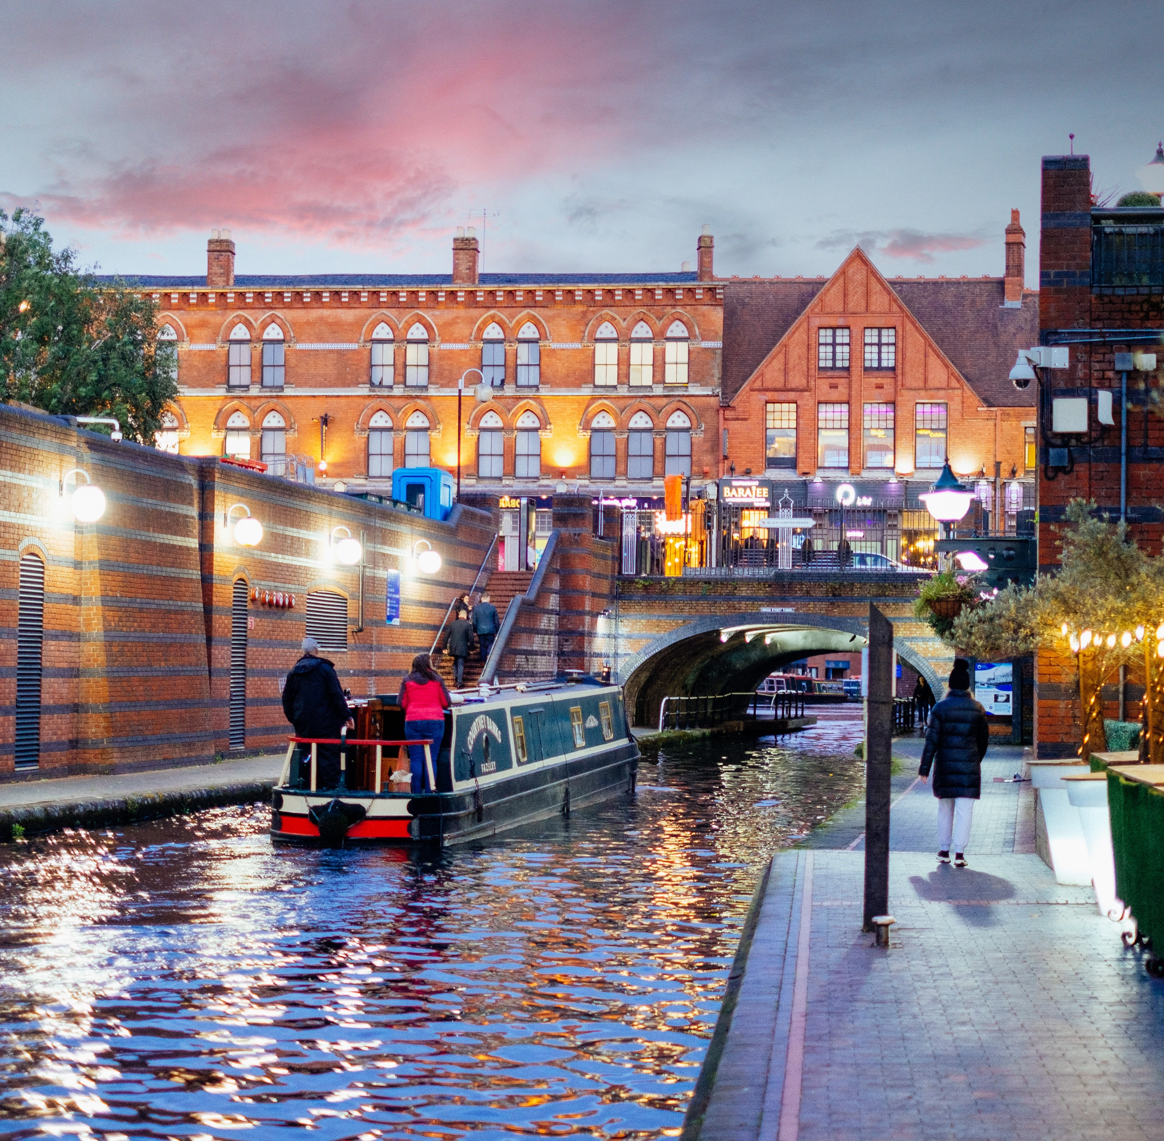
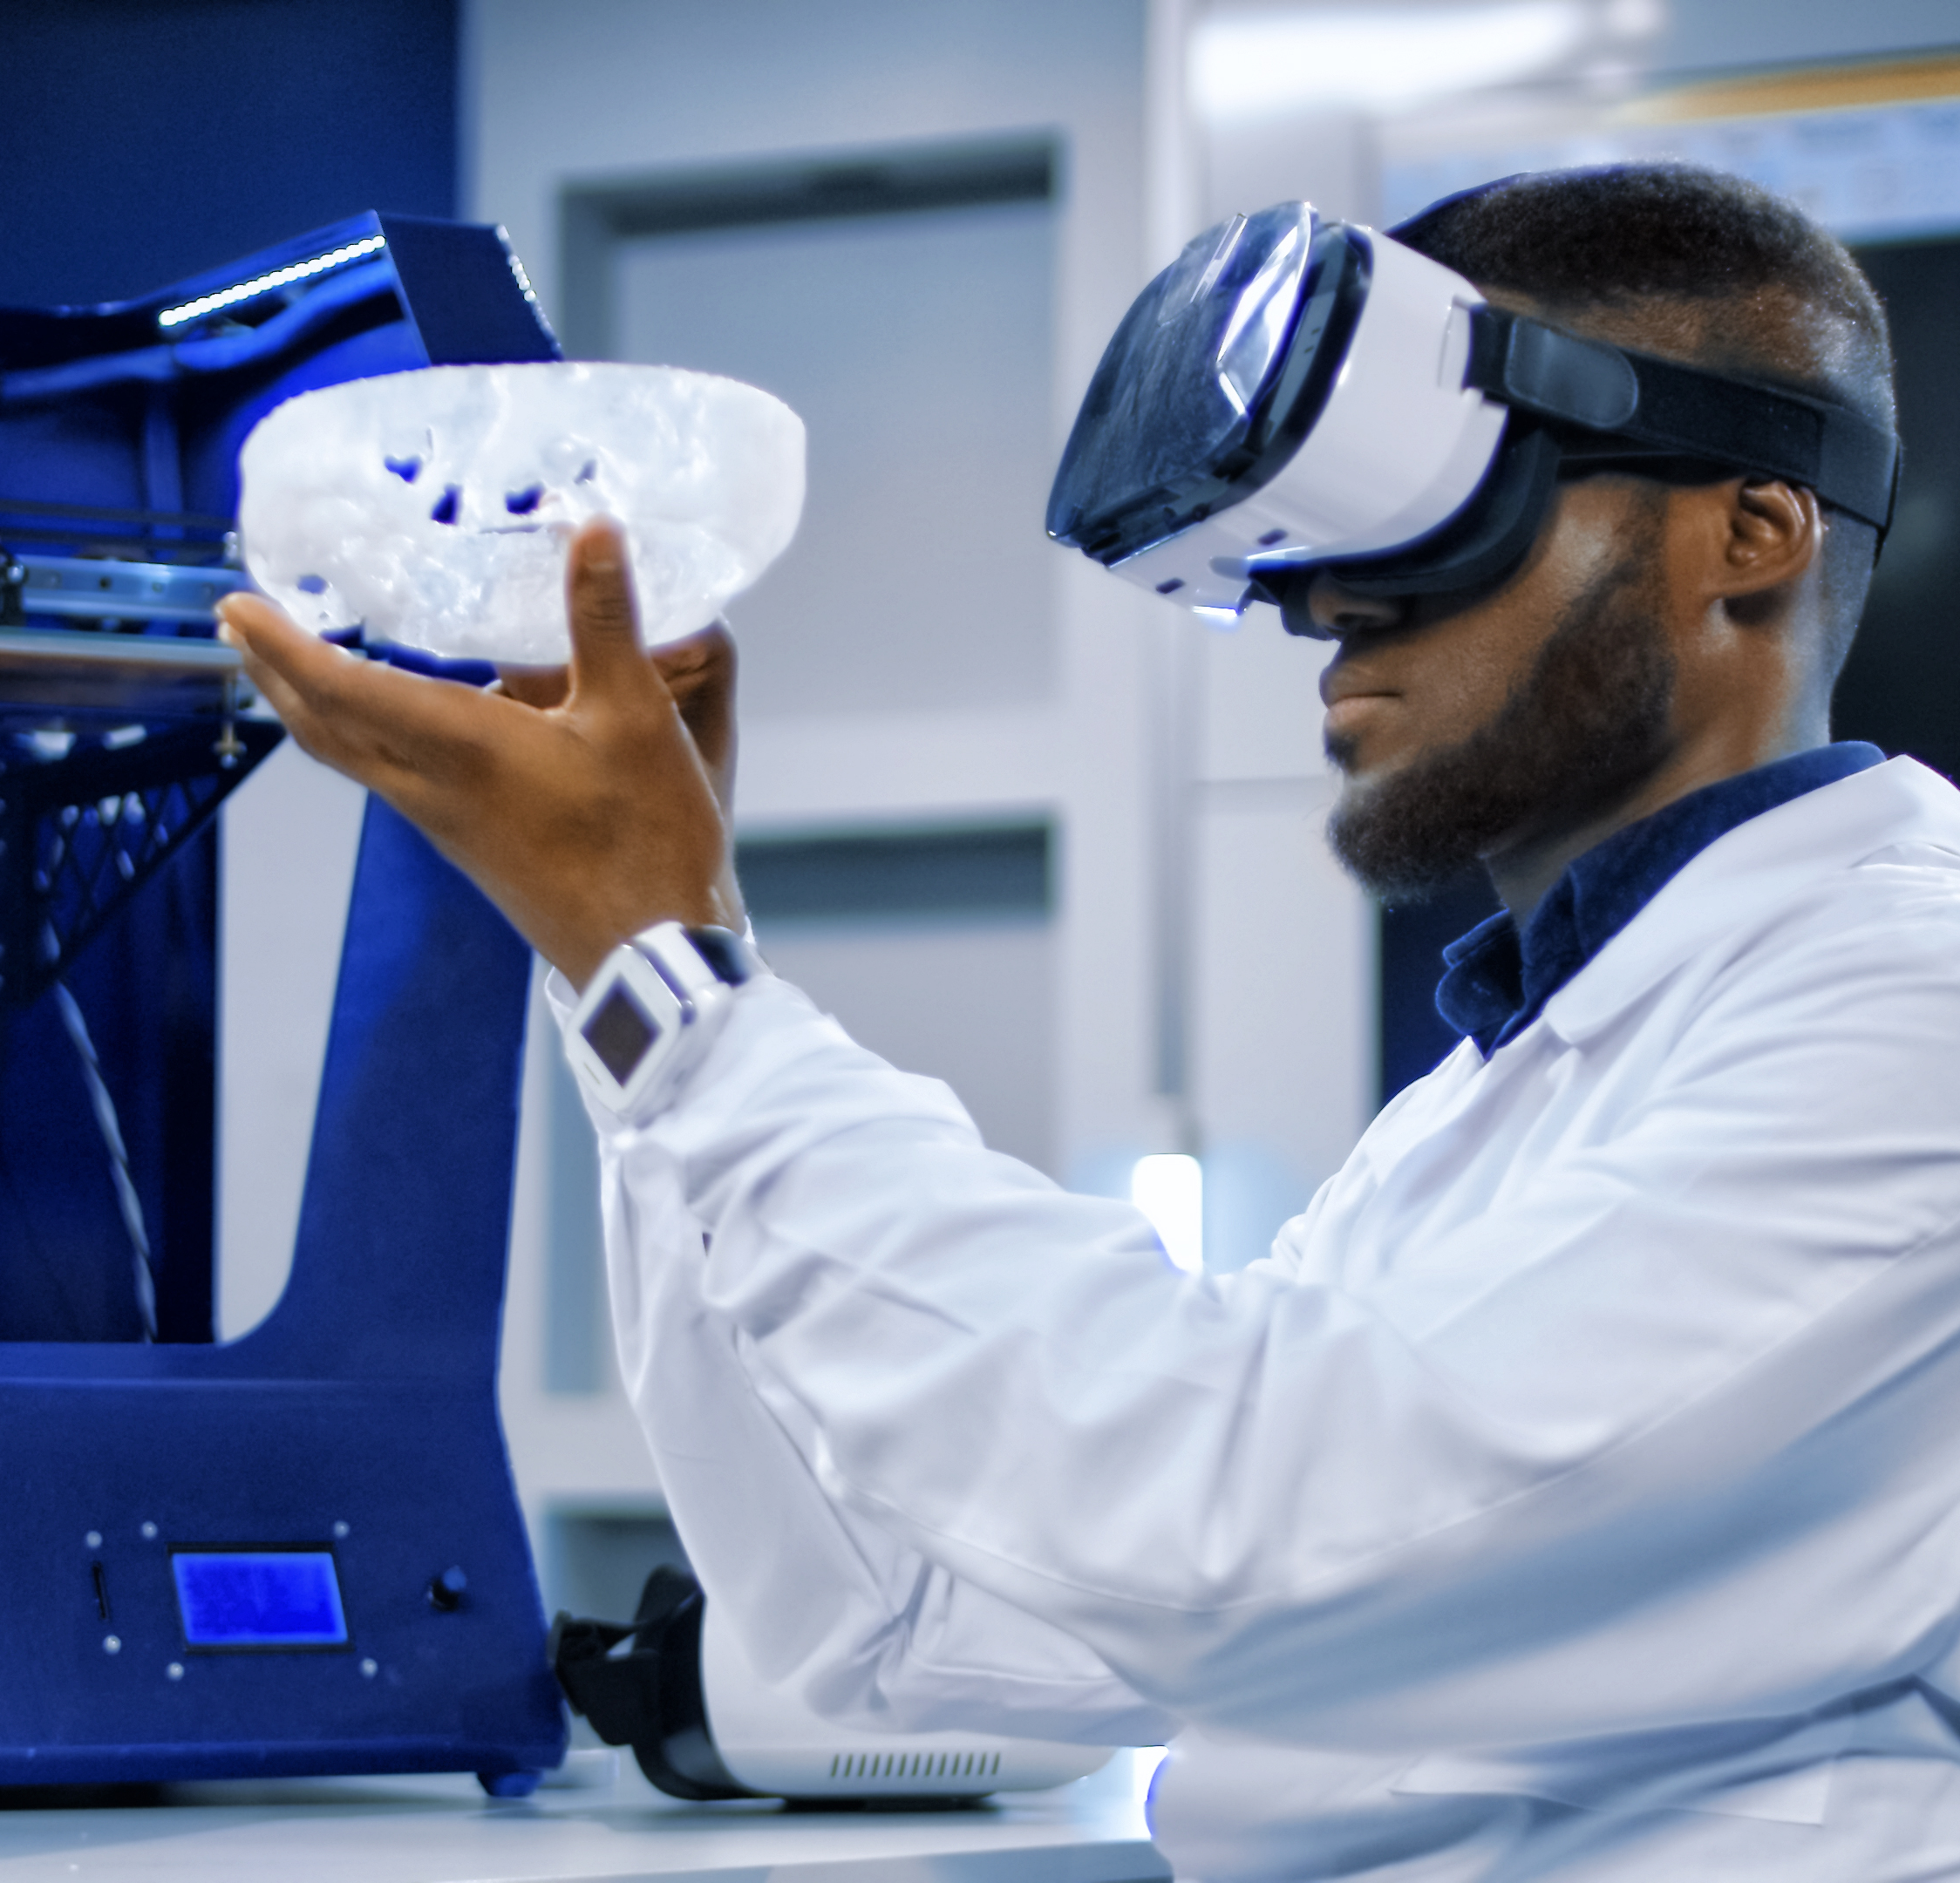

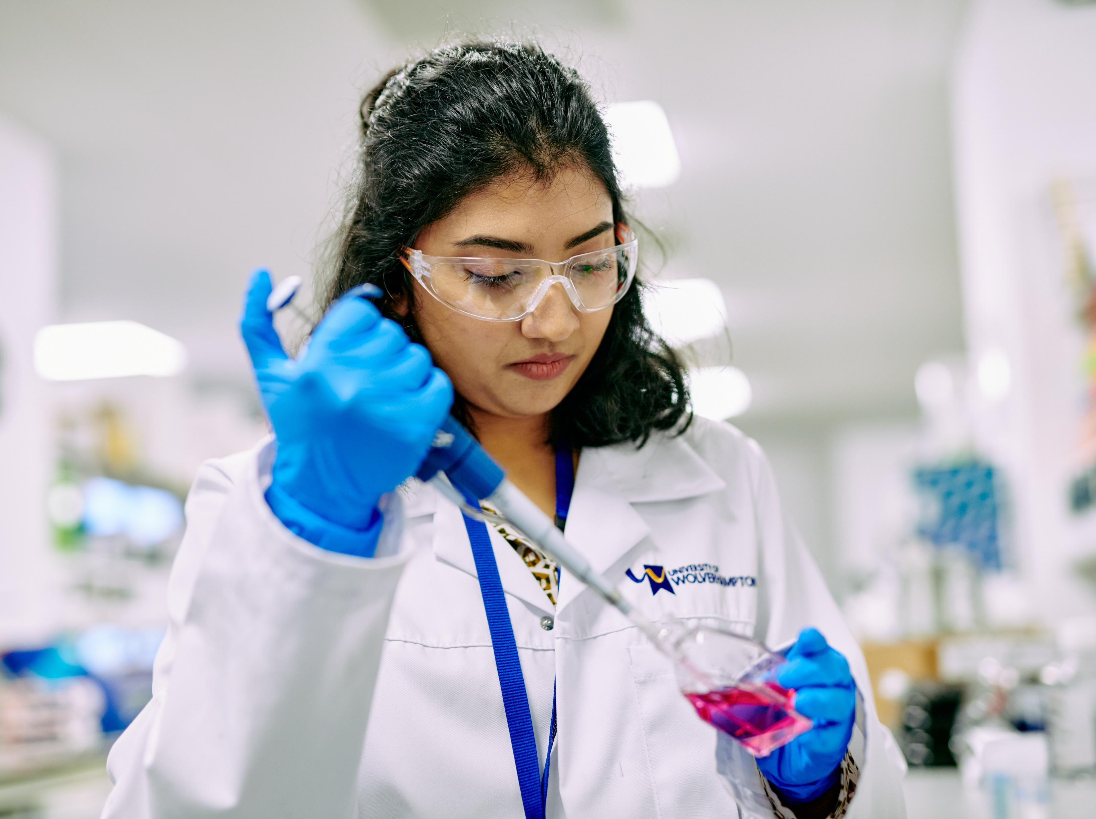
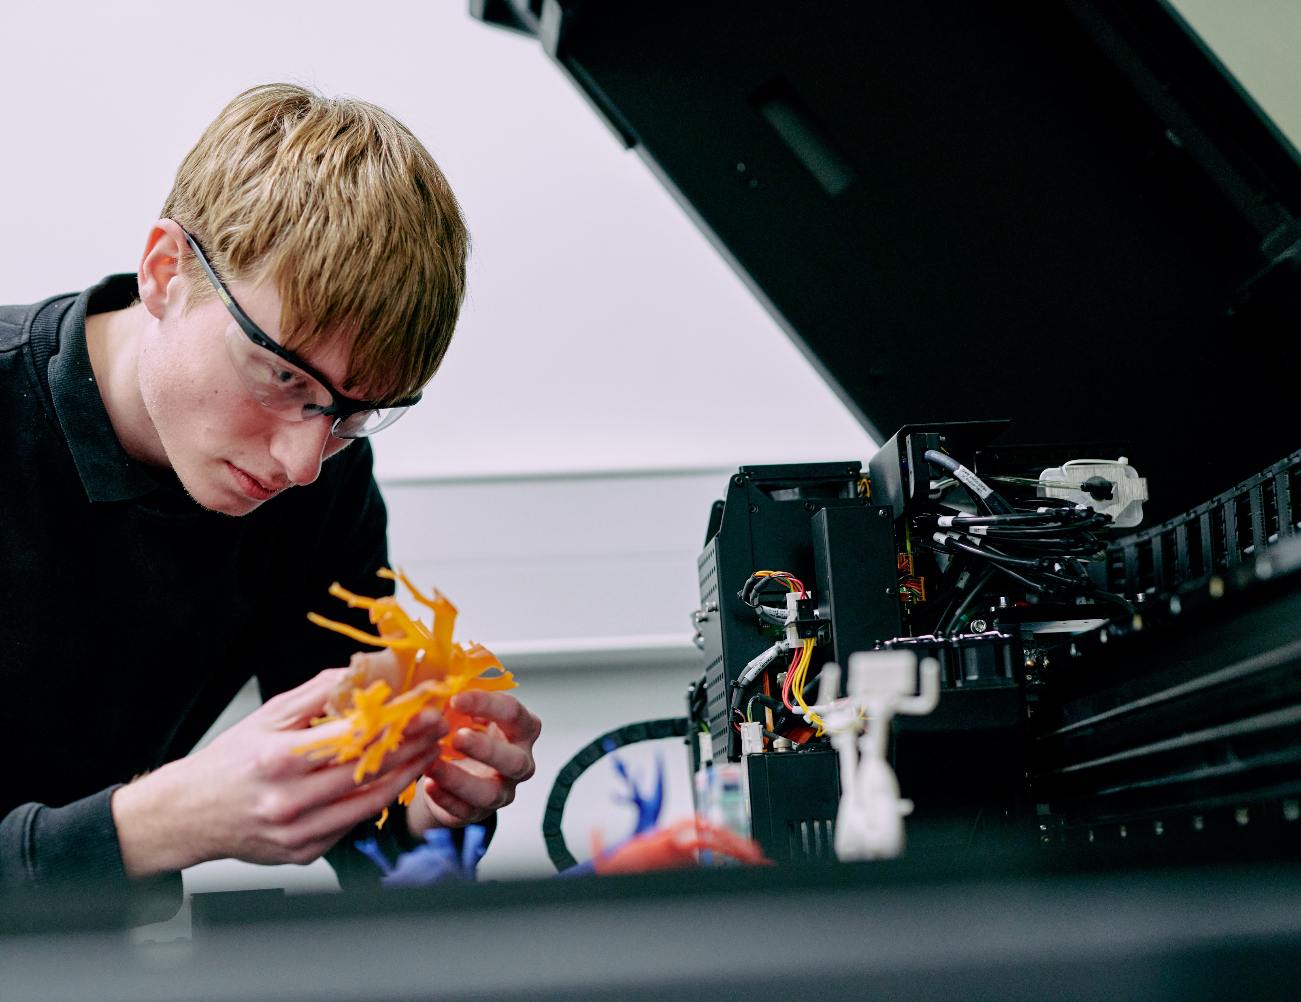
UNLOCKING INVESTMENT POTENTIAL IN THE UK: HOW POLISH TECH COMPANIES CAN SCALE TO THE UK
THE 6TH BRITISH-POLISH TECH FORUM
TUESDAY 12TH NOVEMBER

Slide 2
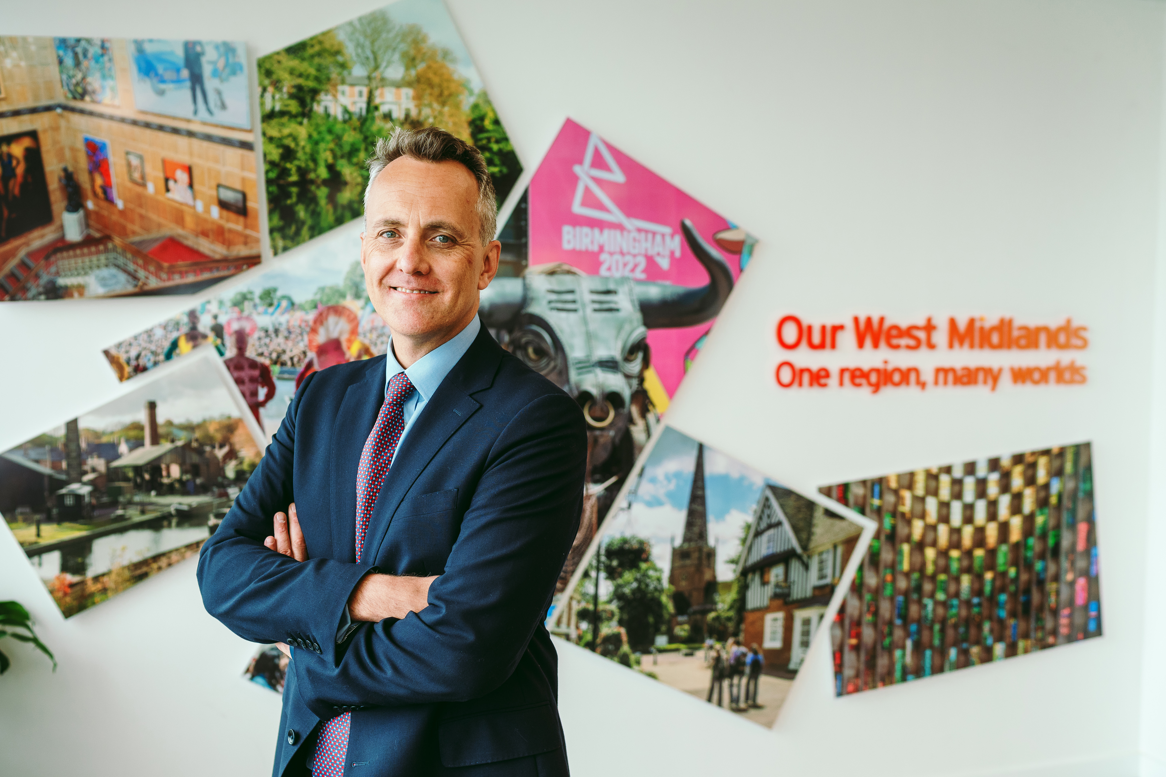

Jordana Ellis
Senior Business Development Executive – International Markets

Slide 3
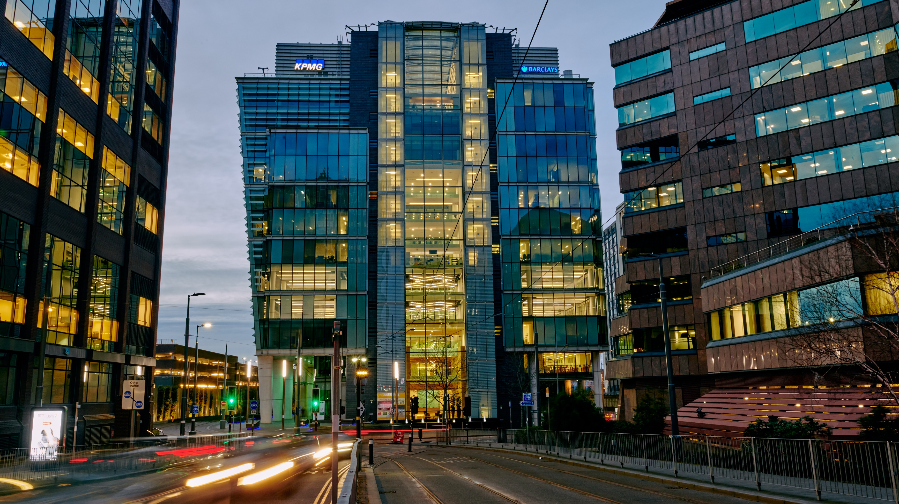

About the West Midlands Growth Company
ABOUT THE WEST MIDLANDS GROWTH COMPANY
Notes:
About West Midlands Growth Company

Slide 4



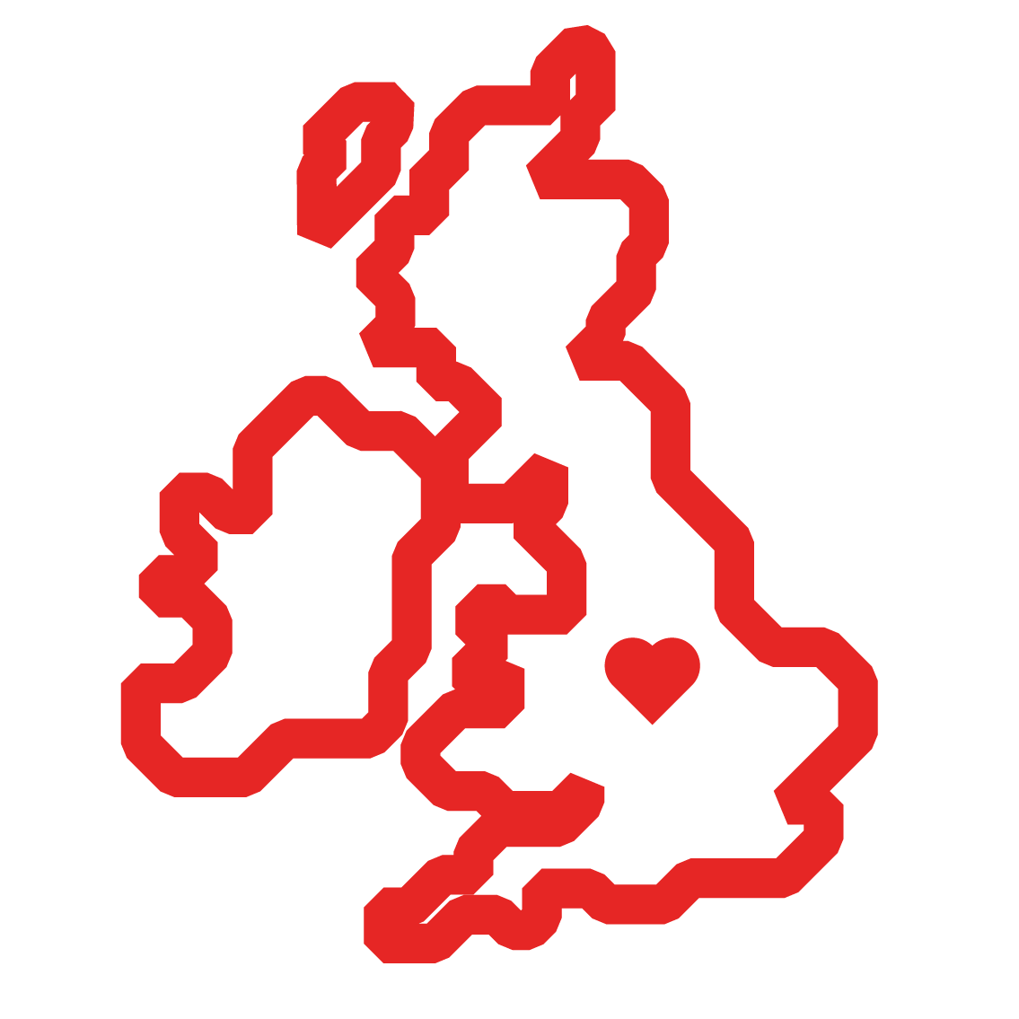






THE WEST MIDLANDS CITY REGION:
DIVERSITY, MATURITY, SCALE
A £117bn, fast-growing economy
UK’s second biggest city-region economy Equivalent to Hungary
  GVA increased
  every year
  2009-2019
  UK's top Foreign Direct Investment (FDI) location outside London (DBT, FY22/23)
Birmingham - UK’s highest rate of start-ups outside
of London for last
five years
UK’s biggest region for manufacturing output
  185,000 students
  Nine world-class higher education establishments
2.9m workforce
4.7m population
190 countries
  Full-service
  economy
  200,000 businesses
  100+ R&D assets
  Commercial testbeds & accelerators
Notes:
Our region is one of Europe’s youngest - and most diverse. We have a proud tradition of tolerance, friendliness and being supportive of all our 4.7 million citizens, with residents coming from 190 countries. For the first time in history, all athletes in the Commonwealth Games will be cheered on by a “home audience” who live and work in the West Midlands. Truly one region, many worlds
Spanning some 900 square kilometres – broadly similar in size to Singapore - our region has a uniquely warm and welcoming character and forms the UK’s largest regional economy, worth £105bn – equivalent to the economy of Hungary.
But what also sets us apart is the strong and coordinated governance from our elected regional mayor, Andy Street, who drives economic development, transport, housing, jobs and skills across our region
Graduate talent:
58,000 graduates per year, 55% retention rate in the region
Home of three international business schools including Warwick – globally #2 behind Harvard in terms of global business influence
World-class industry –led R&D
HORIBA MIRA 850-acre tech park with real-world research and testing for CAV, electric vehicles and vehicle resilience
UKBIC US$162m/CA$208m battery innovation centre, UK’s leading facility for battery development - prototyping to production
5PRING UK’s first commercial 5G accelerator, working across smart cities, transport, manufacturing and construction
Warwick Manufacturing Group Part of University of Warwick, pioneering research across Industry 4.0, digitisation and CAV. Includes the largest automotive research facility in Europe in partnership with Jaguar Land Rover and Tata
Innovation Birmingham 170+ companies; UK’s largest campus dedicated to digital/tech
Energy Systems Catapult Supporting digitalization and AI in energy power networks, smart grids and systems
National Brownfield Institute Europe’s largest specialist campus for brownfield remediation and modern methods of construction

Slide 5
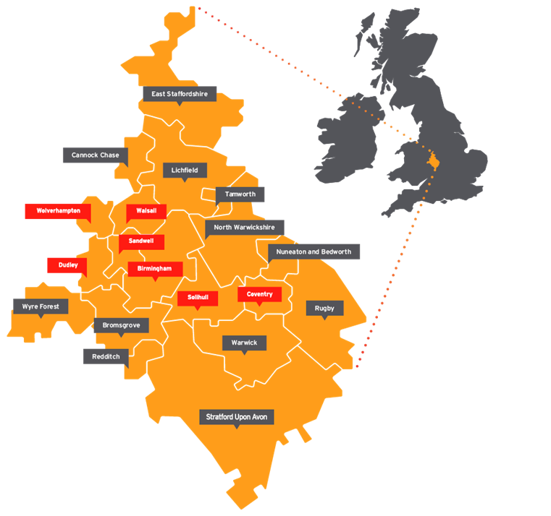
THE WEST MIDLANDS:
AT THE HEART OF THE UK
A unique three-city region, anchored by three dynamic city centres – Birmingham, Coventry and Wolverhampton.
Quarter of the population is under 20, making it one of Europe’s youngest regions.
Best 5G coverage of any UK region.
At the heart of UK rail, home the to the UK's busiest station outside the capital, with direct links to 17 of the UK's 20 largest cities.
133 direct flights (including US & Asia), and 424 further onward connections from BHX.
90% of the UK is within a 4-hour drive.

Slide 6





FIVE KEY SECTORS
Reflecting the world-class industry and innovation strengths of the West Midlands region:
Future Mobility
& Advanced Manufacturing
Creative & Digital Technologies
Modern Business Services
Data Driven Healthcare & Life Sciences
Low
Carbon

Slide 7
A COMMERCIAL ADVANTAGE, WITH NO COMPROMISE ON QUALITY
Maximise your ROI. We offer 30% – 40% savings on the cost of skills and property compared to London yet we’re less than 1.5 hours away by train.
UK Government has named the West Midlands the fastest-growing tech sector in the UK with regional growth outpacing London.
The West Midlands has more people employed in digital tech than any other UK region.
​52,000 new tech jobs expected in the region by 2025 (TechWM).
The WMCA continues to pioneer the largest specialist digital skills and talent re training programme in the UK, offering further diversity of talent available.
Development and Data salary inflation significantly below London & Manchester in 2022:
  Lower job posting density​.
  Lower average salary.
  Higher average employee tenure.

Slide 8

UK GOVERNMENT BACKING AND
VOTE OF CONFIDENCE
One of three
in the UK
WMCA is one of the most cohesive Mayoral Combined Authorities in the UK, and at the forefront of devolution from Central Government.
Backed by UK government and industrial partners to run multiple unique pilots and testbeds in supporting the UK to become global science and technology superpower.
One of only three UK city region's to receive a share of £100m 'Innovation Accelerator' funding, awarded to projects building globally significant innovation infrastructure within the region.
£100m
Innovation Accelerator
20%
uplift
in funding
for regional Catapults
Investment Zones
Driving translational research
Supporting businesses to scale up
Innovation
action plan backed by Government
Co-created with
Notes:
Additional Notes:
- Innovation Accelerator: A newly announced UK Innovation Accelerator (part of £100m investment) funding 5 projects in the West Midlands
- Devolution: 1 of 2 Devolution trailblazer in the UK
- Investment Zone: 1 of 8 in England. £80m backing to support businesses to scale up
- Engaged: Supporting the UK to become global science and technology superpower and the delivery of the Plan for Growth.
- Pilots: Large concentration of national pilots and test beds. The West Midlands is a centre of gravity for capabilities and people. Need to specifically reference the devolution deal future energy zones and future mobility zones (available online) here as tangible examples
- Trusted: The confidence is echoed by large multinationals, such as Tata, Thermofisher or Vodaphone who have all elected the West Midlands as their location to undertake globally significant game-changing innovation.
Innovation Accelerator:
Principles - The West Midlands Innovation Accelerator will:
Be focused on specific clusters of comparative advantage identified in the West Midlands Plan for Growth.
Support cross-sector R&D and innovation. This means using the region’s strengths in R&D – particularly in engineering and advanced manufacturing – but helping to stimulate applied and translational R&D in diversified fields and grow private R&D investment.
Position the region on the global scale as a beacon for Foreign Direct Investment.
Provide a sustainable framework for building innovation capability and capacity.
Be driven by market demand with strong private sector business leadership.
Devolution: 1 of 2 Devolution trailblazer in the UK
The Deeper Devolution Deal represents a real step forward for the West Midlands​
Devolves funding and powers from Whitehall ​
The Single Funding Settlement sees the region treated like a Whitehall department given a lump sum and it is up to the region to decide the spend ​
There will be a 10-year retention of business rates –worth £45m per annum to the region ​
The West Midlands Combined Authority to designate Levelling-Up Zones leading to 25 years’ worth of business rates retention ​
There is also funding secured to support housing, retrofit, skills and training ​
Trade & Investment ​
WM's partnership with the Department of Business & Trade recast with WMGC recognised as the lead agency for trade & inward investment​
Greater strategic alignment supported by the international strategy ​
Review of KAM and funding extended and a review of business competitiveness​
DCMS and VisitBritain to work with WMGC to establish a second destination development partnership ​
Investment Zone: 1 of 8 in England. £80m backing to support businesses to scale up
Investment Zones​
Focused on primary economic sector – agreed between WMCA and HMG​
Must be innovation/R&D focused, linked to universities​
Govt. providing £80m funding over 5 years + Rates Retention​
Can be deployed flexibly between spending and tax incentives​
Tax incentives on up to 3x 200Ha sites could include:​
SDLT relief (commercial use)​
Up to 100% rates relief on new occupancy​
100% enhanced cap allowances​
Employer NICs
Levelling-up Zones​
Focused on addressing levelling-up in key strategic corridors across conurbation.​
Self-financing via bus. rates retention of 100% above agreed baseline for 25 years, creating leverage to attract private investment.​
Zones must be underpinned by approved masterplan to deliver investment in housing + transport, digital & energy infrastructure.​
WMCA pursuing agreement with HMG to:​
Pilot SDLT retention on new homes​
Grant WMCA additional powers on localized CPO & compensation, and flexible deployment of existing grant funds within zones.​

Slide 9
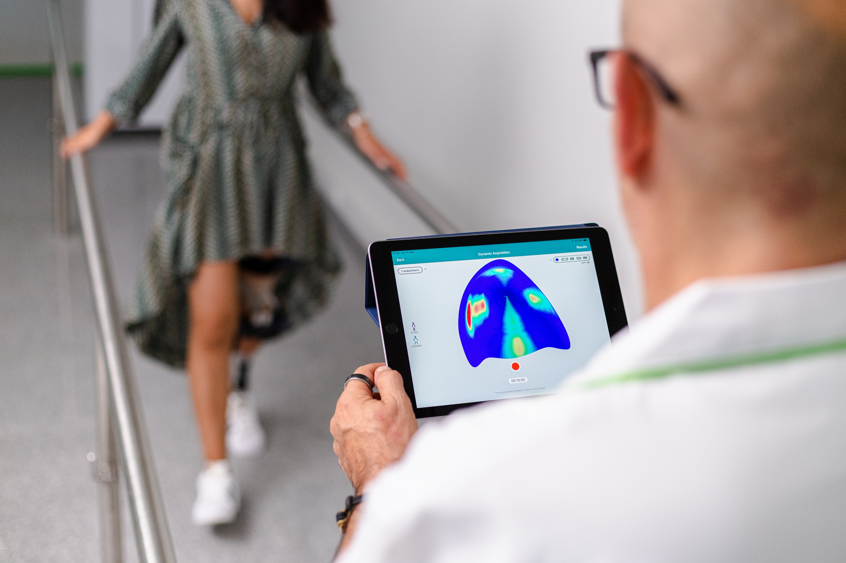
A HUB OF HEALTHCARE INNOVATION, ACCELERATION AND COMMERCIALISATION

Slide 10




INVESTMENT OPPORTUNITIES: THE 4D’S
The West Midlands has the commercial power to develop research and accelerate market access, taking innovative patient-centred healthcare solutions from early development to real-life application, driven by usable healthcare data.
Data
Access a large number
of data sets and the largest clinical trials portfolios in Europe.
Digital
Validate your digital health innovation in real-world applications in one of the UK’s most vibrant regional start-up ecosystems.
Diagnostic
Validate and test diagnostics solutions from
a location internationally recognised for its capabilities in this field.
Devices
Identify patient and industry need in a region that sets the medical devices standard
for healthcare.
Notes:
Data – PIONEER – Health Data Research Hubs - UHB
Digital – UK’s Fastest growing tech hub - £15.3bn
Diagnostics – key priorities of region nationally and regionally. Cancers – blood cancers. 1 in 5 clinical trials in the UK are in the West Midlands, Health Data Research Hub – PIONEER
Devices -

