Slide 1
British – Polish Tech Forum 12th November 2024 Invest in NORTHERN IRELAND

Slide 2
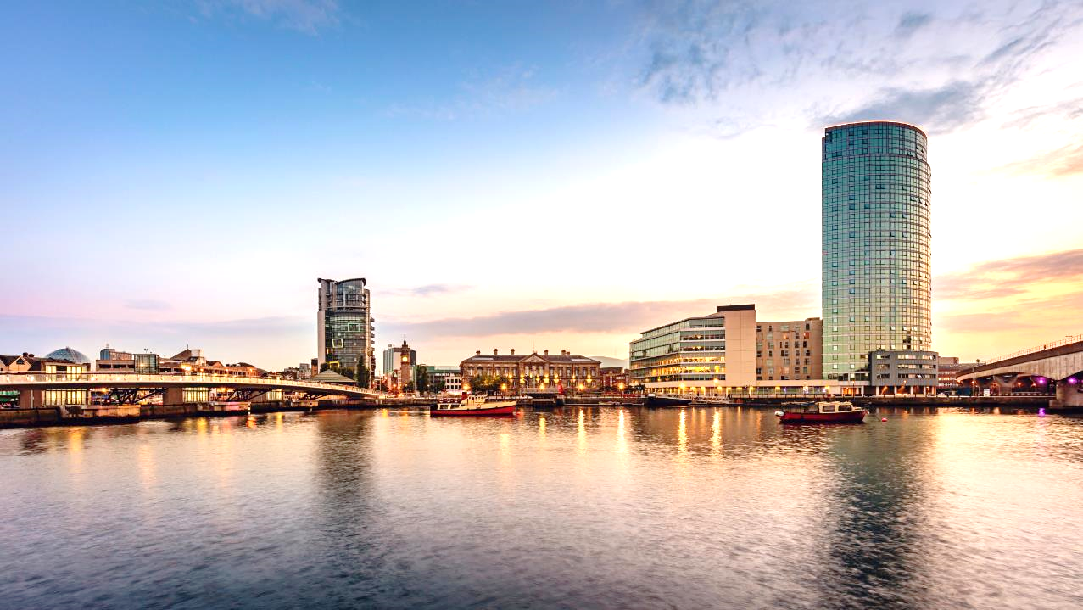



Introductions
Belfast, Northern Ireland
Cathy Bradin
Head of Investment & Sectors, DBT NI , Based in Belfast
cathy.bradin@businessandtrade.gov.uk
Sharon De la Puente Investment Lead,DBT NI
Based in Belfast
sharon.delapuente@businessandtrade.gov.uk

Slide 3




Northern Ireland - Did you Know?
Cyber Security
Northern Ireland is the #1 international investment location for US cyber security firms
Life & Health Sciences
The first battery operated portable defibrillator was developed in Northern Ireland
Fintech
Belfast is ranked in the top 3 Global Fintech locations of the future after London and Singapore
Creative Services
Game of Thrones was largely filmed in Northern Ireland.
Netflix, Sony, Universal Pictures, BBC, Virgin Media and Disney have also filmed in NI.

Slide 4
Northern Ireland

Slide 5
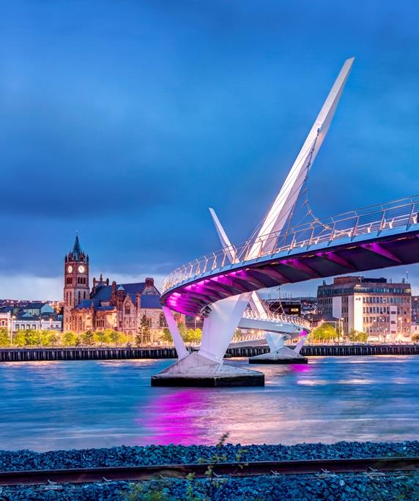
The Northern Ireland offer
Competitive Operating costs
Track record
Internationally recognised
Academic excellence
Young, talented workforce Connectivity
Advanced infrastructure Capability and expertise Land and expand
Further information NI region and Invest in NI
Notes:
Northern Ireland is an integral, uniquely positioned part of the UK and is the ideal location to grow your company. Its combination of a highly educated workforce, competitive operating costs, quality skills pipeline and unique market access offer a compelling proposition for your business.

Slide 6






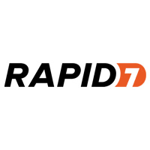



The Northern Ireland offer – Track record
Operating costs One of the most cost-efficient business environments in Europe.
Internationally recognised Long-standing history of international trade performance
1,500 international firms have established themselves
Land and expand
Investors can benefit from tailored support to ensure the talent, skills, opportunities and connections they need are available.
Further information NI region and Invest in NI
Notes:
Northern Ireland is an integral, uniquely positioned part of the UK and is the ideal location to grow your company. Its combination of a highly educated workforce, competitive operating costs, quality skills pipeline and unique market access offer a compelling proposition for your business.

Slide 7
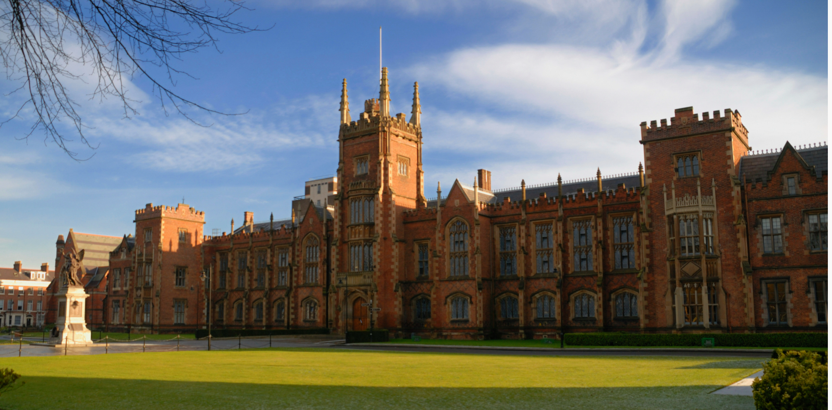
The Northern Ireland offer – Skills and Workforce
Academic excellence​
Two globally recognised universities and an extensive network of further education colleges providing excellent academic and vocational training
World-class research and strong links between industry, academia and clinicians. Over 17 world-leading research centres with more than 1,000 researchers.
Ranked 1st in the UK for educational degree completion rates
Consistently highest performing region of the UK at GCSE and A-level examinations. The best performing education system for primary maths in Europe
Young, talented workforce
A workforce that’s young, educated, innovative, resilient and results-driven.
One of Europe’s youngest and fastest growing populations, with 50% under the age of 40
Low labour turnover
Bespoke workforce support ​
Free, customised, training and recruitment programme for investors complements our well-educated workforce through Assured Skills Programme
Further information NI region and Invest in NI
Notes:
Northern Ireland is an integral, uniquely positioned part of the UK and is the ideal location to grow your company. Its combination of a highly educated workforce, competitive operating costs, quality skills pipeline and unique market access offer a compelling proposition for your business.
Global tech leaders have established hubs in Northern Ireland thanks to the wealth of knowledge, entrepreneurship and talent that our highly skilled workforce has to offer.

Slide 8
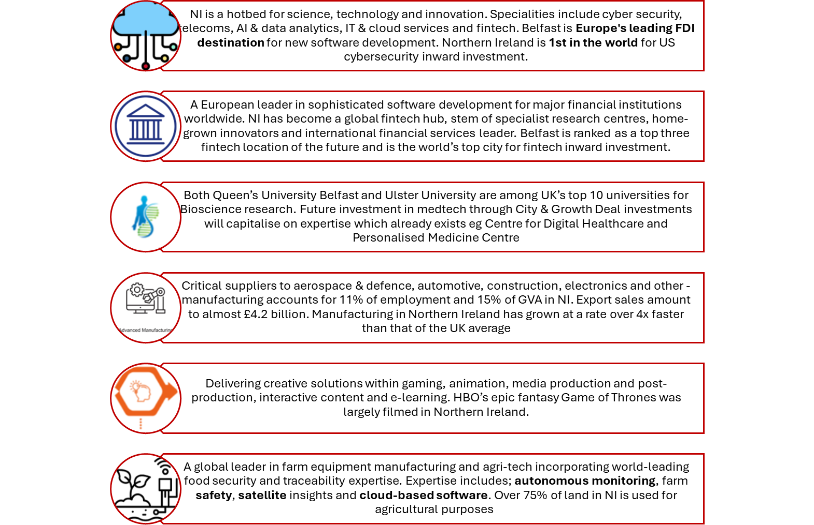
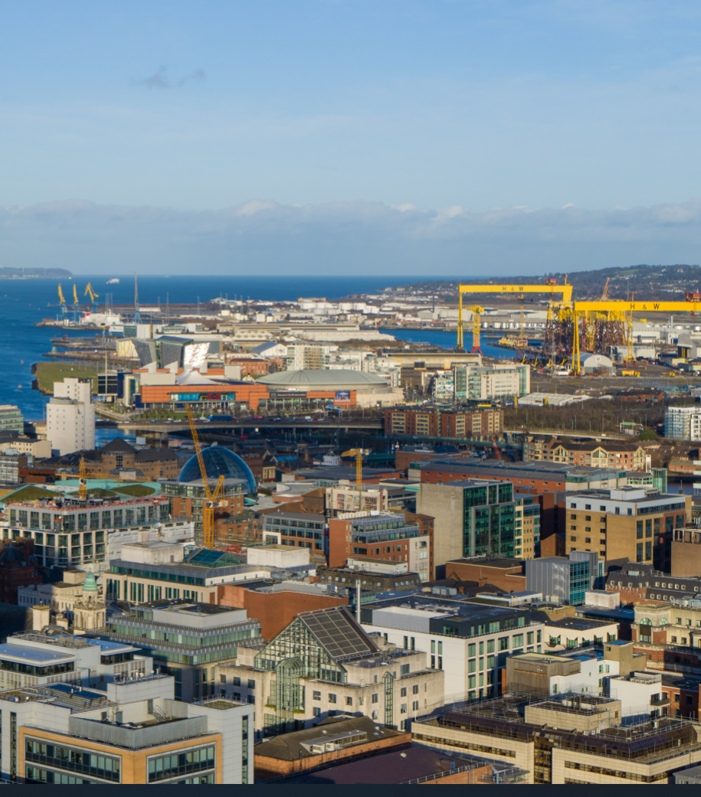
The Northern Ireland offer - Capability and expertise
Further information NI region and Invest in NI
Notes:
Northern Ireland is an integral, uniquely positioned part of the UK and is the ideal location to grow your company. Its combination of a highly educated workforce, competitive operating costs, quality skills pipeline and unique market access offer a compelling proposition for your business.

Slide 9


The Northern Ireland offer – Connectivity
Excellent transport and communications infrastructure allows companies to do business easily with their customer base around the world at a very competitive cost.
Windsor Framework creates a unique opportunity for Dual Market Access
The only place businesses can move goods to both Great Britain and the EU free from customs declarations, rules of origin certificates and non-tariff barriers
No checks or processes
No customs duties or tariffs
No customs border
No EU VAT registration
Notes:
Tech investors include: Liberty IT, Microsoft, Aflac, Allstate, Fujitsu, Rapid7, Bazaarvoice, Insurance of America, CMEgroup

Slide 10
Investor Support
Ongoing government support
Continued support after your business is established in the UK, providing assistance on expansion and representing your interests in government.
Access and introductions to the right people
Working with every UK government department to support access to a vast network of industry experts.
Setting up in the UK
We provide a range of support from applying for visas and entry to the UK to set up procedures, to the UK tax system and site selection.
Bespoke market research Compiling in-depth factual reports, including market entry support, research and development collaborations and cost analysis.
Entrepreneurial assistance
Through a network of mentors to help make a commercial success of early stage companies.
Accessing market opportunities
Helping international companies assess market opportunities in the UK.
Department for Business and Trade
Belfast, Northern Ireland
Working across government, and a vast network of industry experts and leaders, DBT provides a range of bespoke services to help international businesses expand into the UK.
DBT’s international network provides global reach across 170 countries. Staff work to ensure international business can invest successfully in the UK, whether directly in creating a UK entity or indirectly by investing capital in a UK business or development.
Local team in NI to promote DBT’s services to and leverage the depth and breadth of the department’s expertise and networks

Slide 11


Investor Support
Talent Sourcing
Make introductions to help you source talent needed for your future business growth and success.
Training Support
Assured Skills Programme provides necessary support to source a high-quality workforce through bespoke recruitment and pre-employment training.
Property Search and Selection
Assist your search for suitable premises, connecting you to relevant databases and property agents in the region.
Introduction to Centres of Excellence
Introduce you to our universities, colleges and competency centres so you can tap into our world-leading research capabilities and talent.
Financial Incentives
Financial support includes grant for employment, R&D and training.
Business Networks
Connect you with business networks across a range of sectors including technology, financial, professional & business services, advanced manufacturing and life & health sciences.
Invest NI
Belfast, Northern Ireland
Invest NI is Northern Ireland's local promotion agency and offers tailored support packages include cash grants for capital investments and employment, interest relief, plus support for a variety of business operations such as R&D, training and marketing.
Peta Conn
Director GB & Europe, Invest NI
Based in London
peta.conn@investni.com
Invest NI - GB & Europe

Slide 12


