Slide 1
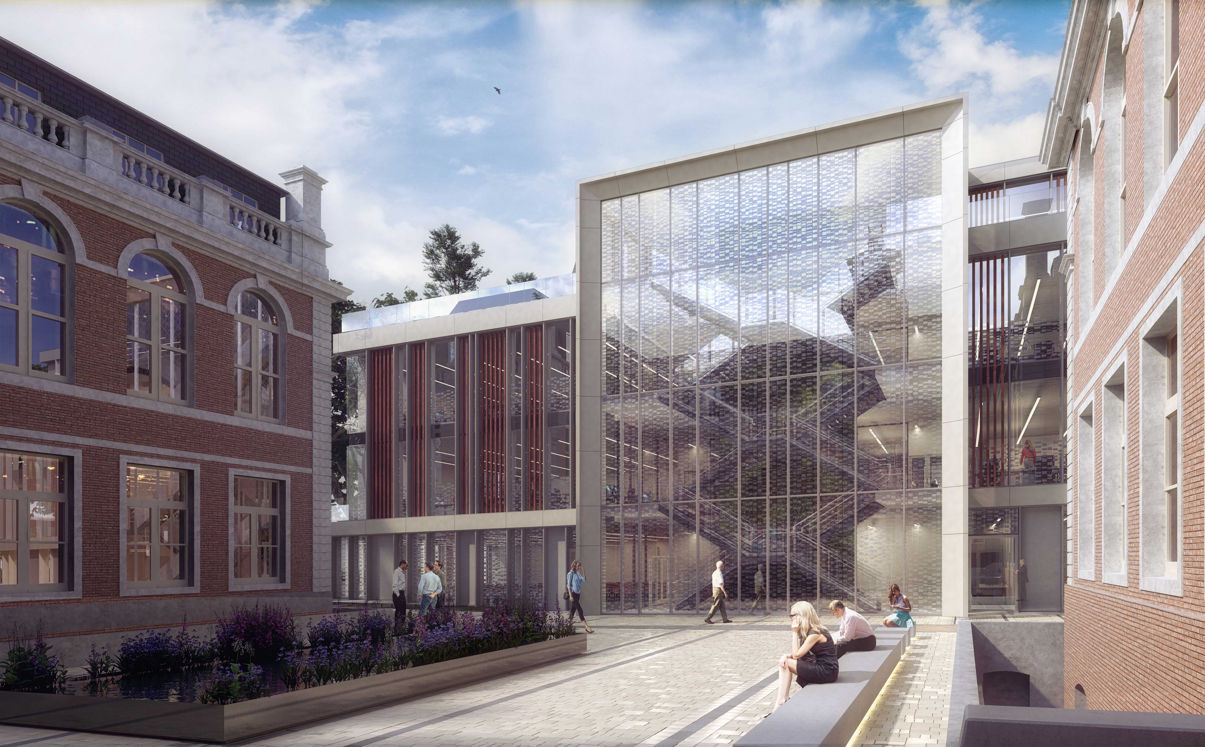


From Bench to Bedside to Boardroom

Slide 2
















Bench-to-Market Translation
An inordinate, multi-faceted challenge for entrepreneurs
TECHNICAL:
Cutting edge,
fit-for-purpose technology
COMMERCIAL:
Profitable; IP; Regulatory pathway; Route to market; Industry acceptance
CLINICAL:
Fits healthcare ops; Value-based; Positive impact on patient care
+
+
+
+
+
+
BUSINESS SKILLS:
Finance; Operations; HR; Legal; IP
Notes:
It is an inordinate challenge to introduce any new innovation in healthcare.
To make any MedTech innovation a clinical and commercial success, a multitude of elements must be considered at the outset.
First and foremost, it has to be cutting edge to be pushing boundaries, and absolutely have real clinical value
Secondly, there has to be a realistic, and scalable business model to attract investment (is the opportunity big enough?), a clear, or at least clearly understood, route to market, and also an understanding of the regulatory pathways, as well as industry trends and appetites (e.g. all investment in TB disappeared overnight when Covid struck)
Thirdly, it has to take into consideration the operational and financial impact the innovation will have on stretched financial systems, burned out hospital staff, and, last but not least, on the patients themselves
This is on top of having to develop skills in finance, IP operations, HR and governance.
Each one of these challenges is unique, and it requires unique skillsets in a variety of functions. However, this is often expected to be fully understood, mapped out and executed on by the small number of founders.
For academic founders, this journey can appear as very daunting.

Slide 3
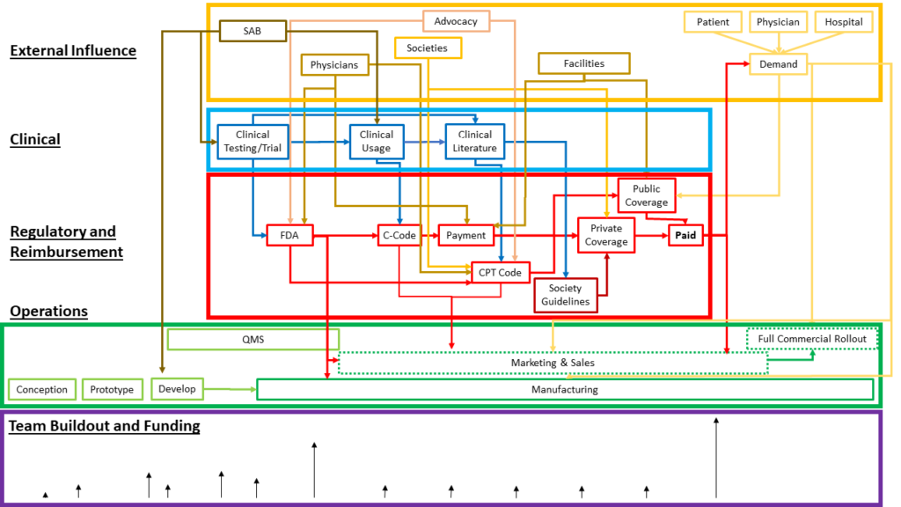
7+ years from concept to market
Notes:
Here in simplified manner are shown the critical elements for the successful commercial release of a new device.
Note that conception to prototyping and most of the development are just the beginning. To have any chance of success, a MedTech company has to deliver on a number of interconnected threads. Note also the fact that the company gets paid for its work in real terms (i.e. there is reimbursement for the use of their tech) almost at the end of the process, and after almost the entirety of investment in the millions required has been expended (shown by the black vectors at the bottom of the screen)
This process takes on average more than 7 years, and usually over 10 years.
Source: FUS Foundation

Slide 4
Some Startling Statistics for New MedTech (USA)
Cost to Market*
510(k): $31m, 77% on regulatory costs
PMA: $94m, 80% on regulatory costs
Failure Rates (2019)**
Overall: 90%
75% do not make returns
* https://www.massdevice.com/exploring-fda-approval-pathways-for-medical-devices/
** https://www.embroker.com/blog/startup-statistics/
Notes:
And here is the outcome. The numbers speak for themselves

Slide 5
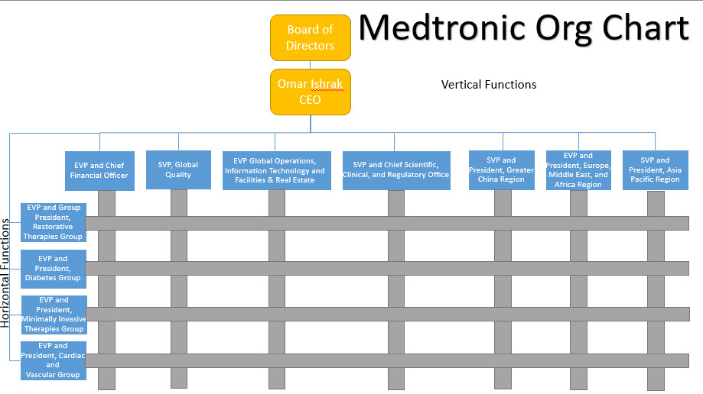
Industry – A Successful Structure
MedTronic Org Chart, 2015-2016
Quality Assurance
Medical/Reg & Scientific affairs
2016 article: https://rosenbaumweb.wordpress.com/2016/10/23/medtronic-a-company-no-one-knows-and-how-it-dominates-the-medical-device-industry/
Notes:
If it is such a challenge, how do established MedTech companies do this repeatedly?
The answer is, they have the critical elements of the process, i.e. Quality and Regulatory, Market Access etc as verticals serving their product lines.
Here is a version of the MedTronic Org Chart fro 2015-2016. You can see that Quality Assurance is a separate vertical, and so is Med/Reg/Scientific affairs, basically Regulatory and Market Access, as a separate vertical. Note that these are at the board level of the company, and they are critical to the release of any new product (and maintenance of existing ones) as released by each business line.
In effect, the release of new medical device to market requires a robust, rigorous approach that is driven for RA/QA/Market access from the top, and permeates all other effort.

Slide 6
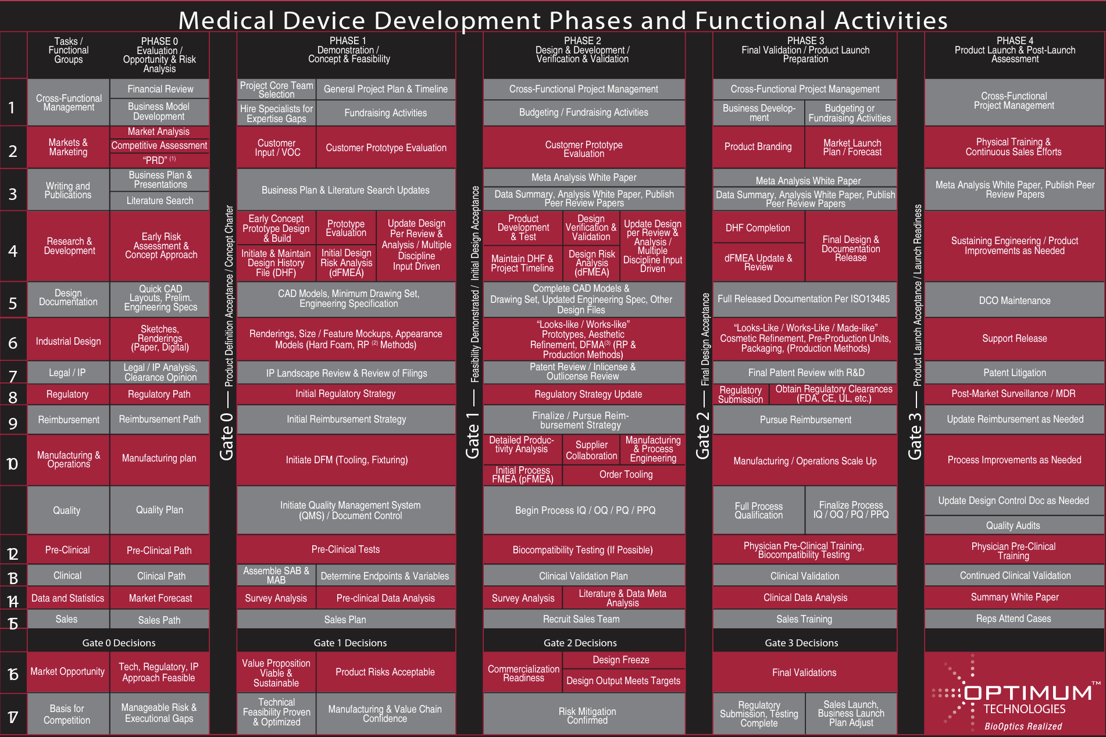
Notes:
And they implement a New Product Introduction (NPI) process to bring all this expertise together.
A typical NPI for medical devices is shown here. You can think of this as a cookie cutter approach for releasing medical devices to the market if the corporate structures are in place.
We will have most of the necessary expertise in LIHE to implement a NPI process. All the areas I am highlighting are covered, to some degree, by our experts. We will then create a stage-gate approach to how we move companies from their starting point at joining to their next inflection point, which we will work out in collaboration with the company.
Hence, LIHE will become a medtech company builder. It is a venture studio more than an accelerator, and one that is fully dedicated to medtech.

Slide 7
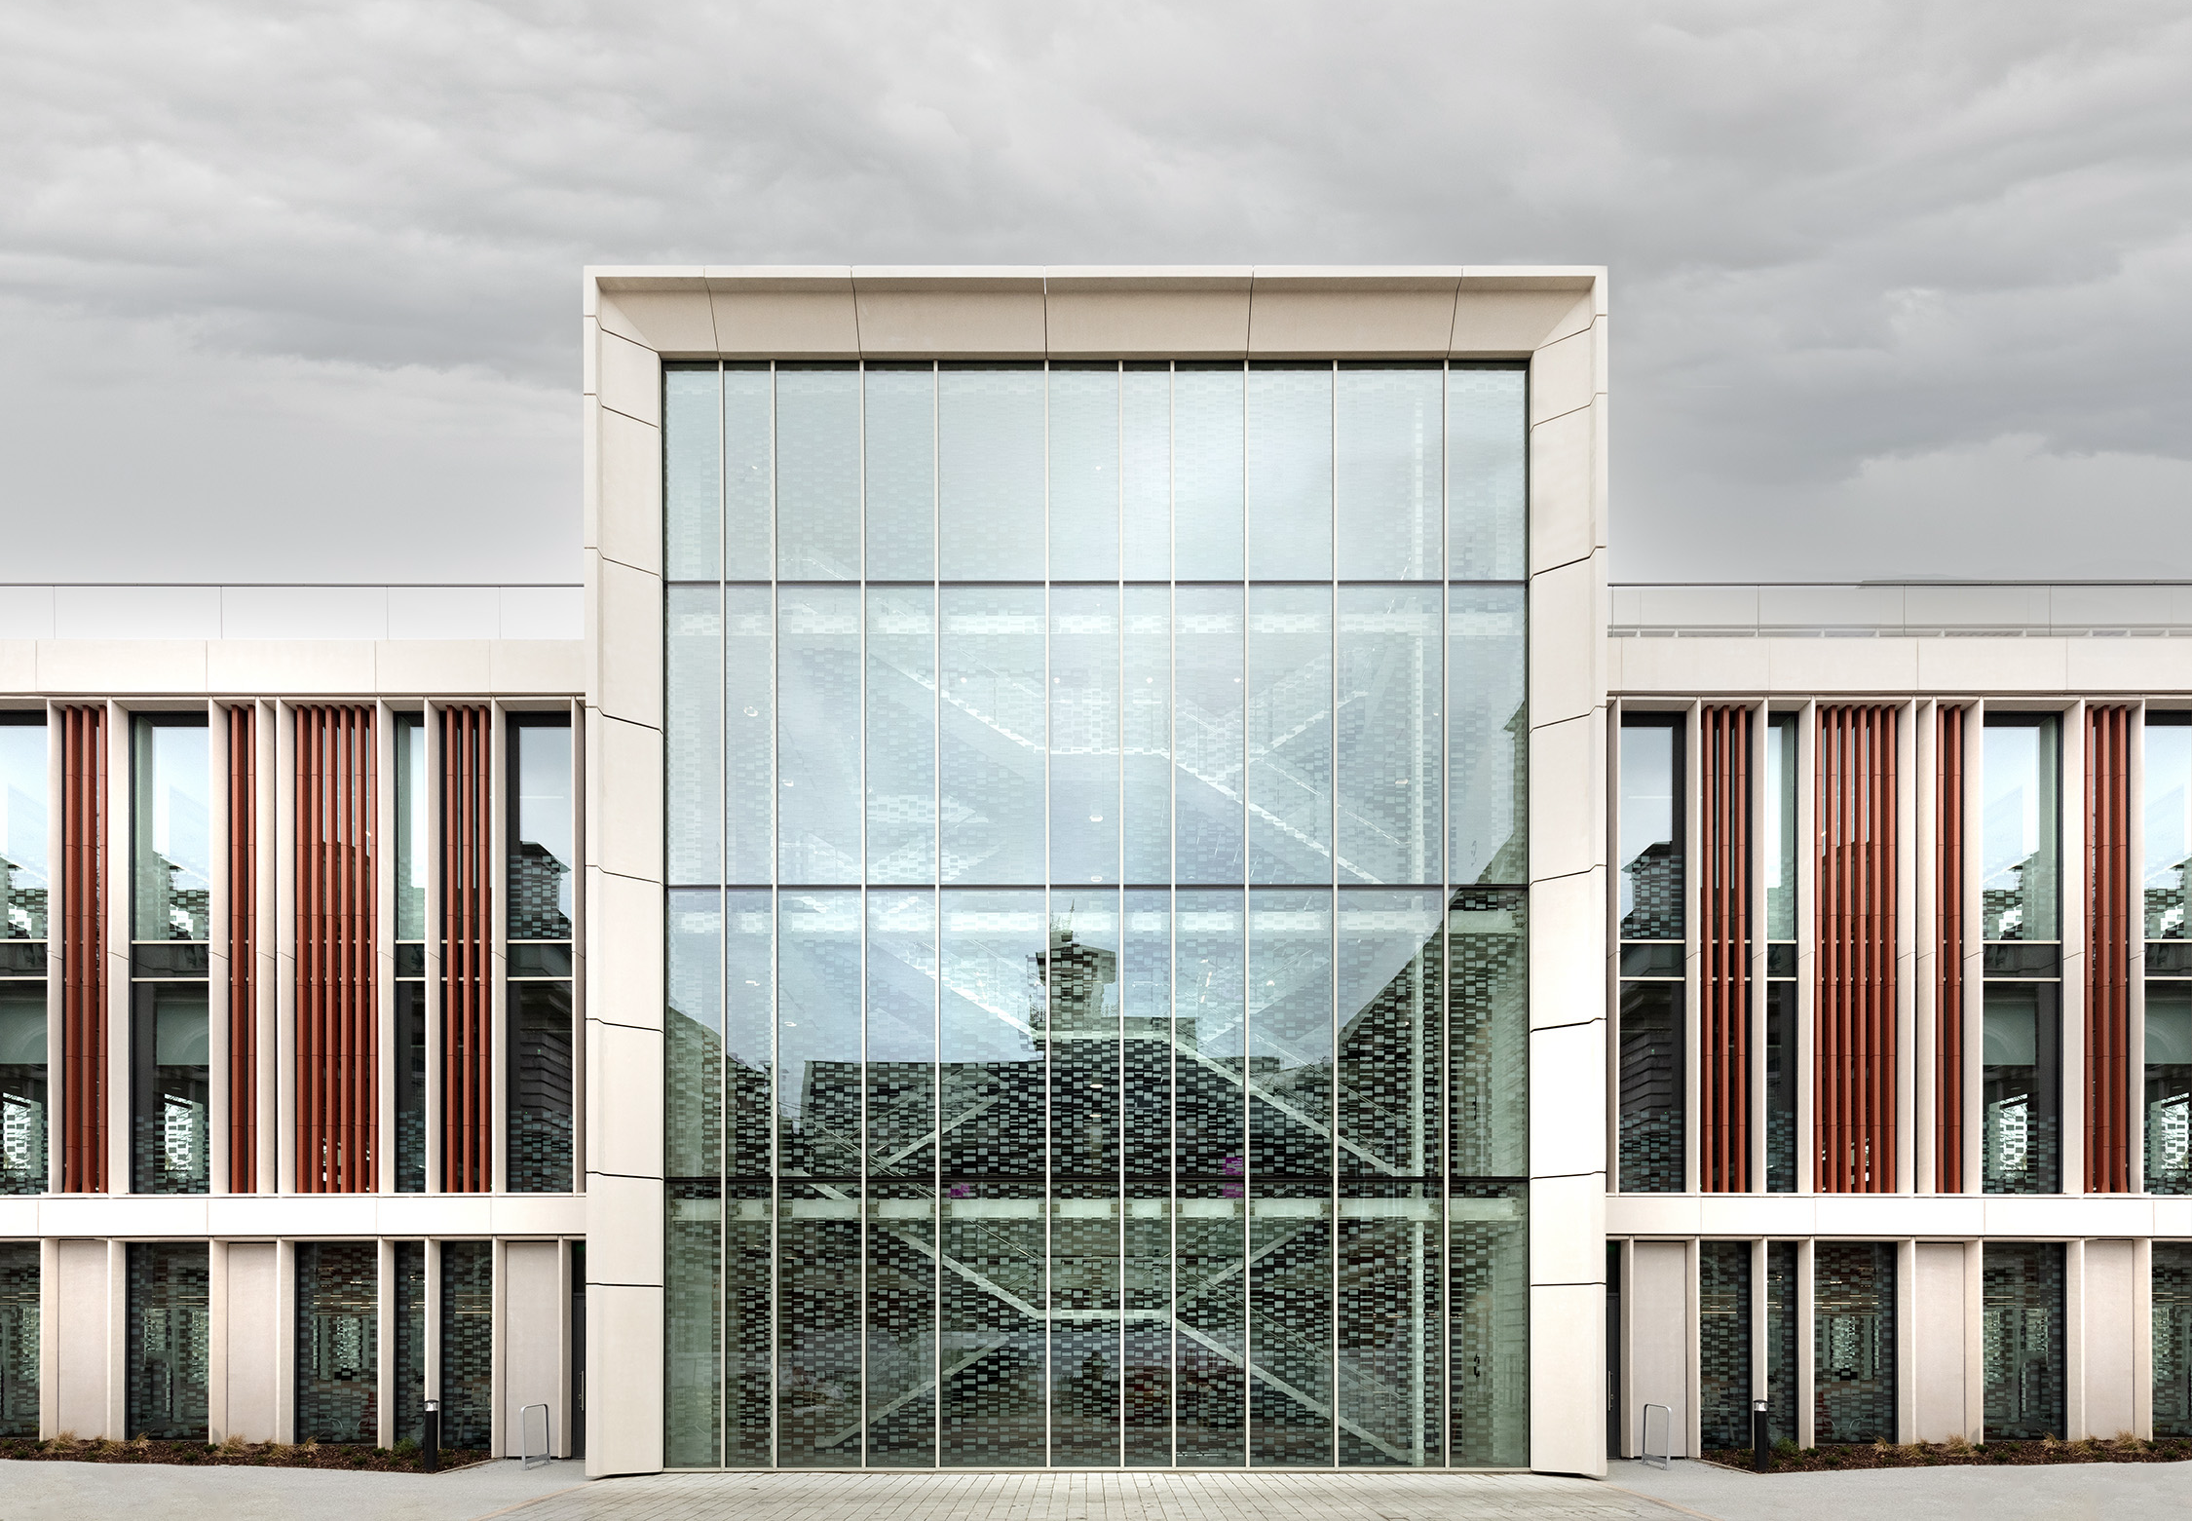
A National Asset
A National Centre of Excellence for MedTech Translation
The Hub for all MedTech Activity in the UK and EU
An Ecosystem of the MedTech Industry With Global Reach
Notes:
What we want LIHE to become is a National Asset.

Slide 8














A Unique Ecosystem for MedTech Translation
Venture Sourcing
Partnerships
Support Infrastructure
Clinical & Regulatory
SIE
Notes:
This is uniquely feasible due to the ecosystem surrounding LIHE. The resources available to the BMEIS school in terms of support infrastructure, the links with KHP, NICE and MHRA we hold, our extensive network of funders (for- and not-for-profits) and industry partners, and our ability to source and accelerate ventures, all come together at LIHE seamlessly.

Slide 9


Unique Resources From King’s Infrastructure
BMEIS Research Facilities
Extensive facilities to support research across the biomedical and imaging science spectrum
King’s Health Partners
Academic Health Sciences Centre, translation of innovation to clinic
King’s Technology Evaluation Centre
Health economics, technology assessment, medical affairs, clinical trial design
Wellcome/EPSRC Centre
MAISI
Clinical translation of advances in basic science research, first-in-man studies
Quality & Regulatory Affairs, prototype manufacture to ISO13485
AI4VBH Centre
Surgical & Interventional Engineering
SIE
SIE Validation Suite, surgical training, cadaveric studies, hardware development
Access to clinical data (GDPR), AI farm, federated learning, clinical app deployment
Notes:
In more detail, here are the main contributors to LIHE’s strategic acceleration programmes in terms of resources and infrastructure. (READ OUT EACH ONE AND EXPLAIN VALUE OF EACH)

Slide 10
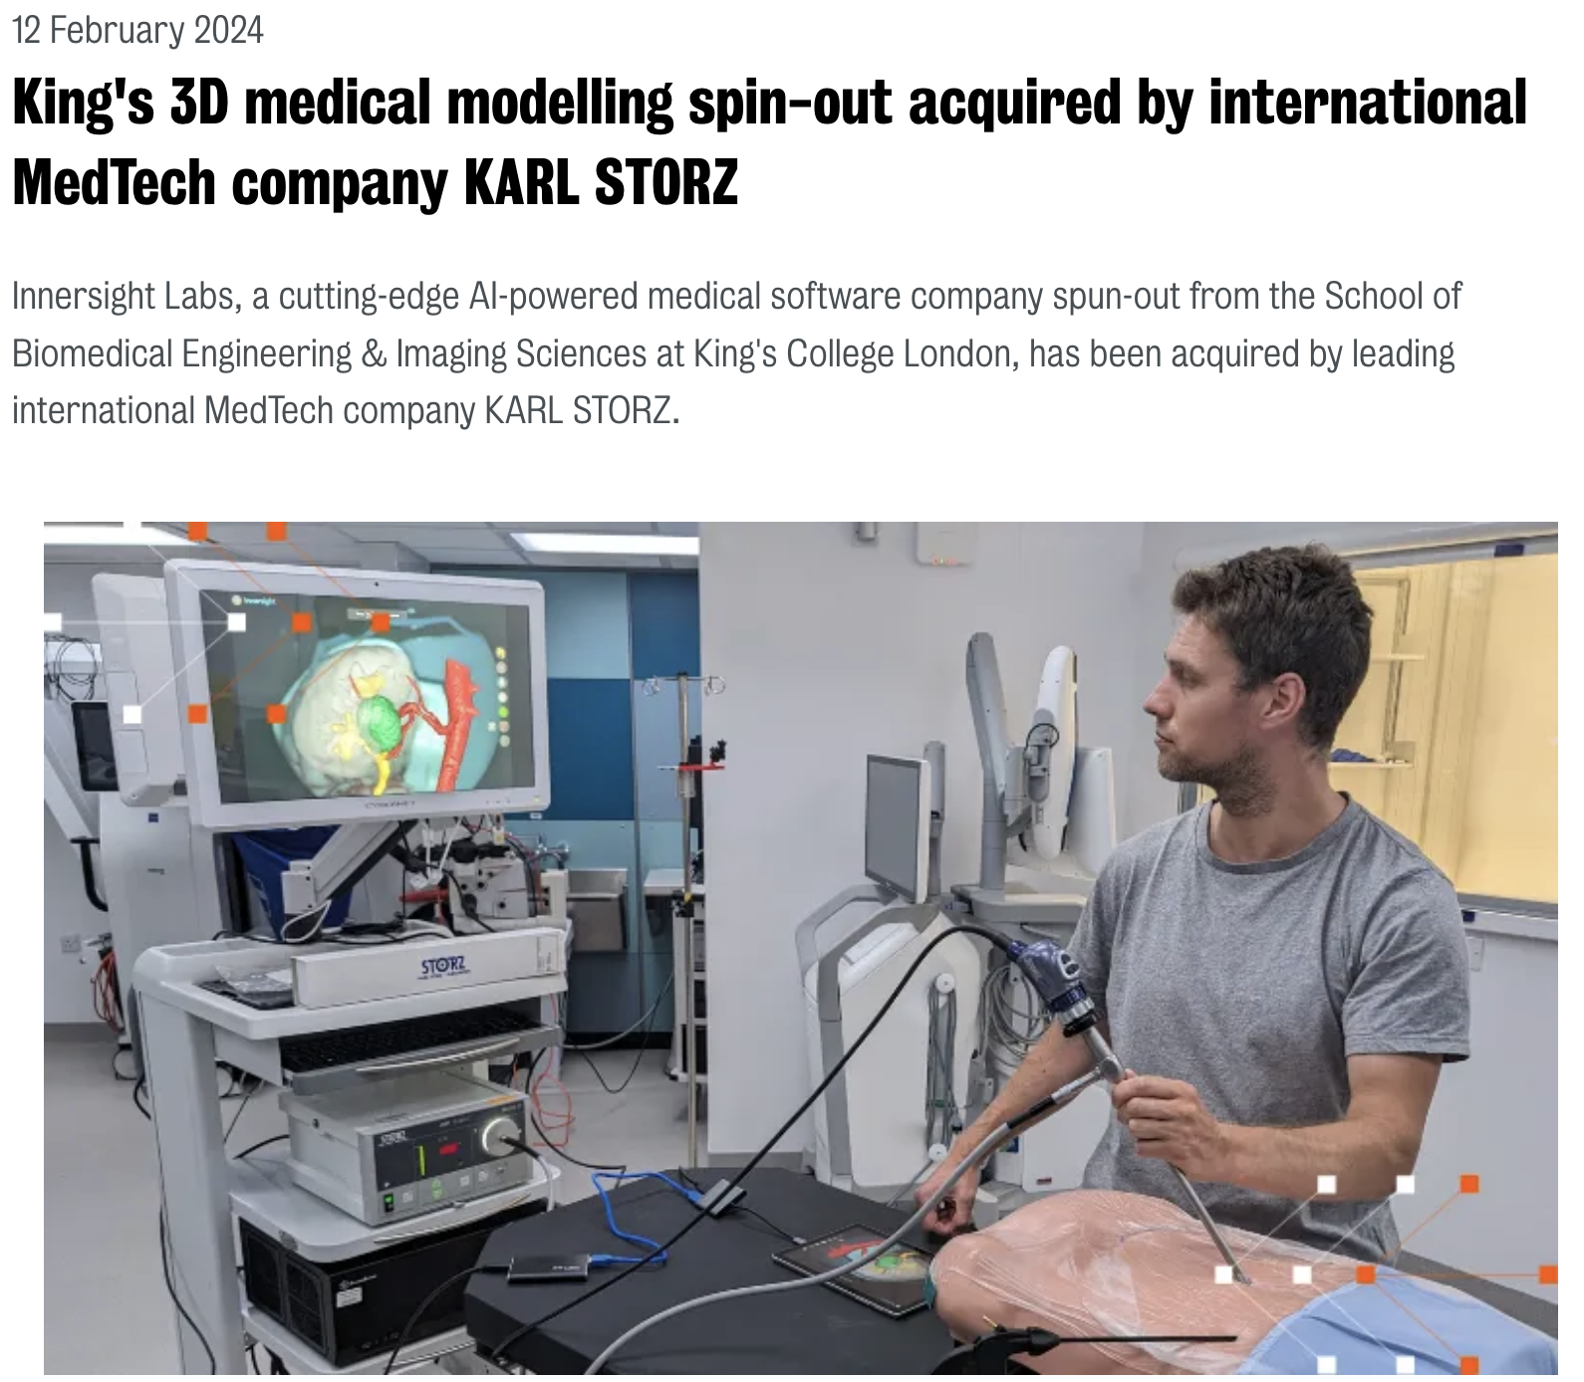
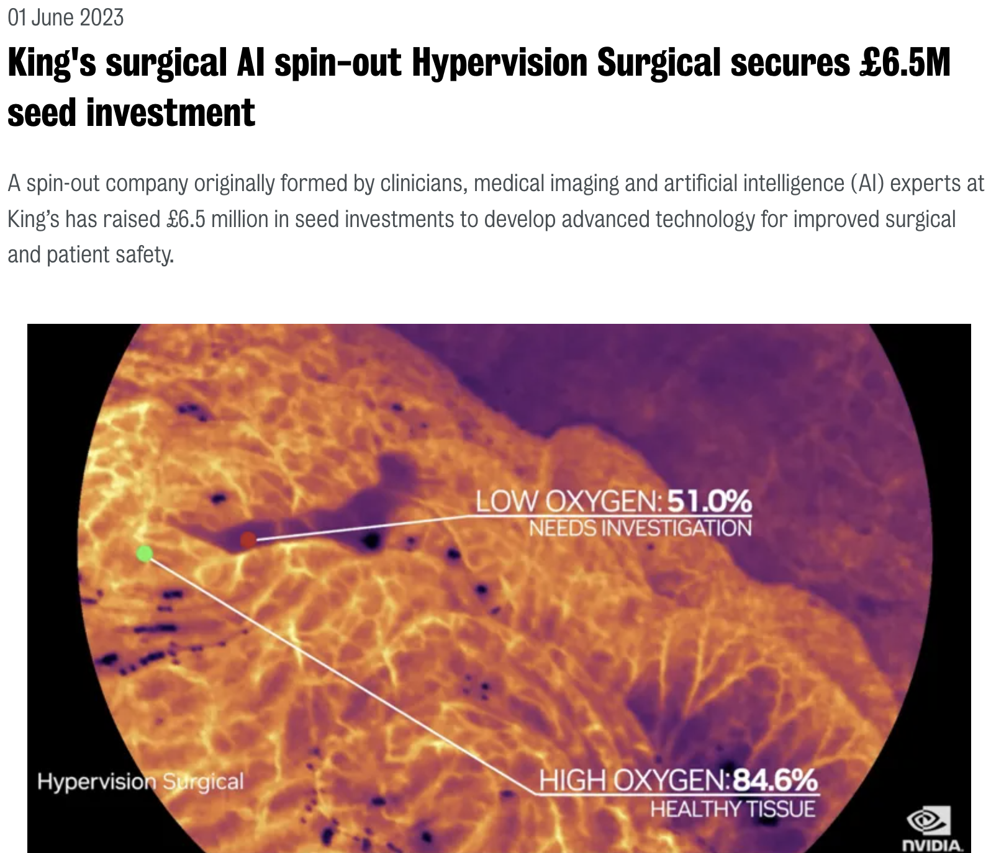
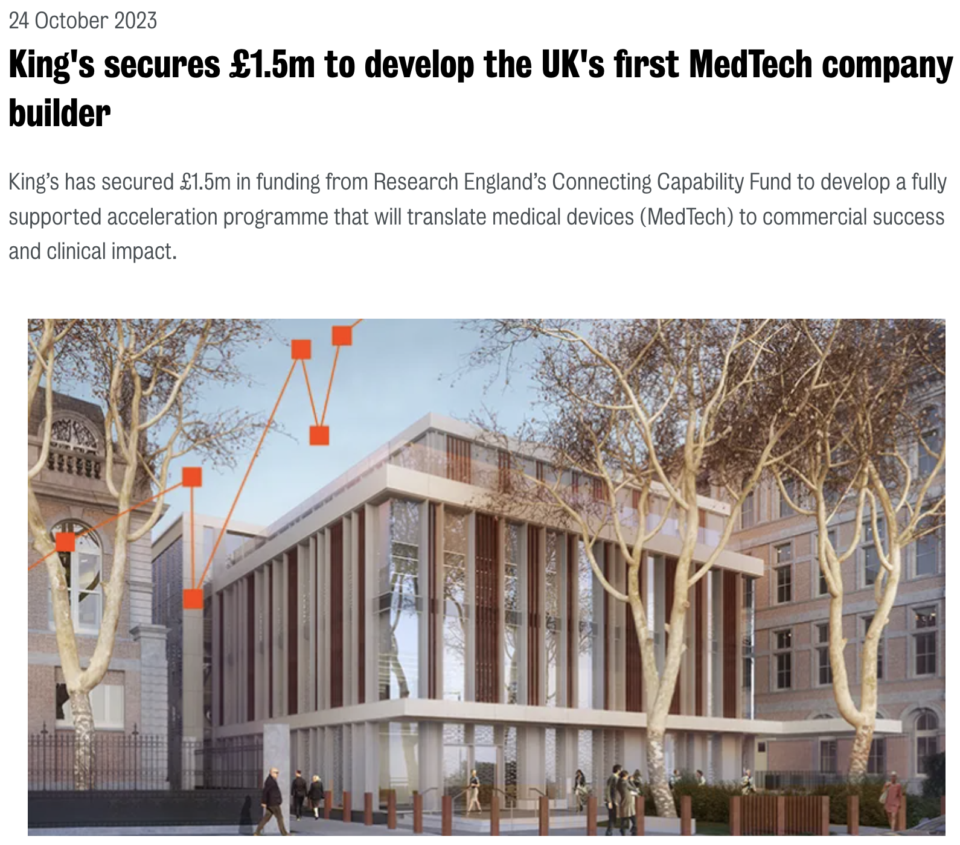
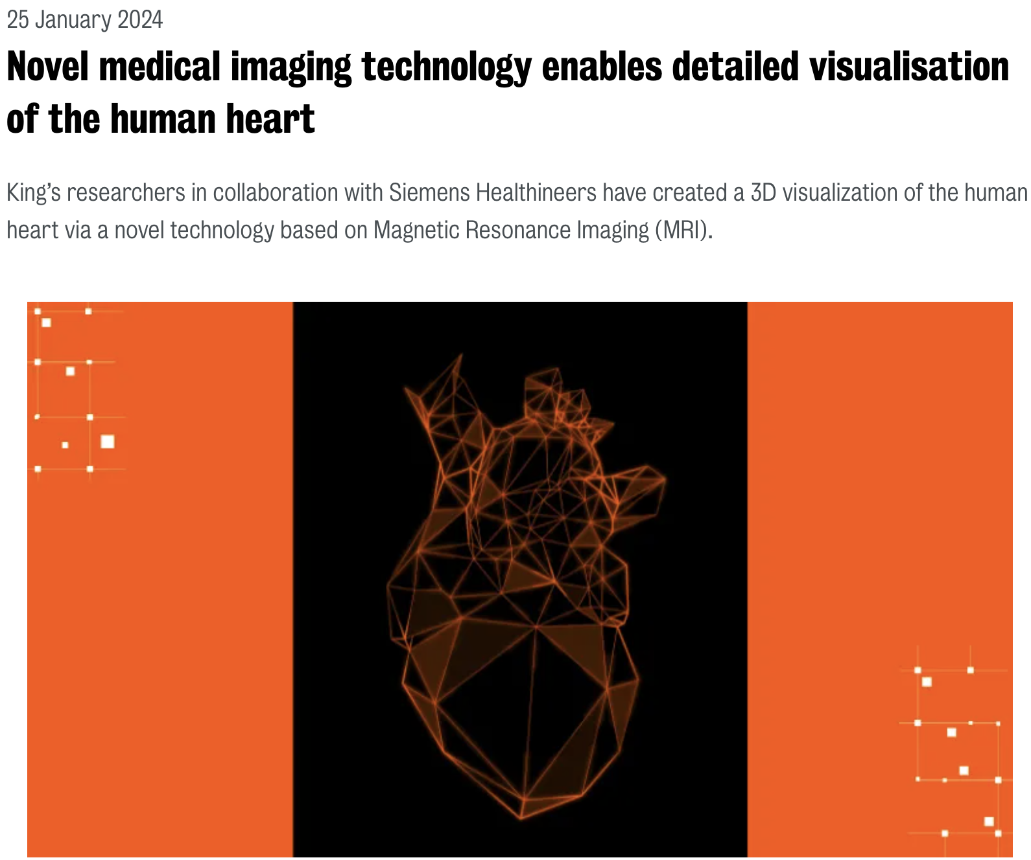
Notes:
And our approach is already bearing fruits. From a recent exit in MedTech to Karl Störz, to a significant financing round, to a number of grants, we are already seeing the fruits of this co-location and of our extensive ecosystem.

Slide 11











Progression of value from bench to boardroom
For industry : Research collaboration with KCL. Pipeline of disruptive MedTech
Partnering
For scale-ups: Partnering with the most important names in the Industry
Scale-up
Scaling up through strategic guidance and access to global network
SIE
Strategic guidance
Health economics
QA/RA &
Prototyping
Clinical governance
Clinical partnering
Bench prototype
MedTech startup
From bench to MedTech startup with robust industry practices
Notes:
LIHE is a community, and as such it is meant to provide value to all its members and stakeholders.
Innovators with bench-level prototypes will receive the support they need to develop robust MedTech startups.
These startups can reach out to our extensive network of partners (only a few shown) to help them in their scaling-up journey. Similarly, scale-ups can join LIHE to take advantage of our network and leverage it to support their growth.
Finally, scale-ups and/or more mature technologies can partner with the largest incumbents in MedTech. The latter will get value from a deeper research collaboration with KCL, and from having access to all technologies/startups coming through LIHE, as well as being very connected to the London MedTech ecosystem.

Slide 12




MedTech Venture Builder

Slide 13

MedTech Venture Builder – A company-led programme
A UK-first – Funded by Research England
Designed and delivered by LIHE + Cambridge Consultants
Purpose: To get companies from their A to their B (i.e., next value inflection point)
Delivered in 2 stages: 1) Jul-Dec (Gearing Up), 2) Jan-Jun (Venture Building)
Clear GO / NO-GO point between stages based on performance
70 applications – 12 companies selected from partners and from across the UK

Slide 14
Final cohort (affiliation)
Cardiology Devices Ltd (Cambridge) – Implantable heart pump to reduce afterload and avoid LVAD
YourPatientChoice (independent) - Digital clinic for Autism
Macusoft (GSTT) - Explainable AI protocol for automatic scheduling of treatment for macular degeneration
Lannsair (Imperial) - Soft-robotic attachment for endoluminal surgery
Nilocas (QMUL) - Patch device that can detect CAD non-invasively outside of the hospital setting
iHeF (QMUL) - AI-enabled solution designed to predict cardiac imaging measurements crucial for heart failure (HF) diagnosis
Pryfiber (QMUL) - Novel, AI driven hybrid endoscope that is easy to use and provides accurate real-time images for the clinicians
Crainio (City) – Device enabling simple, affordable, risk-free and non-invasive measurement of intracranial pressure
Curebyt (City) - Intelligent wound healing dressings
Fraiya (King’s) - bringing AI to pregnancy ultrasound
Revitalise (King’s) – Flexible robotics for delivery of regenerative retinal therapy treatments
Sorotymp (King’s) - Soft robotics to provide targeted drug delivery to the cochlea via the ear canal

Slide 15
MedTech Venture Builder – Executive Support
Strategic milestone development (by Cambridge Consultants)
Strategic regulatory plan development
Access to an ISO13485 Quality Management System
Health technology assessment – Gap analysis and Budget Impact Analysis as min.
Generation of a clinical protocol for clinical studies/trials (where applicable)
Investor engagement, pitch preparation and showcase event
Ongoing community support post-programme

Slide 16

The Building
Top floor event space and terrace
2 board rooms with foldable partition
Resident industry partners
Spin-outs/SMEs
Entrepreneurship programmes
LIHE expert team offices
Common area and members’ café
2 x 70 person capacity lecture rooms Foldable partition
Notes:
The building itself has been designed to foster collaboration.
Starting from the ground floor, the LIHE team, including experts of RA/QA, market access, commercialization etc. will support all other activities in the building. The lecture theatres will ensure training and industry events take place in a space dedicated to MedTech, where exchange of ideas and knowledge should happen naturally

Slide 17
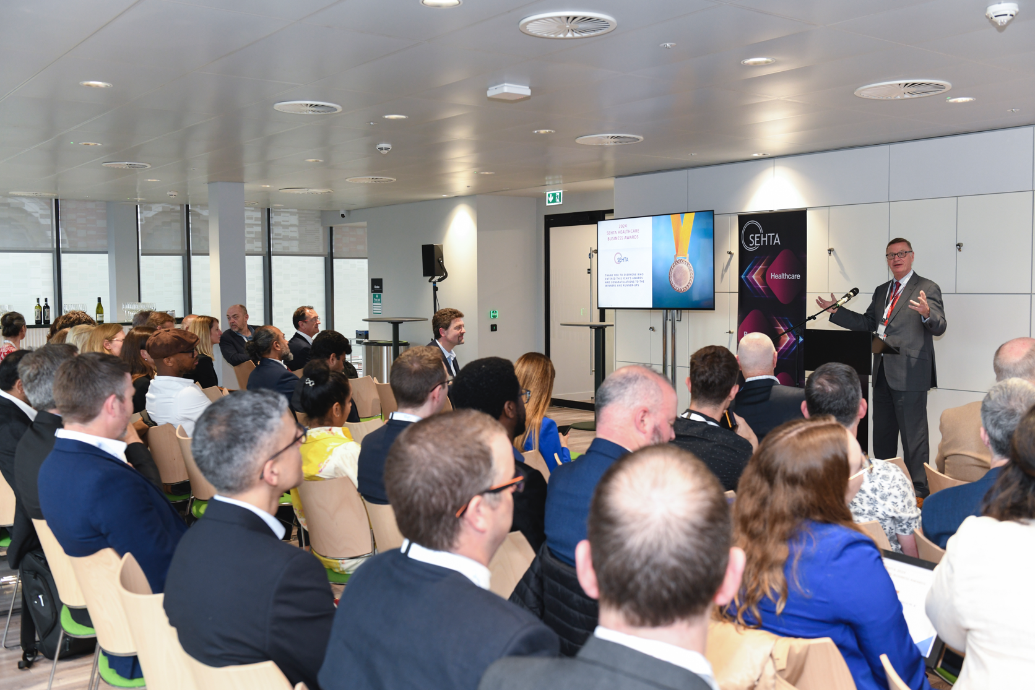
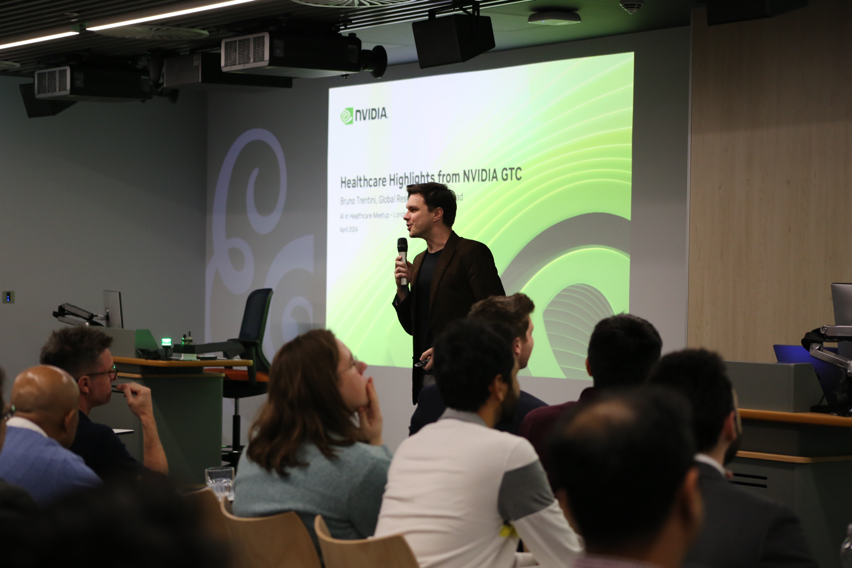
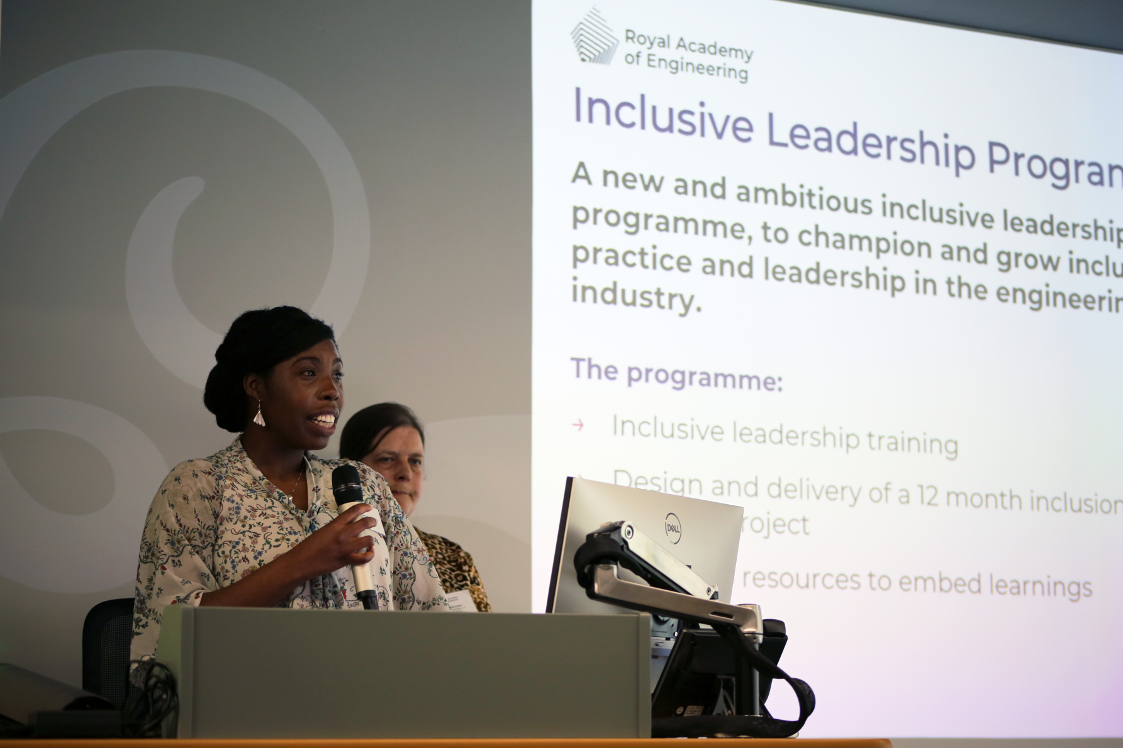

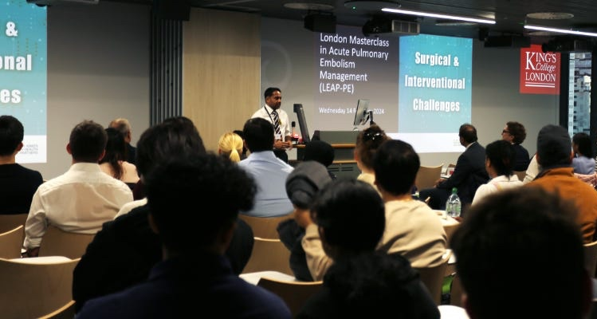
Bringing the MedTech community together
Notes:
In the first few months of the building opening we have hosted over 160 events, all dedicated to strengthening our ecosystem and driving impact.
We currently host the NVIDIA series of meetups in GenAI for Healthcare. We host the SEHTA industry awards. We host the KHP “Surgical Challenges” clinical and scientific education programme. We host the investor mixers of the BioCapital Network, introducing select startups. And we have hosted the RAENG Diversity Impact Programme.

Slide 18
LIHE’s unique position
An ecosystem dedicated to new medical device translation (incl. SaaMD)
Structured entrepreneurship programmes with fit-for-purpose tools
Uniquely collocating industry, startups, experts, and academics
Uniquely embedded in a hospital setting
Leveraging unique R&D and clinical facilities of the King’s MedTech Hub*
*Under ethics approval and/or research agreement with KCL/GSTT
Notes:
Once these components work seamlessly together, we will be able to make some bold statements about LIHE that will be validated.
First and foremost, LIHE is dedicated to medical device translation. Contrary to most other accelerators, including deep-tech ones, LIHE is entirely dedicated to MedTech (and this excludes BioTech), and this sets it apart from all the other efforts in London/UK/EU. Crucially, we are a not-for-profit, and our work and costs are to support and expand LIHE’s work.
Secondly, the acceleration program is structured to provide fit-for-purpose tools (QMS/Regulatory/Clinical Roadmap), which are not provided directly by any other accelerators. This is because providing such tools requires significant support and guidance.
So, thirdly, our experts will work closely with startups and spinouts to provide strategic support, as well as hands-on guidance and support. Importantly, there will be periodic review of progress on the use of the tools (i.e. is the QMS being populated and is it moving the company closer to filing for reg approval?). This progress review is sorely lacking in other programmes offering support of startups. The hope is that such periodic review will embed good MedTech practices into the startups to become professional MedTech companies.
Fourthly, LIHE is uniquely collocated within a hospital campus. Such proximity to clinicians (and through events organized at LIHE) will facilitate the understanding by the startups of the end-user needs, so crucial to new device adoption. Through KHP, there will be a very extensive network of interested clinicians, who companies can collaborate with under relevant research agreements/grants.
Finally, startups can have access to our research facilities and resources, including clinical data, where applicable. Again, this will be under ethics approval and may require a research agreement to be in place between the startup and KCL/GSTT.

Slide 19
Thank you

