Slide 1


Setting up in the UK
A Practical Guide
EBS Ltd
London, 12th November 2024

Slide 2



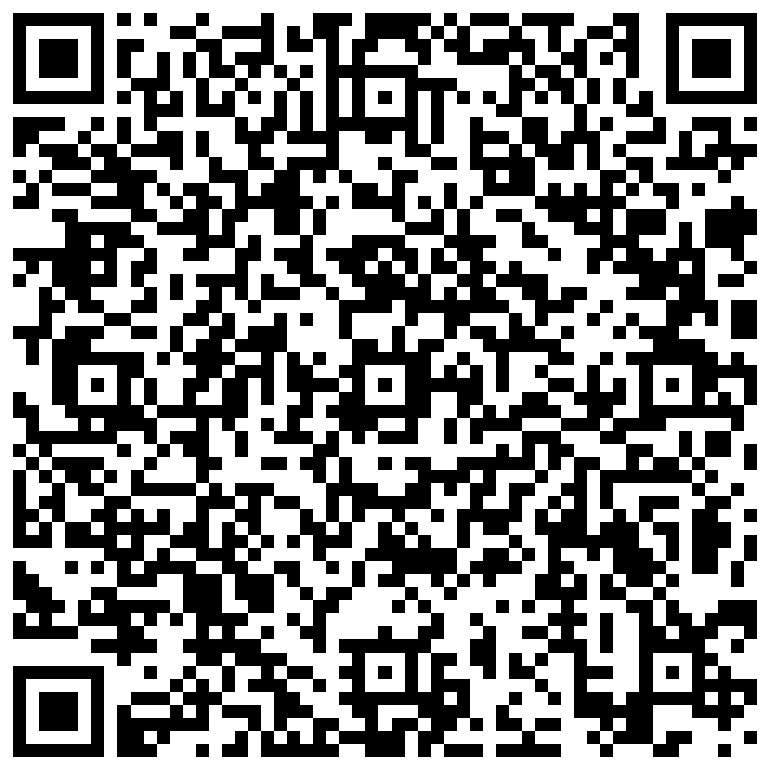
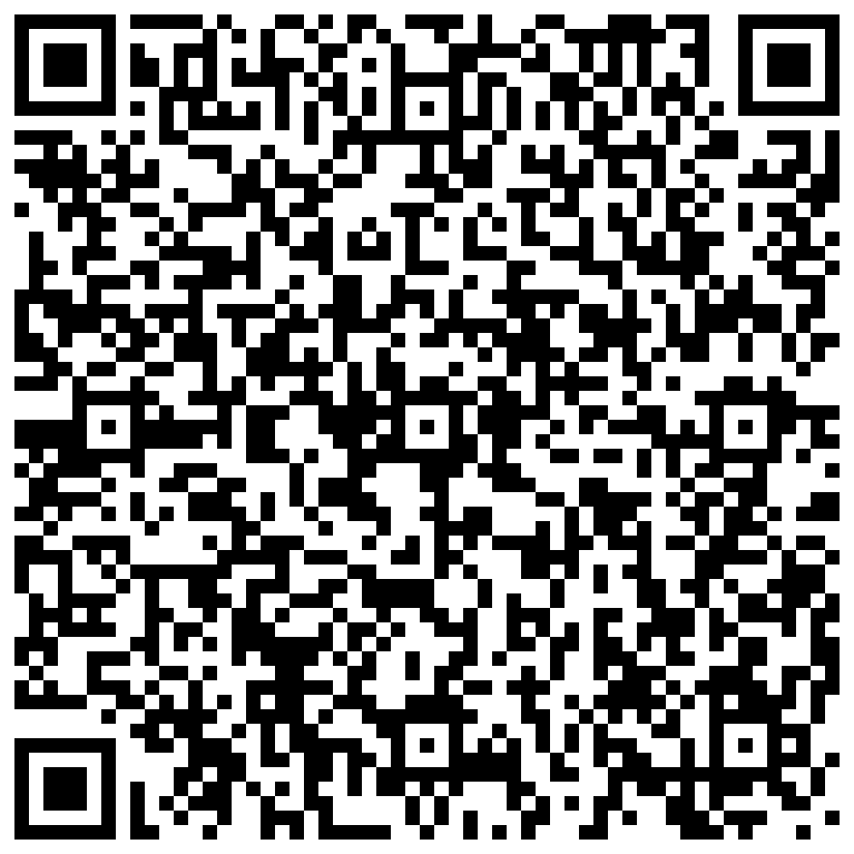
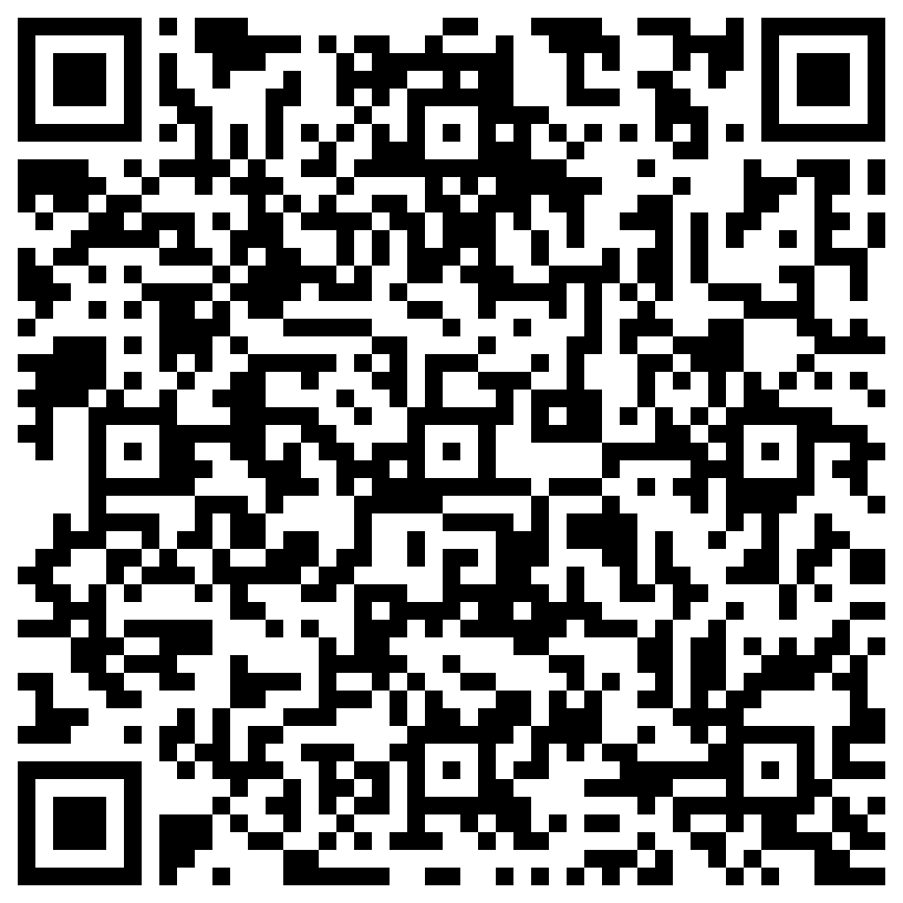
Our Team
Joe Williams
Karolina Staniak
Marcin Boron
Compliance Director
Business Development Director
Head of Expansion - Europe
+44 (0)1926 217744
+44 (0)1926 217748
+48 737 974 238
joe.williams@ebs.ltd.uk
karolina.staniak@ebs.ltd.uk
marcin.boron@ebs.ltd.uk
EBS Ltd, Innovation Centre, Gallows Hill, Warwick, CV34 6UW
www.ebs.ltd.uk
info@ebs.ltd.uk
+44 (0)1926 217700

Slide 3

European Business Solutions
Company formation, finance office, trading address, bank accounts, compliance services, insurance, car leasing and more.
Over 30 years’ experience, helping foreign-owned companies establish and grow in the UK market.
Licenced accountancy practice, member of The UK Investment Support Directory.

Slide 4
Establishing a Company in the UK
Each UK Limited company needs…
A company name
1 Shareholder
1 Director
Shareholders can be a person or another company
Directors can be of any nationality and can live in any country
Identify the Directors and any person ultimately controlling 25% or more

Slide 5
Establishing a Company in the UK
A company can…
A company does not need to…
Be formed in a few days
Visit the UK
Trade on the day it is formed
Specify the trade in the Constitution (‘Articles’)
Govern itself totally on paper – no physical meetings
No other registrations needed unless undertaking a regulated trade

Slide 6
Registered Office & Company Secretary
Registered Office
Company Secretary
Every company must have an official registered office address.
Keeps the Statutory Books up to date as required by The Companies Acts.
For companies formed in England, the Registered Office must be in England.
Files appointments and resignations of Directors or Secretaries with Companies House.
Registered office can be different to the place where the company normally does business.
Files Changes of Directors details, usually change of address, with Companies House.
Any official letters must be sent to Registered Office if they are to be effective.
Completes and files the Confirmation Statement to Companies House.
Registered office can’t be a P.O Box address.

Slide 7

UK Taxes
Corporation Tax
VAT
Shares
19-25%
20%
NO TAX
Tax Rate
(unless exempt)
on issue of new shares
Payable 9 months after year end.
Losses carry forward without limit, or back one year for a refund.
No tax on dividends received unless from a tax haven.
No withholding tax on dividends paid.
No withholding tax on professional services or fees.
Capital allowances.
Register if turnover exceeds GBP90k in any 12 months.
20% on most things.
Paid every 3 months.
0.5% Stamp Duty on transfer of shares. Exempt if GBP5 or less

Slide 8
Setting up in the UK according to EBS Clients
“ ”
Setting up business in UK is simpler. The whole process is user-friendly and no out of pocket expenses!!
- CFO, professional services & software development company
“ ”
As a start-up deep tech company we can enter the ecosystem through various portals. We could be part of multiple start up launch pads, get University and corporate partnership. This multi faceted approach helps to inject new technology into the market - a multi prong approach.
- CEO & Founder, tech company
“ ”
Very easy to do business in the UK. Starting a Private Limited Company took less than a week and there is far less paperwork and notices from government offices.
- Entrepreneur, founder of fintech companies
“ ”
I like EBS – they bring me solutions, not problems. Dealing with the UK is very simple for us.
- CFO, renewable energy company

Slide 9
Contact us
Joe Williams
Karolina Staniak
Marcin Boron
Compliance Director
Business Development Director
Head of Expansion - Europe
+44 (0)1926 217744
+44 (0)1926 217748
+48 737 974 238
joe.williams@ebs.ltd.uk
karolina.staniak@ebs.ltd.uk
marcin.boron@ebs.ltd.uk
EBS Ltd, Innovation Centre, Gallows Hill, Warwick, CV34 6UW
www.ebs.ltd.uk
info@ebs.ltd.uk
+44 (0)1926 217700

