Slide 1




Investing in the UK - embrace the
change
M&A landscape in the UK and key things to consider
when doing deals in the UK

Slide 2
Welcome speech
Andrzej Pośniak
Managing Partner
CMS Poland
Jennifer Tyldesley
Minister Counsellor
British Embassy Warsaw

Slide 3
M&A landscape in the UK and key legal issues to consider when doing deals
in the UK
Eva Talmacsi
Partner
CMS UK

Slide 4
M&A landscape in the UK - Poised for action
Global M&A activity in 2023 was impacted by heightened geopolitical conflicts, high inflation and interest rates and increased regulatory pressures (1).
In line with global trends the UK experienced a decrease in M&A activity in 2023, with the total deal value dropping to GBP 109.4 billion (from GBP 133.6 billion in 2022), and the number of deals reducing to 1,388 (from 1,592 in 2022) (2).
Despite this decline, the UK remained the most attractive destination in Europe for inbound and domestic M&A, and 3rd globally (3). Some industry views attributed this in part to the pound’s depreciation against other major currencies and the decline of the share price of UK-based companies.
(1) Source: Mergermarket
(2) Source: Mergermarket
(3) Source: Bayes Business School of London

Slide 5
Geographical Breakdown of inbound investment (2023)
North America: the largest M&A investor into the UK by both deal volume and deal value (765 deals; GBP 32.5bn) with most of this coming from US companies who alone were involved in 699 deals, contributing GBP 28.6bn.
Europe: European companies were involved in 607 deals and a reported deal value of GBP 28.7bn, with largest numbers of investments coming from France (117), Germany (112) and Sweden (72).
Asia: M&A deal volumes from Asian investors remained relatively stable in 2023, with deal value increasing by around 33% from GBP 18.2bn to GBP 24bn.
Middle East: 52 M&A deals by Middle Eastern Companies into the UK with a reported deal value of GBP 11.7bn. The majority of deal value made up of mega deal involving acquisitions of Dechra Pharmaceuticals valued at GBP 4.9bn as well as the acquisition of a 25% stake of Heathrow Airport Holdings valued at 2.4bn.

Slide 6
UK Inbound Deal Sector Overview (4)
Sectors | Deal Value (2023) (GBP) | Deal Volume (2023) | Deal Value Change (%) | Deal Volume Change (%)
Technology | 22.3bn | 540 | -20.9 | -8.31
Life Sciences | 15.6bn | 112 | 34.3 | 1.8
Energy & Natural Resources | 12.8bn | 88 | -51.5 | 3.5
Consumer & Retail | 9.1bn | 124 | 35.8 | -13.3
Real Estate | 5.2bn | 35 | -54.4 | -30
Transportation | 4.5bn | 42 | -41.6 | 16.7
Financial Institutions | 4.4bn | 112 | 46.7 | -1
Business Services | 4.4bn | 193 | -57.3 | -23.7
Industrials | 3.8bn | 163 | -71.6 | -1.2
Communications, Media & Entertainment | 2.7bn | 46 | -70.9 | 0.095
(4) Source: Mergermarket

Slide 7
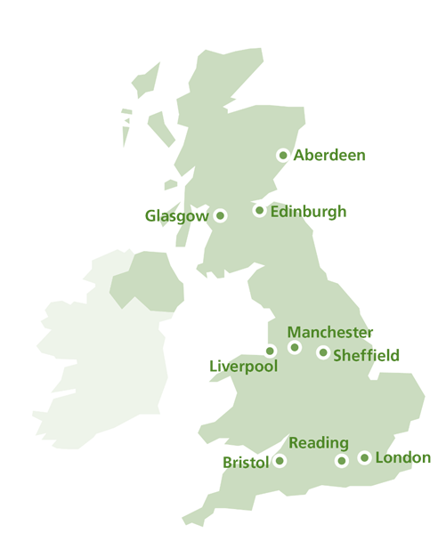
UK Inbound by Select Sectors (5)
 | Target | Acquirer | Deal Value (GBP)
Tech | Dechra Pharmaceuticals | EQT AB | 4.9bn
 | Abcam plc | Danaher Corp | 4.5bn
 | GSK plc (exclusive license for HS-20093) | Hansouh Pharmaceutical Group | 1.4bn
 | GKK plc (development and commercialisation of HS 200-89) | Hansouh Pharmaceutical Group | 1.3bn
 | Multipharma International (consumer healthcare brands) | iNova Pharmaceuticals | 424m
 | Target | Acquirer | Deal Value (GBP)
Life Sciences | ARM (10%) | Softbank Group | 12.5bn
 | Civica Holdings | Blackstone | 1.6bn
 | Reward Gateway | Edenred SE | 1.2bn
 | InstaDeep Ltd | BionTech SE | 562m
 | Mobica Ltd | Cognizant Technology Solutions | 250m
(5) Source: Mergermarket

Slide 8
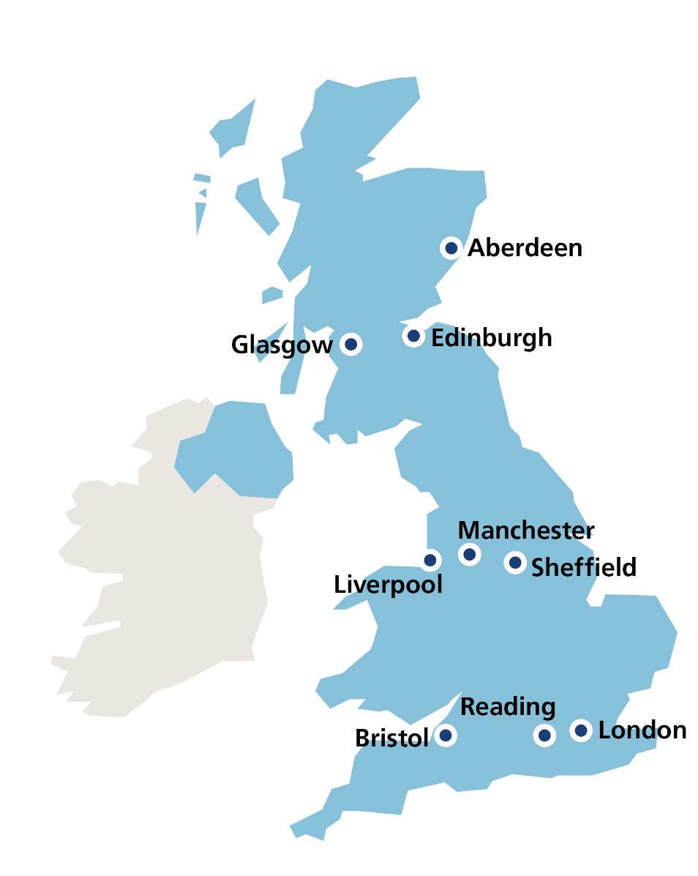
UK Inbound by Select Sectors (5)
 | Target | Acquirer | Deal Value (GBP)
Energy and Natural Resources | Neptune Energy (Neptune Global business except Germany and Norway) | ENI Spa | 2.0bn
 | Repsol Sinopec Resources UK | Danaher Corp | 1.7bn
 | Smart metering Systems plc | KKR & Co inc | 1.4bn
 | Power Station (3 wind farms) | RWE AG | 963m
 | Zenobe Energy Ltd | Equinor ASA | 870m
 | Orange Square Co | Kering SA | 3.0bn
 | Restaurant Group | Apollo Global Management | 1.2bn
 | Rocco Forte Hotels | Public Investment Fund | 534m
 | Hotel Choclat Group | Mars Inc | 506m
 | Snowfox Group | Zensho Holdings Co | 494m
(5) Source: Mergermarket

Slide 9
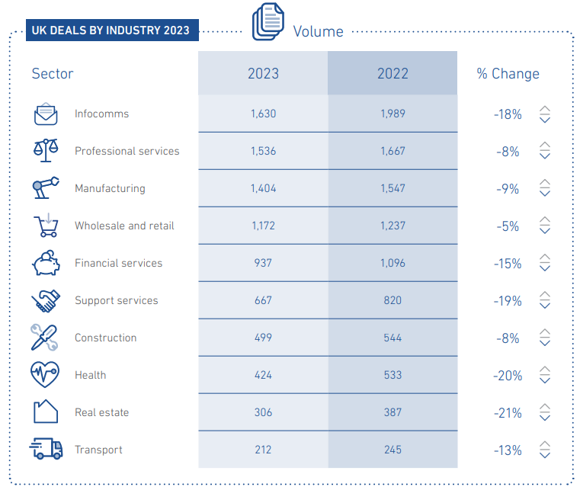
UK deals by Industry 2023 (6)
(6) Market IQ Report 2023 Full.pdf

Slide 10
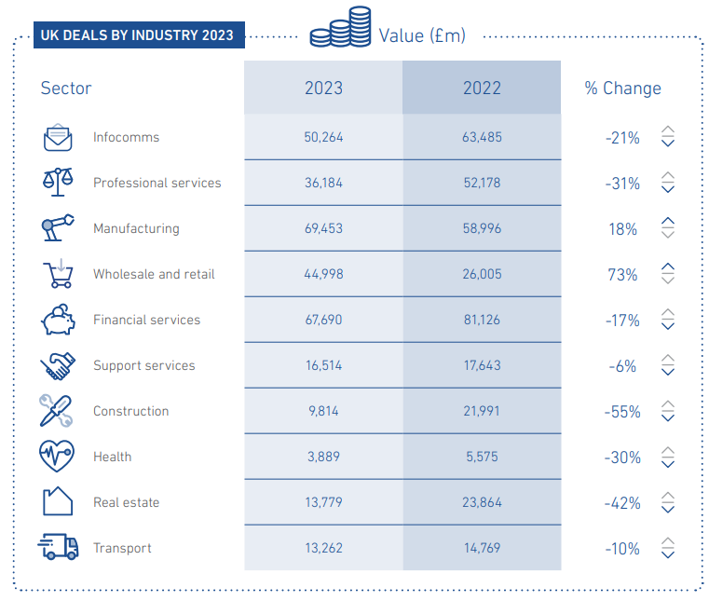
UK deals by Industry 2023 (6)
(6) Market IQ Report 2023 Full.pdf

Slide 11
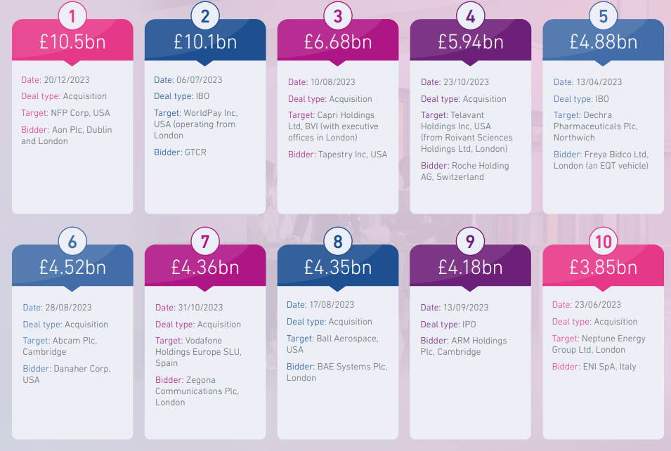
Top ten deals: UK (7)
(7) Market IQ Report 2023 Full.pdf

Slide 12
Key legal issues to consider for dealmaking in the UK
Eva Talmacsi
Partner
CMS UK

Slide 13
The UK National Security and Investment Act (NSIA) |
Key points
So what?
What?
Who?
When?
  Wide powers to call-in transactions and impose remedies
  Consequences of not making a mandatory notification:
    Void transactions
    Criminal penalties, up to 5 years imprisonment
    Civil/ Financial penalties
    Business: up to greater of £10 million or 5% of total worldwide turnover (including business owned/controlled by the offender)
    Individual: up to £10 million
  Stand-alone regime for national security screening
  Hybrid: mandatory and voluntary notification regime
  No definition of “national security” / opaque process
  No monetary thresholds
  Always assessed case-by-case
  Investment Security Unit (ISU) within the Cabinet Office screens
  Decisions made by Secretary of State
  SoS may ‘call in’ transactions within scope of regime
  Other government departments involved
  In force since 4 January 2022
  Applies retrospectively to transactions after 12 November 2020

Slide 14
Mandatory filing?
Is target a Qualifying Entity?
UK company, limited liability partnership, partnership, unincorporate association, trust, body corporate
A foreign entity could be captured
  If they carry on activities in the UK; or
  Supply goods or services to persons in the UK
Asset acquisitions not captured
Trigger Event?
Share held by acquirer increases to more than 25%, more than 50%, or to 75% or more
Voting rights held by acquirer increases to more than 25%, more than 50% or to 75% or more
Acquisition of voting rights to secure or prevent the passage of any class of resolution
  Minority veto rights – where the holder acquires the right to vote on “all or substantially all matters governing the affairs of the entity”
  Excludes contractual veto rights

Slide 15
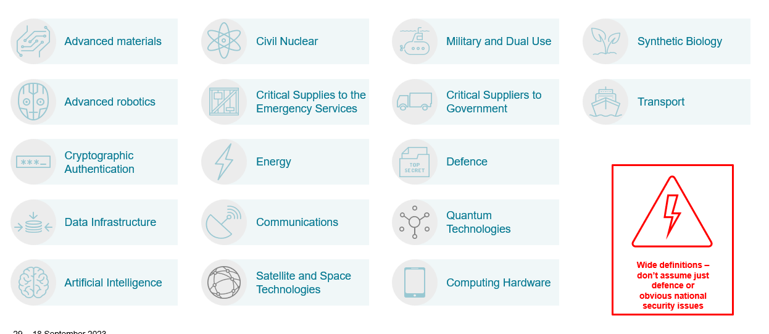
Mandatory sectors

Slide 16
Notification process and timescales
Final notification
Call-in notice
Notification and
initial review
Final order
No further action
Initial screening
Assuming notification accepted, max 30 working days for decision.
National security assessment
Detailed review, in up to 30 working days, which may be extended by a further 45 working days or if more time needed, by agreement between parties.
Power to request information / compel attendance of witnesses

Slide 17
Remedies
A final order can impose any necessary and proportionate remedies to prevent, remedy or mitigate a national security risk.
  Could include e.g. ownership, governance, access rights or disposal / prohibition
  May combine conditions / voluntary undertakings, formalised in an order.
If national security concerns identified, SoS will consider representations on remedies before making a final order

Slide 18
Merger Control in the UK – a voluntary regime
CMA entitled to review both anticipated and completed mergers where either:
  Turnover Test: UK turnover of Target exceeded £70m in last financial year
  Share of Supply Test: Acquirer + Target will jointly account for at least 25% of goods or services of a particular description supplied in all (or a significant part) of the UK
  NOTE: amended threshold tests included in Digital Markets, Competition and Consumers Bill –2024
Filing is voluntary but issues to consider before deciding not file include:
  What are the competitive overlaps between the parties?
  Will the transaction receive publicity? Likely complaints?
  Can you bear the risk of a post-completion investigation
  What is the deal timing (UK has very long phase I clearance period)
CMA can be ‘creative’ in claiming jurisdiction over deals that it sees as potentially problematic

Slide 19
Merger Control in the UK – the risk of not filing
The reality
CMA actively monitors non-notified deals
Enquiry letter sent to parties with request for information
If investigation launched, CMA will impose a hold-separate order (IEO) preventing any further integration
Creates significant practical difficulties
If merger found to raise substantive concerns, CMA can order divestment of acquired business
Can you avoid it?
Briefing paper to Mergers Intelligence Committee of CMA prior to completion
Get the clock started at completion – issue a press release
Parties will need to agree allocation of regulatory risk
Alternative structuring options

Slide 20
Tax considerations
The slide shows current tax rates and subject to potential changes
Share Sale Subject to certain exceptions, stamp duty and/or stamp duty reserve tax is payable on a share sale, at the rate of 0.5% of the consideration paid for the shares. A copy of the executed stock transfer form must be submitted electronically and payment of the stamp duty made to HMRC. HMRC can then check and confirm that, following due receipt of the stock transfer form and payment, the stock transfer form is treated as duly stamped.
Asset Sale Stamp duty land tax is payable on a transfer of real estate. It is charged as a percentage of the amount of consideration paid and allocated to the real estate, at the following rates for commercial real estate (different rates apply to residential real estate): The portion up to GBP150,000: nil. Any portion over GBP150,000 up to GBP250,000: 2%. Any portion over GBP250,000: 5%. If a new leasehold interest is granted to a buyer (instead of transferring an existing interest in land), duty is charged on the "net present value" of the rents reserved under the lease (according to a formula set out in the relevant legislation): The portion up to GBP150,000: nil. Any portion over GBP150,000 up to GBP5 million: 1%. Any portion over GBP5 million: 2% Stamp duty land tax is also payable on any premium paid on the grant of the lease, at the rates set out above for commercial real estate.

Slide 21
Other important developments - ESG
Increased focus on the part of regulators, investors and customers on environmental, social and corporate governance (ESG) considerations => greater scrutiny by bidders on such matters during their due diligence of targets. (E.g., bidders are examining target companies’ ESG history to assess risks relating to reputation, shareholder activism and potential litigation.) To support their diligence, bidders are increasingly pushing for the inclusion of ESG-specific warranties in sale and purchase agreements.
Negotiations of such warranties with the sell-side may be complicated by the use of transaction insurance as primary recourse for breach of warranties with a low or nominal liability cap for the warranties, as such insurance may be difficult to obtain for ESG-specific warranties. As a minimum, insurers will want to see robust diligence conducted on ESG.

Slide 22
Finding, negotiating and making
an acquisition in the UK
Ran Carmon
Managing Director
Chelsea Corporate

Slide 23



Slide 24

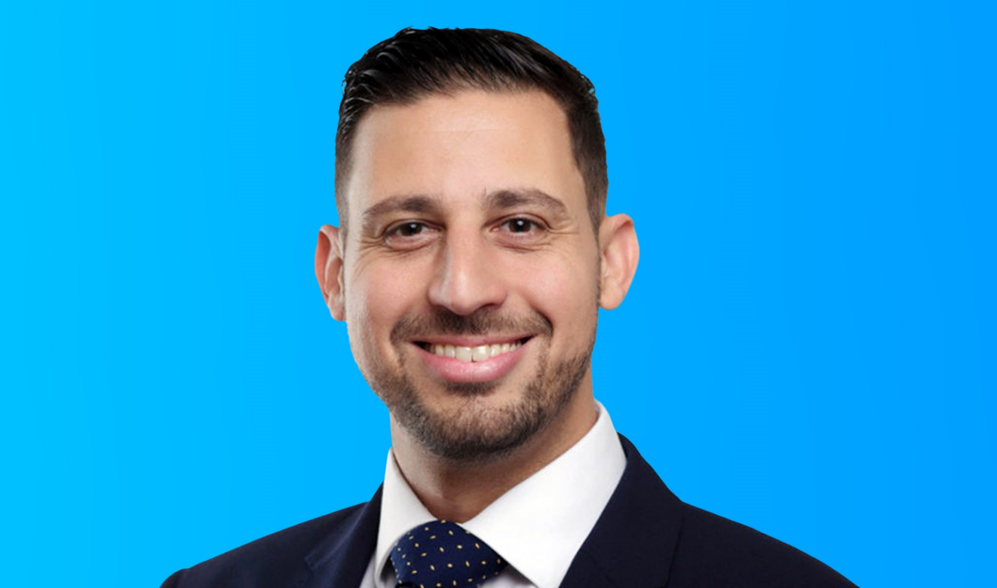
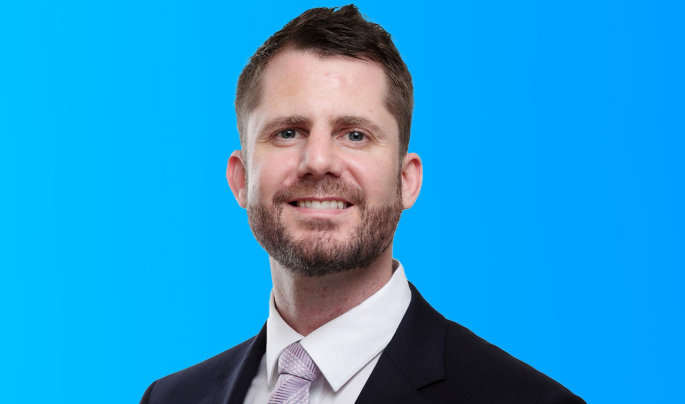

Ran Carmon
Chief Executive Officer
Thomas Biley
Chief Finance Officer

Slide 25


Question
Who has bought a business?

Slide 26
Topics covered today:
Deal origination and negotiations
The UK market post Brexit and COVID
Checklist for initial due diligence

Slide 27

01
Buy a business workshop – Warsaw 2024
Department for Business and Trade
Deal origination and negotiation
How to find UK deals
The difference between ‘on market’ and ‘off market’ opportunities
Why 80% of the deals we do never come to market?

Slide 28
02
Buy a business workshop – Warsaw 2024
Department for Business and Trade
The UK market post Brexit & COVID
The lending landscape
Baby boomers are becoming appropriate targets
UK businesses have become more open to being acquired by eastern European companies.

Slide 29
03
Buy a business workshop – Warsaw 2024
Department for Business and Trade
Checklist for initial DD
Deal checklist
Staff
Target company & additional information
Clients
Funding profile
Transaction
Documentation
Working capital

Slide 30
04
Buy a business workshop – Warsaw 2024
Additional
Questions
Details of any relatives or personal connections of the shareholders or directors transacting or providing services to, or customer of the business?
Does the owner also own competing businesses, customers, or suppliers?
Is the company, or are the directors subject to ongoing litigation?
Is there a lease on the building, and if so, does it allow for a sublet? Is there a dilapidation clause in the lease?
Does the business require any specific licence to operate?
When does the current lease end? Is there an option of renewal or break clause?
Does the business hold any stock? If so, is there any aging inventory over 90 days? If so, how much of the stock is older than 90 days?
Department for Business and Trade

Slide 31
05
Buy a business workshop – Warsaw 2024
Department for Business and Trade
Additional
Questions
Can the business support more sales? If so, at what point would you have to recruit additional members of staff to handle the growth?
Have you got up to date management accounts, and accounts from the last 3 years? Including a present balance sheet and profit and loss.
What debt is to be settled on completion, and what debt is to be taken over by the buyer?
Will the change of ownership impact lending, clients, or staff in anyway? Are there any change of ownership clauses in existing contracts?
Is there any debt in the target? Does the business require invoice discounting? If so, what level, and with whom?
Is the target in administration? If so, is there an IP involved?
Are there any CCJs, mortgages, security or personal guarantees against the target?

Slide 32

Any questions?

Slide 33
Thank you

Slide 34
Financing international expansion with Polish International Development Fund
Piotr Kuba
CIO
Polish International Development Fund

Slide 35


Polish International Development Fund
Providing co-financing for foreign investments from Polish companies
Warsaw, April 2024

Slide 36




Polish International Development Fund - PFR TFI
PFR TFI manages two specialized funds supporting international expansion - the Polish International Development Fund CEF and the Polish International Development Fund 2 CEF. The funds co-finance international investments from Polish companies by providing equity and debt funding.
The first fund was launched in 2016 and has completed its investment period. The latter started in 2023. In total, both funds have already invested or committed to invest more than €200 million in foreign projects conducted by Polish companies. To date,
20 investments have already been made.
Foreign direct investments from Polish companies support development and help integrate best practices.

Slide 37









Investment strategy
The Polish International Development Fund 2 CEF co-invests with a Polish company directly into a foreign subsidiary and shares the risk of a foreign project
Typically, the investment agreement is concluded for
a period of 5 to 10 years
The fund supports international greenfield and brownfield projects including:
acquisition of a competitor or a distributor
brand acquisition
construction of a plant, warehouse
The fund is a minority investor
Operational management remains in the hands of a Polish partner
Typical fund ticket:
€3 million – €20 million
The fund is both sector and geography agnostic in its investments
The fund provides:
loans
equity
The expected rate of return depends on the risk of the project, country, and selected financial instrument

Slide 38





Investment process
1
2
3
4
Project appraisal
1-2 months
Terms agreement
Financing
5-10 years
Contact
Discussion on initial assumptions
Preliminary analysis to committee’s approval
Detailed analysis to committee’s approval
Investment agreement
Operational stage and monitoring
Preliminary concept review
Fund presentation
Concept and scope of the project
Polish partner’s competences and experience
Polish partner’s audited financial statements
Polish partner’s ownership structure
Initial project financing structure
KYC, AML, reputation risk verification
Full business plan
Market analysis
Project’s ownership structure
Project managers’ competences
Financial projection (10 years)
Compliance with the fund’s social responsibility policy
Legal opinions
Conditions precedent fulfillment
Disbursement
Periodic reporting
Cooperation on the supervisory board
Additional financing
Exit

Slide 39
Typical structures of transaction
PP
(Polish company)
FEZ
(Polish International Development Fund)
EQUITY
50,1%
49,9%
Foreign company

Slide 40
Typical structures of transaction
PP
(Polish company)
FEZ
(Polish International Development Fund)
EQUITY
50,1%
49,9%
SPV
Transaction no 1
Transaction no 2
Transaction no 3

Slide 41
Typical structures of transaction
PP
(Polish company)
FEZ
(Polish International Development Fund)
100%
DEBT
Foreign company

Slide 42
Typical structures of transaction
FEZ
(Polish International Development Fund)
PP
(Polish company)
100%
SUBORDINATED
DEBT
Foreign company
Bank
SENIOR
DEBT

Slide 43
Fund investments to date
Germany – 6 projects
USA – 6 projects
Croatia – 2 projects
Romania – 2 projects
Czech Republic
Greece
Lithuania
Luxembourg
[0 to 100[
1
[100 to 200[
[200 to 300[
[300 to 400[
400+
1
400+
[0 to 100[
Lithuania
400+
[100 to 200[
400+
[200 to 300[
400+
[300 to 400[
Germany
400+
400+
USA
400+
Czech Rep.
1
400+
Luxembourg
400+
400+
400+
Romania
1
Croatia
Greece
Number of investment projects: 19
Fund’s total investment:
€110+ million
Total investments
from all parties:
€310+ million
Projects in 8 countries
Malta
Zaangażowanie
> 100 mln euro

Slide 44










Polish International Development Fund CEF – selected transactions
Czech Republic
€4.3 m
Loan
2022
Romania
€6.5 m
Loan
2022
IT
USA
Equity +
Loan
2022
Residential developer
Germany
€3.0 m
Loan
2022
Intermodal transport
Germany
€10.0 m
Equity
2021
Recycling, urban mining
USA
$6.0 m*
Equity
Investment: 2021
Exit: 2023
Recycling, urban mining
USA
$1.3 m*
Equity
Investment: 2021
Exit: 2023
Residential developer
Germany
€7.0 m
Loan
2021
Construction (prefabrication)
Germany
€2.9 m
Equity
2020
Recycling, urban mining
USA
€2.8 m
Equity
Investment: 2019
Exit: 2023
Agricultural machinery
USA
€1.8 m
Loan
2019
IT
Croatia
€0.9 m
Loan
Investment: 2019
Exit: 2022
Hotels, tourism
Greece
€9.0 m
Equity
2019
Recycling, urban mining
Germany
€2.3 m
Equity
Investment: 2019
Exit 2023
IT
Romania
€2.1 m
Loan
Investment: 2018
Exit: 2022
Recycling, urban mining
Lithuania
€5.3 m
Equity
2017
Logistics
Croatia
€7.8 m
Equity
Investment: 2016
Exit: 2023
*in cooperation with PFR Investment Fund CEF

Slide 45



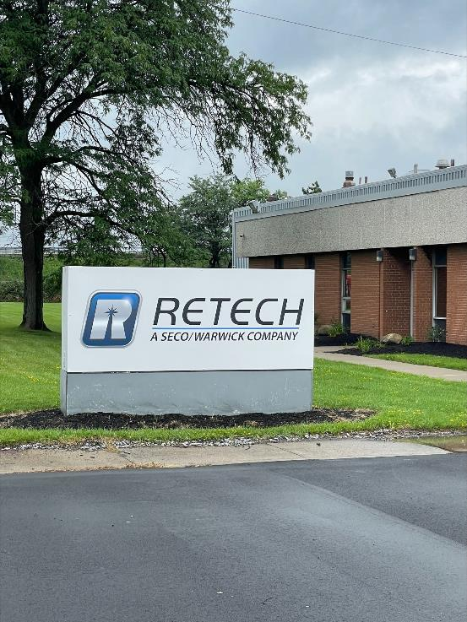
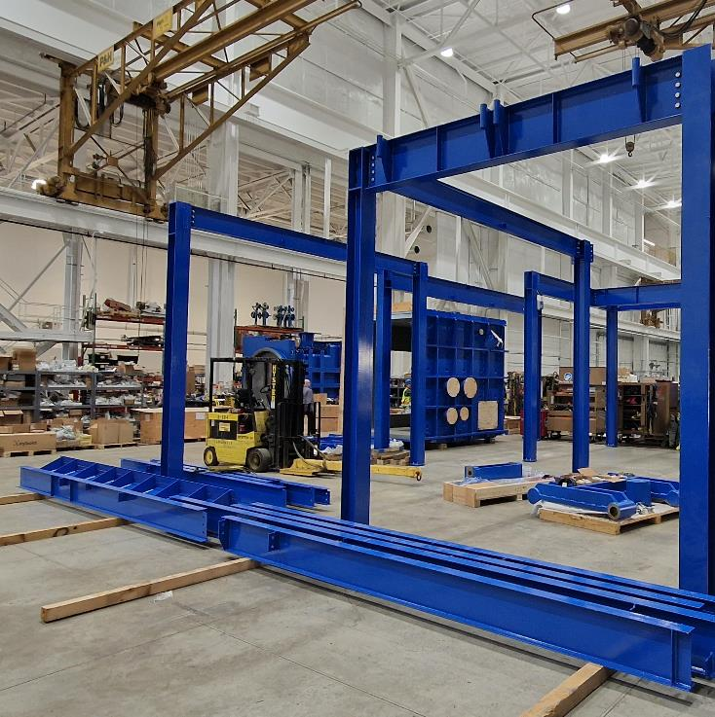
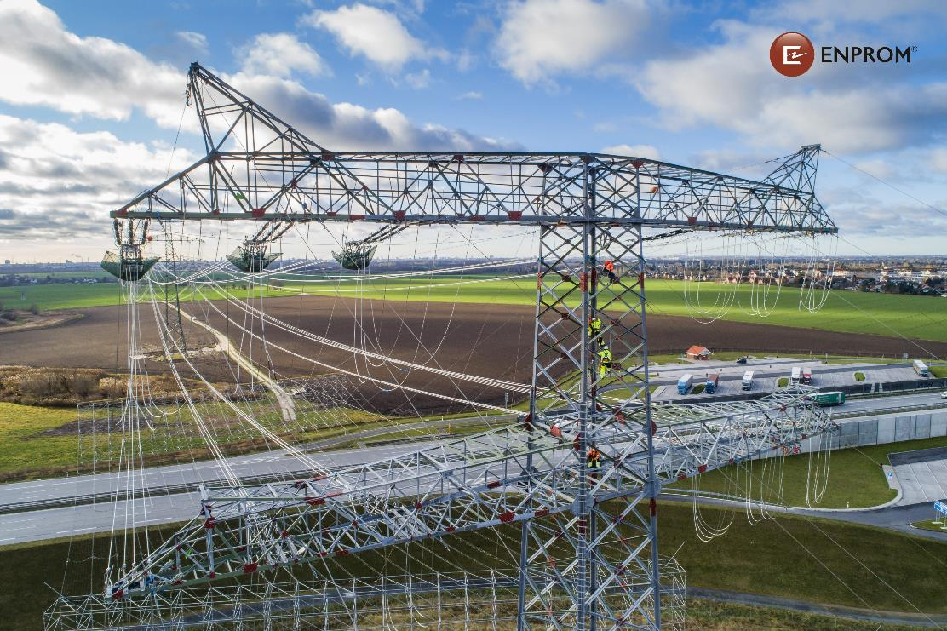
Polish International Development Fund 2 CEF transactions
USA
$10.0 m.
Loan
2023
Germany
€ 3.1 m.
Loan
2023

Slide 46



The fund’s social responsibility policy is based on the principles of sustainable development as defined by the United Nations (UN Global Compact - The 10 Principles)
Investing
responsibly
Areas of particular concern to the fund are:
respect for human rights
respect for employee rights
countering corruption
countering climate change
Social responsibility policy of the Polish International Development Fund
When embarking on an investment project, the fund cooperates with a Polish partner to identify and characterize socially sensitive areas, as well as identify key stakeholder groups. A corporate social responsibility strategy is developed and implemented for each project company

Slide 47
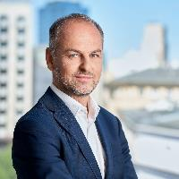
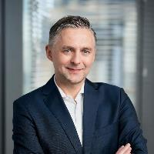
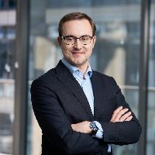
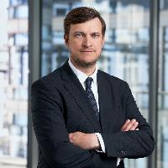

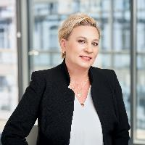
Team
Marcin Prusak
Head of the Investment Department
Marek Buczak
Fund Manager, Investment Manager
Marcin Ciesielski, ACMA, CGMA, CIIA
Fund Manager, Investment Manager
At PFR TFI since 2023. Oversees fund management and the work of the investment department. Manager with more than 20 years of experience in the financial market in structured finance, project finance, M&A transactions, and corporate banking.
In the fund since 2023. He has 20+ years of experience in capital markets. He started his career at DWS Investment GmbH in Frankfurt. Long-time fund manager at DWS Polska TFI and Quercus TFI. He has extensive knowledge of equity and bond markets, the characteristics of foreign investments, and corporate finance.
At PFR TFI since 2020. Working in capital market since 2018. He has been responsible for overseeing portfolios of closed-end investment funds, including private equity/venture capital and managing the funds' own investments in public companies. Licensed investment advisor and CIMA member.
Wojciech Jabłoński
Investment Manager
Katarzyna Kutrzepa
Legal Advisor
Joanna Glinicka
Senior Specialist
In the fund since 2018. She has more than 15 years of experience in transaction advisory gained at KPMG in Poland and abroad. She has worked on all aspects of the structured investment process, including due diligence and preparation of transaction documentation. She has advised recognized companies and investors on corporate matters and in investment processes. Member of the Warsaw Regional Bar Association.
In the fund since 2019. He is responsible for the entire investment process - from sourcing deals, negotiating, preparing transaction documentation to overseeing projects.. Seasoned manager with 13 years experience in the financial market and expertise in managing investment funds. Cooperated in the creation and management of dozens of investment funds.
At the fund since 2020. At PFR TFI since 2016, where she has been responsible for administrative and backoffice processes. She has more than 20 years of experience in transactional documentation, cooperation with management bodies, coordination of transactional, and administrative processes. Previously, she has worked in financial institutions, including Millennium Leasing.

Slide 48

Thank you

Slide 49
Investment insurance for foreign direct investments
Ewelina Mazur
Transaction Manager
Bank Gospodarstwa
Krajowego
Adam Grzybowski
Head of the Political Risk and Investment Insurance
KUKE

Slide 50


Export and Expansion Financing
Bank Gospodarstwa Krajowego
Polish Development Bank
Warsaw, 2024
www.100lat.bgk.pl

Slide 51
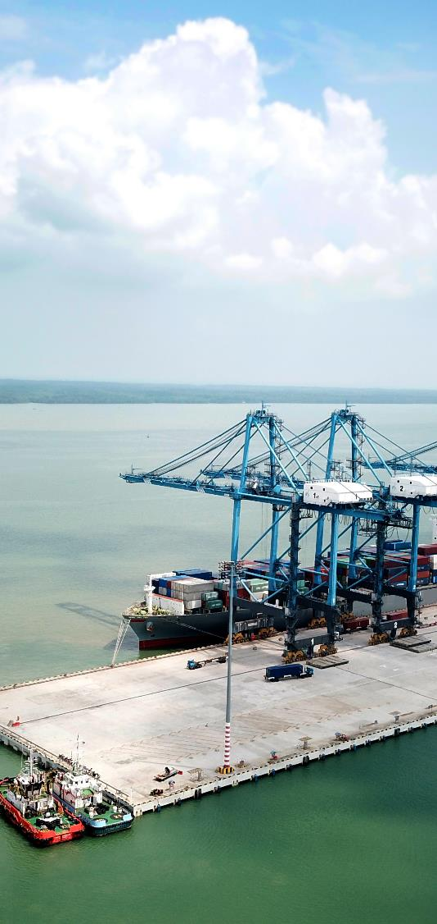
BGK’s role
  Polish Development Bank established in 1924
  100% state-owned
  Fitch rating: A-/stable, equal to the Republic of Poland
  Established by the BGK Act to support the government’s social and economic programmes
  16 corporate branches in Poland and 4 foreign offices in Brussels, London, Frankfurt and Amsterdam
  Equity: 8,29 billion EUR (3Q2023)
  Assets: 52,57 billion EUR (3Q2023)
BGK mission: Supporting social and economic development of Poland and the public sector in the fulfilment of its tasks.
A financial partner actively involved in the support of entrepreneurship and efficient use of development programmes.
Initiator and participant of the cooperation initiatives between business, the public sector and financial institutions.

Slide 52
Financial support for Polish Exporters/Investors
Financial instruments of BGK: a unique offer
 | government programme Financial Support for Exporters | investment support | suplementary instruments of support for exporters
long-term (over 2 years) | buyer’s credit purchase of receivables buyer’s bank credit | structured credits for financing of international expansion of Polish companies | credits for investments with ECA cover working capital facility with ECA cover (up to 2 years) supply chain financing cross-boarder gurantees guarantess and letters of credit lines
short-term (up to 2 years) | Letter of Credit: confirming discounting post-financing export pre-financing

Slide 53

Foreign investments and expansion
Polish company as an investor
Credit for a Polish company financing foreign investments / acquisitions
Main characteristics | Financing of projects such as foreign investments and acquisitions. Polish corporate group or an enterprise as the main foreign investor. Possible cooperation with Polish and foreign commercial banks.
Financing type | Long-term investment financing, based on a Polish investor’s financial standing / foreign entity or the project’s assets
Credit amount | Assessed case-by-case, according to the profile of the transaction, min. 5 m EUR
Costs of financing | Reference rate + margin Arrangement fee Commitment fee
Securities | Standard and according to the financing type, including: assets-based (of the project / acquired company) collateral, KUKE insurance policy.

Slide 54

Foreign investments and expansion
Foreign acquisition financing scheme 1/2
Main characteristics:
financing based on the balance of a Polish investor,
collateral based mainly on the assets of the Purpose of Acquisition (after the acquisition),
possible additional collateral on assets in Poland.
Cash flow
3 Credit disbursement
Documents flow
Seller
6 Repayment
5 Guarantee and other collaterals
4a Changes of ownership
2 Credit Agreement
Polish
Investor
Example transactions:
Fixed assets acquisition financing in Italy by Wielton S.A.
Acquisition financing in Spain for BIBP Sp. z o.o.
Acquisition financing in the United Kingdom for Amica Wronki S.A.
4b Acquisition
Purpose of Acquisition
1 Sale and
Purchase Agreement

Slide 55
Foreign investments and expansion
Foreign acquisition financing scheme 2/2
Cash flow
Document flow
4a Changes of ownership
Main characteristics:
financing based on the balance of the Polish Investor,
collateral based primarily on foreign assets,
possible additional collateral on assets in Poland.
Purpose of the Acquistion
Seller
6 Repayment
4b Asset
acquistion
2 Credit Agreement
5 Guarantee and other collaterals
3a Credit disbursement)
3c Settlement of
the Acquisition
Example transactions:
Financing of fixed assets purchase in France.
Foreign Subisdiary
Polish
Investor
1 Sale and Purchase Agreement
3b Cash flow

Slide 56
Foreign investments and expansion
Financing scheme of a foreign investment 1/2
Main characteristics:
project financing (collaterals based on the assets of the SPV),
SPV as a borrower,
recourse to a Polish entity,
financing dedicated for investments.
Cash flows
6 Repayment
Documents
3 Guarantee
4 Securities
2 Credit Agreement
5 Credit disbursement
Example transactions:
Financing of a galvanised products factory in Germany for Boryszew Oberflächentechnik Deutschland GmbH.
Financing of hydrocarbon exploration project in Canada by ORLEN Upstream Canada Ltd.
Financing of hotel construction projects by a Polish investor.
SPV/Foreign subsidiary
Polish
Investor
1 Shares

Slide 57

Foreign investments and expansion
Financing scheme of a foreign investment 2/2
Cash flow
2 Securities
Document flows
Main characteristics:
project financing,
SPV as a borrower,
recourse to the Polish entity,
financing dedicated for investments.
Foreign subsidiary
Foreign subsidiary
5 Credit repayment
1 Credit Agreement
3 Credit dsibursement
Foreign subsidiary
Polish
Investor
Example transactions:
Financing of production facilities development by Boryszew S.A. in China, India and Mexico.
4 Cash flow

Slide 58















Financing expansion
Norway
Reserve based credit
USA
Acquisition
financing
Brazil, the Netherlands Production plant construction
China, India, Mexico Production plant construction
Greece
Hotel construction
43 m USD
4 m USD
100 m EUR
27 m EUR
15,5 m EUR
Great Britain
Acquisition
financing
Hungary
Acquisition
financing
USA
Acquisition
financing
France
Acquisition
financing
Great Britain
Hotel construction in Luton
220 m PLN
7,5 bn HUF
6 m USD
6 mln EUR
17 m GBP
Great Britain
Hotel construction in Edinburgh
Italy
Acquisition
financing
Chile
Mining
Germany
Production plant construction
Spain
Acquisition
financing
8,5 m GBP
3,5 m EUR
700 m USD
21 m EUR
3,9 m PLN

Slide 59

Bank Gospodarstwa Krajowego
Al. Jerozolimskie 7, 00-955 Warsaw
Temporary correspondence address:
Varso 2
73 Chmielna Street, 00-801 Warsaw
International Expansion and Trade Finance Department
Foreign Expansion Office:
e-mail: ekspansja@bgk.pl
Trade Finance Relations Team:
e-mail: RelacjeFH@bgk.pl

Slide 60

Insurance of
- direct investment abroad
- financing of such investment
Support for Polish exporters in their foreign expansion
April 2024 / Warsaw

Slide 61
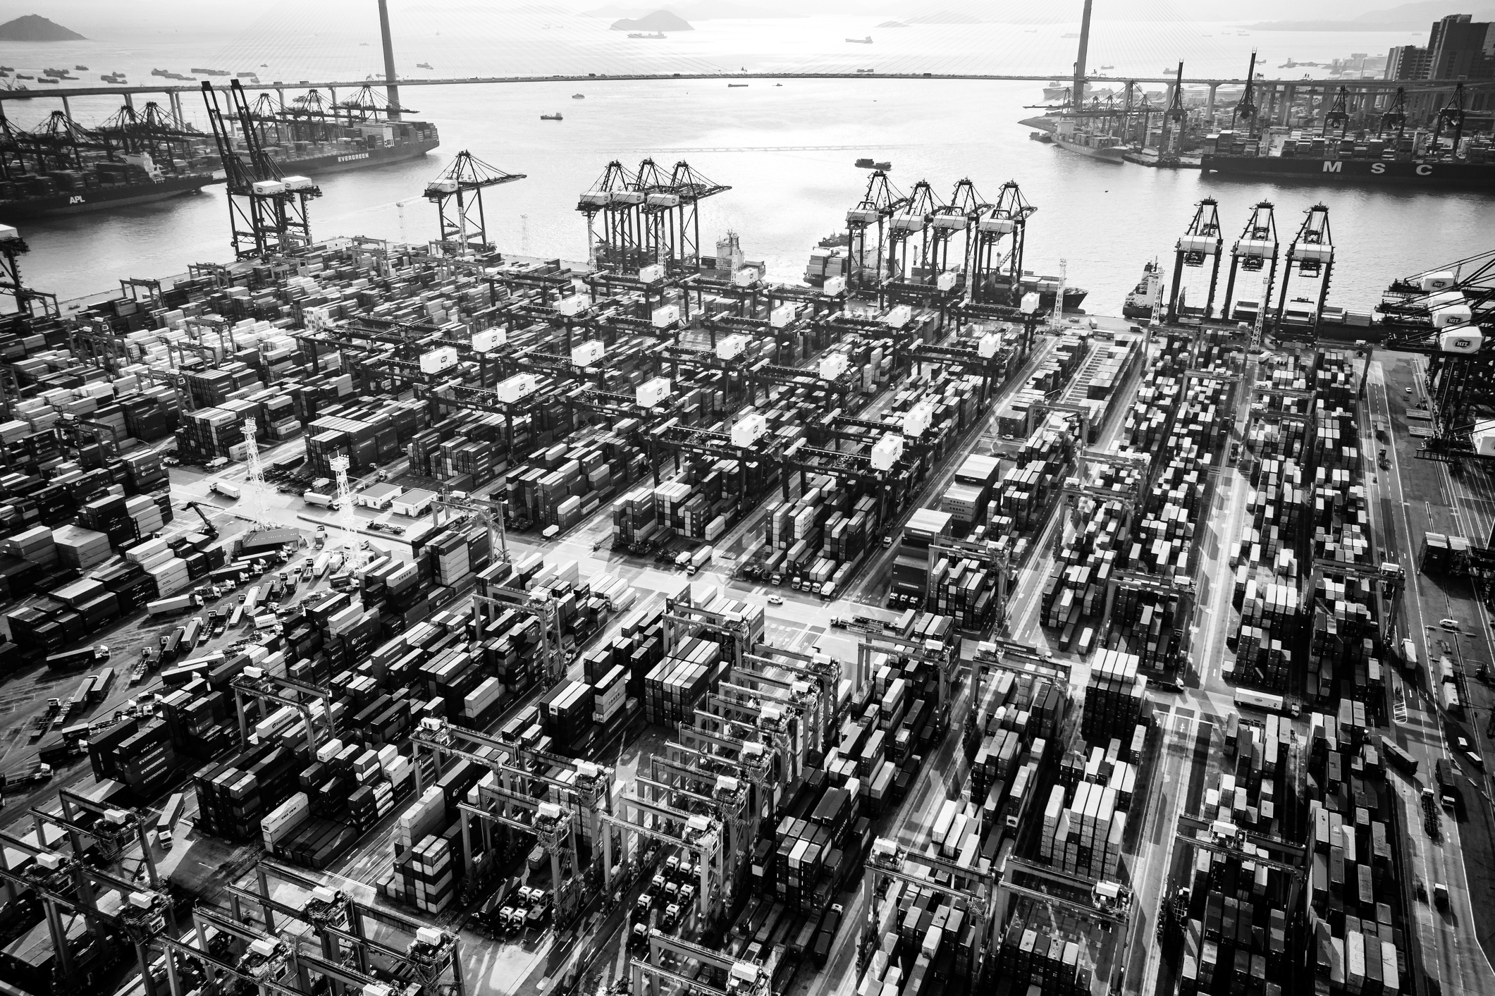


KUKE is the official
Polish export credit agency
Since 1991, we have been managing
and taking on risk associated with trade.
Currently our cover spans over 200 export markets – from Canada to Indonesia and from Norway to South Africa.

Slide 62


Who we are?
Over 30 years supporting Polish companies in the expansion abroad
100% of shares held (directly and indirectly) by the State Treasury
We are a part of Polish Development Fund
The only institution in Poland authorized to provide export insurance backed by the State Treasury, i.e. KUKE is a Polish ECA (export credit agency)
Global cooperation – member of the Berne Union since 1999, re-insurance and co-operation agreements with other ECAs
We facilitate access to external financing, among others through our factoring company KUKE Finance
Dedicated staff of more than 200 professionals working in Warsaw and five regional offices across Poland

Slide 63

What can be the subject of the loan?
Direct Investment Abroad (IBZ)
is an investment cared out to establish a direct economic ties manifested in the running of a business, including a branch or a representative office registered abroad provided that it has separate capital and assets in the investor financials books.
Loan can be disbursed to investment abroad in many ways. Possible ways of direct investment abroad:
acquisition of a foreign company or its organised part;
establishment of a company abroad;
additional contributions and granting of loans by shareholders;
acquisition of real estate and other fixed assets abroad in connection with a business conducted abroad.

Slide 64
Solutions available:
1. Insurance od direct investment abroad (IBZ)
In this solution we cover the investor's documented capital expenditure against political risks and force majeure (including war)
2. Insurance of loans financing direct investment abroad (IBZ+)
In this solution we can cover the financial institution against commercial risks in connection with the financing of direct investment abroad
3. Synergy of both solutions
A comprehensive solution enables full coverage against all risks. The insurance of direct investment abroad granted to the investor becomes a security for a loan granted to finance this investment by a financial institution

Slide 65

Transaction scheme with a participation of KUKE (IBZ)
Foreign investment
capital
Investor
Insurance premium
KUKE
Insurance

Slide 66

Example of a transaction scheme with KUKE (IBZ+)
Borrower
Investment abroad
capital
loan
insurance premium
Bank
KUKE
insurance

Slide 67
Upon the occurrence of nonpayment of the loan KUKE pays indemnity to the bank (IBZ+)
Borrower
Payment default
Bank
KUKE
indemnity

Slide 68

Thank you we look forward to working with you
Finding possibilities
This presentation (the "Presentation") constitutes exclusively promotional material concerning product solutions offered by KUKE S.A. (the "Company"), prepared by the Company.
The Presentation does not constitute an offer of sale and is purely promotional in nature and under no circumstances constitutes an incentive or basis for making a decision to purchase a particular product solution. The information contained in the Presentation is for informational purposes only and is based on sources that the Company believes to be reliable and tried-and-tested. The information provided may be updated, supplemented, corrected or amended, and such changes may be material. The Company makes no representations or warranties, express or implied, as to the correctness, completeness or reliability of the information or opinions contained in the Presentation and shall not be liable for any decisions taken on the basis of such information or opinions. Any opinions contained in this Presentation reflect the assessment made as at the date of this Presentation and are subject to change without notice. The Company does not undertake to update or correct this Presentation or the information and data on which it is based. The risk associated with the use of information presented in this Presentation shall be borne by the user. Neither the Company nor any person acting on behalf of the Company shall in any way be liable to users or any third party for any damage that may arise, whether due to negligence or otherwise, in connection with the use of this Presentation or any information contained herein, or for damage that may otherwise arise in connection with any information contained in this Presentation.
The Company owns the author’s economic rights in the Presentation, and any the copying of all or part of the Presentation, as well as making any changes thereto, shall require the consent of the Company.

Slide 69
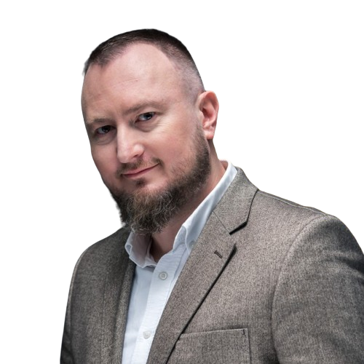
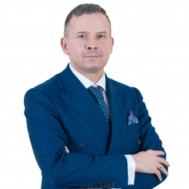
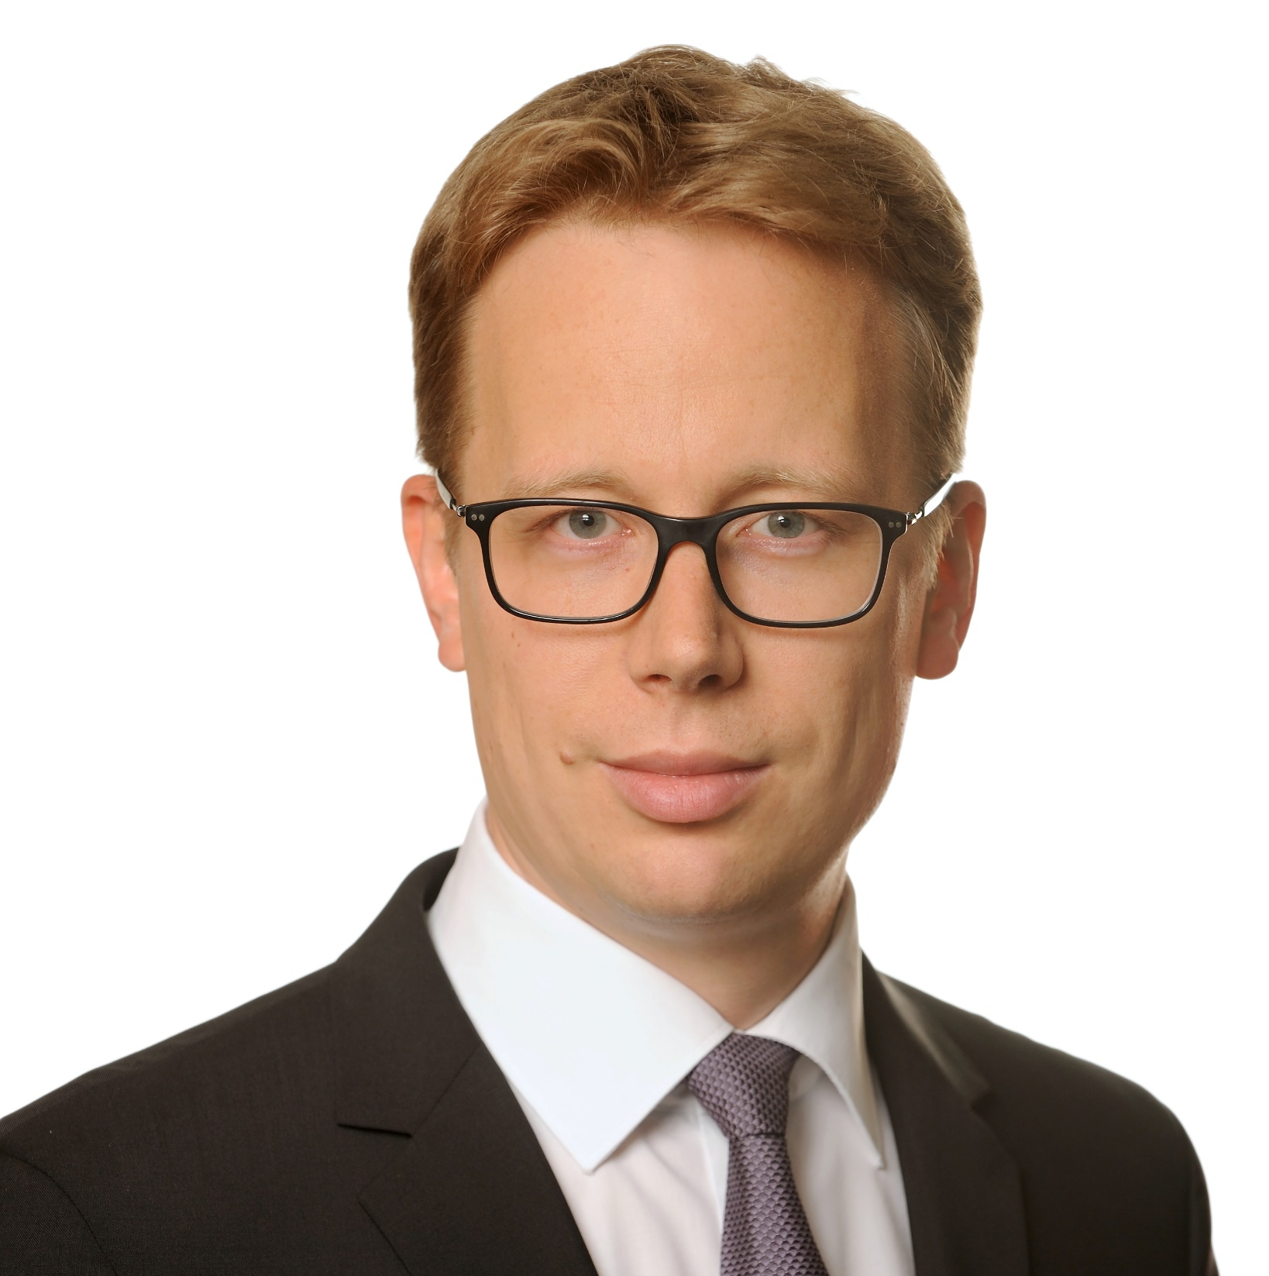
Moderated discussion: How to make M&A and postmerger integration successful
Tomasz Szatkowski
Director M&A
Sescom
Bartłomiej Zgryzek
Vice President
Tele-Fonika Kable
Błażej Zagórski
Partner
CMS Poland

Slide 70
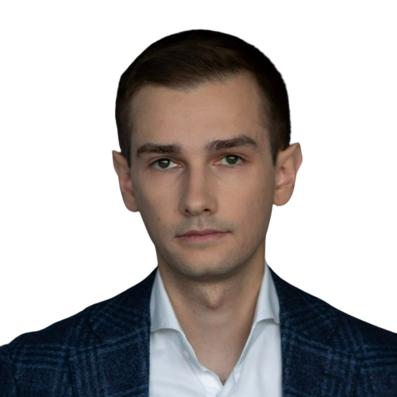
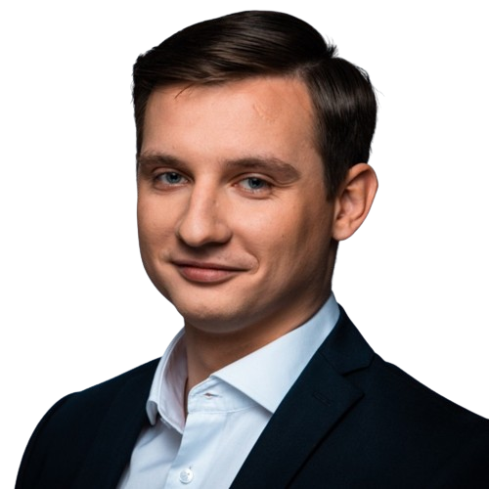
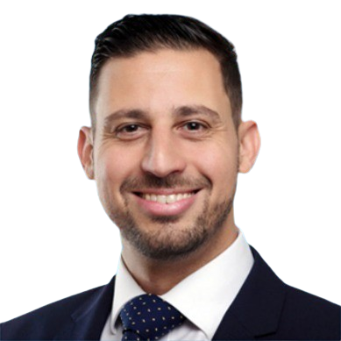

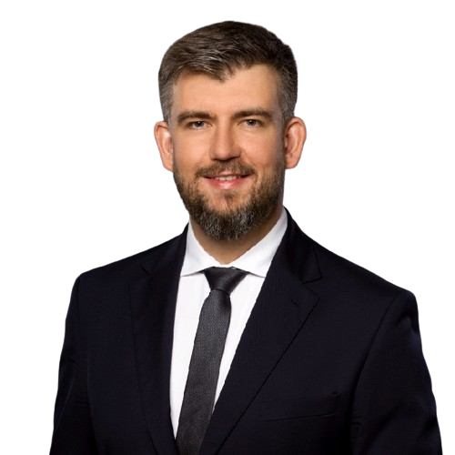
Panel discussion: M&A in the UK
Marcin Bagiński,
Corporate Development Director
InPost Group
Tomasz Szataniak,
Executive Manager to CEO
Wielton S.A.
Bartłomiej Zgryzek,
Vice President
Tele-Fonika Kable
Ran Carmon,
Managing Director
Chelsea Corporate
Eva Talmacsi
Partner
CMS UK
Bartosz Koziński,
FDI Director Poland
British Embassy Warsaw

Slide 71
Investing in the UK - embrace the
change
M&A landscape in the UK and key things to consider
when doing deals in the UK
Thank you!

